Slide 1
Hello Water
A guide to water harvesting for non-experts in the Caribbean
Notes:
Overall Course Goals
Increase shared understanding of water scarcity and impacts in Jamaica
Improve water harvesting knowledge so that non-experts can ask the right questions as they seek assistance
Simplify access to resources that promote water harvesting
Training Materials
Infographics i) speak to the
Flyer for homeowners, farmers, schools and developers that directs them to a website with more information. Website with information on sizing water tanks, sizing irrigation equipment and suggestions for how to infuse
Single to multi-purpose design
Build with nature vs in nature – collaborate with partners – how to work with natural materials and support natural processes – what ecological principles to incorporate. How to maintain and enhance
Permanent agriculture - create productive ecosystems – begins with ethics and mimics natural systems – go beyond sustainability move to resilience.

Slide 2
1. Why harvest water in the digital era?
Curriculum
Course Overview
Start
Start
2. Tools for managing intermittent water supply
Start
3. How to always have water @ home
Start
4. How to always have water @ your farm
Start
5. How to always have water @ your school
Start
Notes:
Overall Course Goals
Increase shared understanding of water scarcity and impacts in Jamaica
Improve water harvesting knowledge so that non-experts can ask the right questions as they seek assistance
Simplify access to resources that promote water harvesting

Slide 3
Course Summary
Course Overview
FAQ

Slide 4
Course Summary
Course Overview
Why this course?
This course builds the capacity of the average homeowner, business owner or teacher, who lives with intermittent water supply, to make better decisions about harvesting water. It uses short modules and case studies to teach non-experts how to make informed purchasing decisions and find local professionals who can deliver the services they need.
The course was made possible via funding from UNDP Jamaica.
What’s included?
Four user-friendly and interactive modules, divided into short, topical lectures. All of these modules are independent and can be taken individually
Practical tasks designed to help you apply theory to your water harvesting context
Case studies to support your learning where appropriate
A certificate upon course completion
Notes:
This course is targeted at individuals who live in environments where water supply is intermittent and the water user will need to take action beyond simply opening up a tank to ensure access to a reliable water supply
The course is targeted at non experts and aims to equip them with just enough understanding so that they can ask the right questions or dig deeper if they want to process with a DIY project.

Slide 5
FAQ
Course Overview
How long does it take to complete the course?
You should plan to spend one hour per module. The course is completely self-paced and will eventually be offered online – ultimately, you decide when you start and when you finish.
What if I want to give feedback on the course?
We are always happy to receive feedback. If you would like to get in touch with us you can email us at xxx@xxx.com
How is this course different from other water harvesting courses?
Many of the existing courses on water harvesting were designed for a highly technical audience. They also primarily emphasize rainwater harvesting in rural settings and ignore all of the other important information that needs to be considered beyond design such as installation and long term maintenance.
We designed this course for non-experts. It aims to equip them with just enough understanding so that they can ask the right questions when seeking professional assistance or dig deeper if they want to proceed with a DIY project.
Notes:
FAQ
Where do I go for more information
What are examples of projects that I might want to do on my own
Do you have a recommended list of suppliers?

Slide 6
1. Why harvest water in the digital era?
Curriculum
Course Overview
Start
Start
2. Tools for managing intermittent water supply
Start
3. How to always have water @ home
Start
4. How to always have water @ your farm
Start
5. How to always have water @ your school
Start

Slide 7
1. Why harvest water in the digital era?

Slide 8
578,336 cisterns installed in semi-arid Brazil over 12 years to improve water availability
Although Brazil has approximately 18% of the world’s total freshwater, only 28% of Brazil’s largest cities have adequate water availability. In 2003, a program called “Programa Um Milhão de Cisternas” (“One Million Cisterns”) was organized by a community group focused on improving the conditions for the residents in semi-arid Brazil - home to approximately 18 million people, half of whom live in rural areas. The project aims to provide one million homes with rooftop rainwater harvesting systems where rainwater can be collected and stored until the dry season. The simple, economic, and efficient system is comprised of a gutter, a pipe, and a 16,000L capacity collection tank.
By October 2015, the project had successfully delivered 578,336 rainwater collection systems, without government support (government now supports given the success of the effort). The impact of these tanks extends beyond eliminating the need for people to travel long distances seeking water; it has allowed residents to practice agriculture, provide water for livestock, and improve sanitary standards at facilities such as rural schools.
Notes:
References:
https://cleanawater.com.au/information-centre/rainwater-harvesting-solutions-which-countries-lead-the-way
https://grassrootsonline.org/in-the-news/newsarticlesbrazilian-government-pulls-plug-million-cistern-project/
https://www.futurepolicy.org/healthy-ecosystems/biodiversity-and-soil/brazil-cisterns-programme/

Slide 9
Learning Objectives
1. Why harvest water in the digital era?
Upon completion of this module, the learner will understand the value of water harvesting in different contexts
In this module you will
Learn about the practical benefits of water harvesting in Jamaica and the wider Caribbean.
Learn about how water harvesting works
Learn about the technology options for water harvesting
Study practical examples of water harvesting implementations
Notes:
Notes
In this chapter, we focus on the effects of intermittent water supply and the value of harvested water in serving as a buffer in different contexts.
In the urban water supply context, harvested water helps to restore some of the convenience of a 24/7 constantly pressurized system,
In the farming context,

Slide 10
To enable food security
1. Why harvest water in the digital era?
To provide a buffer for intermittent supplies
To ensure safe schools

Slide 11
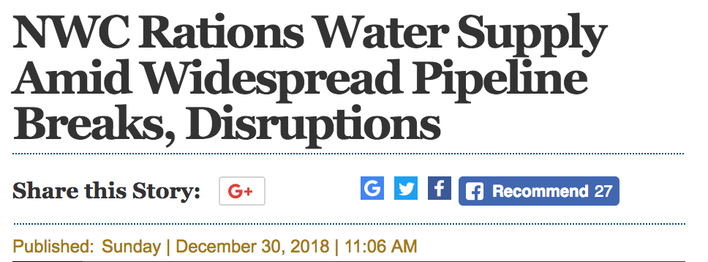
To buffer intermittent water supplies
1. Why harvest water in the digital era?
Piped water disruptions in downtown Kingston are increasing
At the end of December 2018, the National Water Commission put several locations in the Corporate Area on an increased rationing schedule: 8-12 hours ON 12 to 16 hours OFF
Notes:
Water disruptions are increasing
In Kingston, the piped supply does not cover all areas for 24 hours per day, 7 days per week.
http://www.jamaicaobserver.com/latestnews/_NWC_implements_water_schedule?profile=0

Slide 12
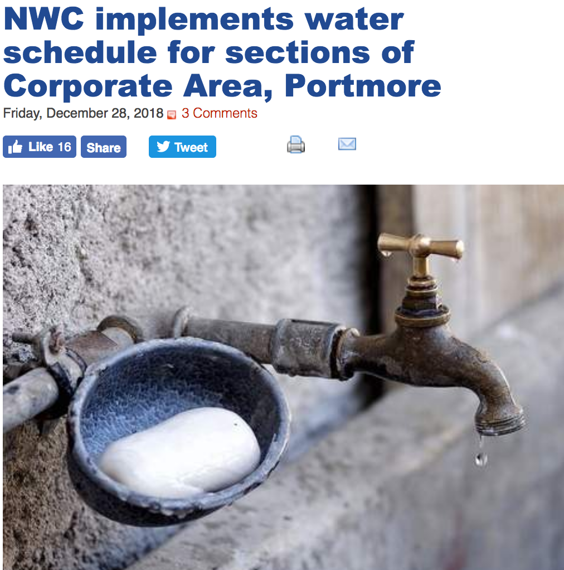
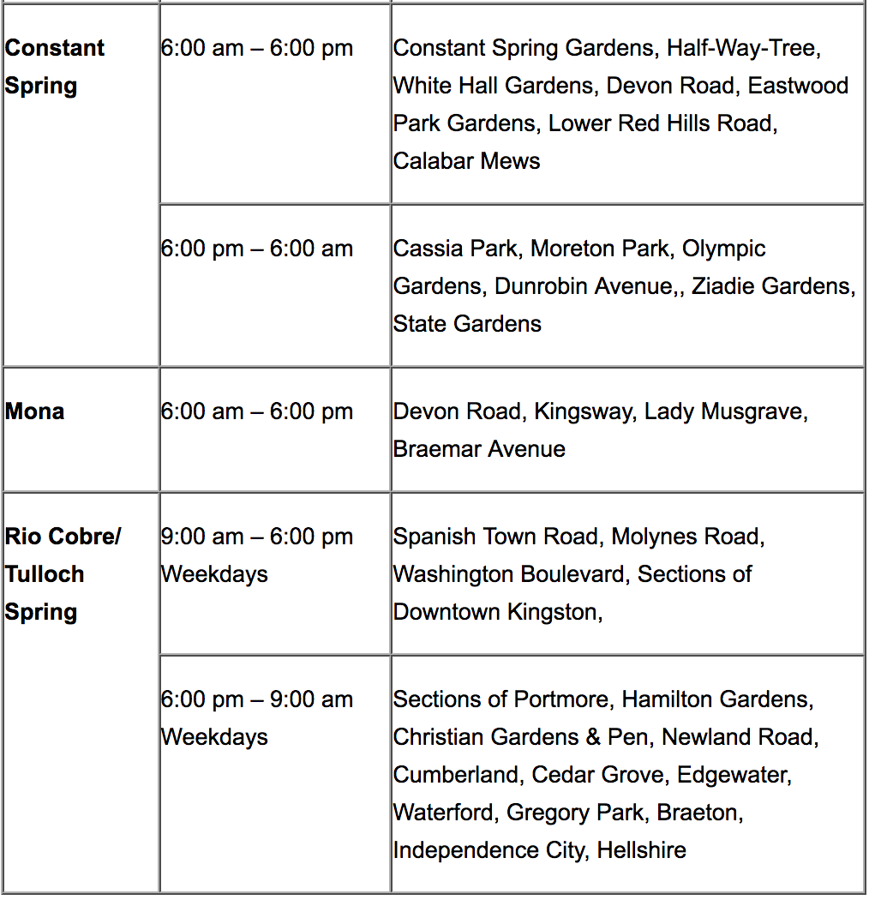
Intermittent water supply in downtown Kingston
Notes:
Buffer against intermittent water supply from piped system and recurring droughts

Slide 13
Let’s Pause & Reflect #1a
On average, for how many hours per day do you receive piped water?
A I do not get piped water
A 8 to 16 hours
A
D
A less than 4 hours
A 16 to 23 hours
B
E
A 4 to 8 hours
A I always have water
C
F

Slide 14
Rainwater
Harvesting
the accumulation and storage of rainwater for reuse on-site, rather than allowing it to run off. Rainwater can be collected from rivers or roofs.
Notes:
Rainwater harvesting is the accumulation and storage of rainwater for reuse on-site, rather than allowing it to run off.

Slide 15
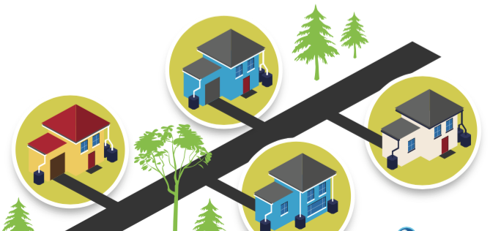
Water Harvesting @ Home
Homeowners can harvest water from rain or the intermittent piped water system. The picture above demonstrates a typical set up for roof-top water harvesting.
Notes:
Rainwater harvesting is the accumulation and storage of rainwater for reuse on-site, rather than allowing it to run off.

Slide 16
urban homeowner
User context determines the amount of storage required
rural farmer
school principal
20,000 gal
20,000 gal
700
gallons
[minimum storage volume recommended by Draft Planning Guidelines]
[will supplement water throughout the week for a 1 acre farm]
[assume small school with less than 150 students + staff]
Notes:
How how much water per hour is “normal?
How much water used per hour, how much water remains stored per hour?
How how much water use per day is “normal?
How much water used per hour, how much water remains stored per hour?
Hourly water use Calculation
* Level at the end of the hour – level at the start of the hour
Get a list of the activities/ What is primary water use?
How many in household? Who are they? How do they make money?
How do you get water (what means/sources)
What is household budget and biggest expense?
Rent
Food?
Show pictures of RWH options and gauge familiarity with two or three RHW options
Gauge entrepreneurship capability
Gauge digital literacy

Slide 17
Rainwater Harvesting Guidelines
Summary
Draft Planning Guidelines for Rainwater Harvesting have been developed by Jamaica’s Ministry of Economic Growth & Job Creation. The guidelines offer minimum water storage tank recommendations that ensure homeowners and businesses have at least a week of supply on hand to serve as a buffer for when rain or piped water is not available.
1,500 gallons
1,000
gallons
700
gallons
Residential Use
Commercial + Industrial Use
Office Use
Notes:
Residential /700 Gallons/3,150 litres
Commercial/ Industrial - 1,500 Gallons/6,750 litres
Office Use - 1,000 Gallons/4,500 litres

Slide 18
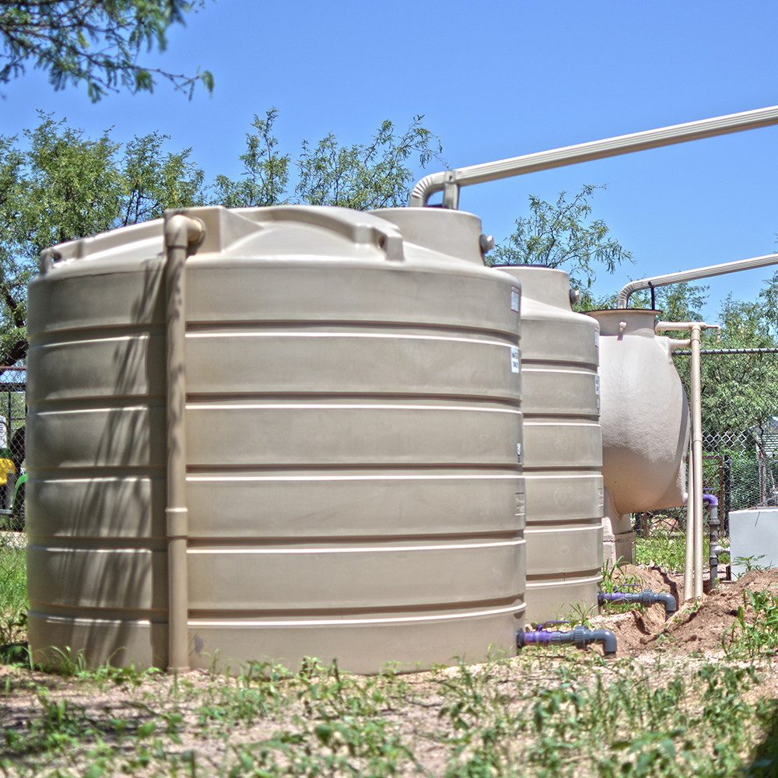
Other Tank Sizes
Minimum storage size for small family recommended by Planning Guidelines for RWH
Largest poly tank size available from roto tank
Minimum size needed for school with up to 150 individuals or a 1 acre farm
Smallest poly tank size available in Jamaica
700 gals
3,150 L
135 gals
2,000 gals
[7,571 L]
20,000 gals
[75,710 L]
v
v
370 gals
Minimum weekly storage recommended for a small family by HELLO RAIN

Slide 19
Let’s Pause & Reflect #1b
Should water harvesting be mandatory?
A YES
A
A NO
B
A I’m not sure
C

Slide 20
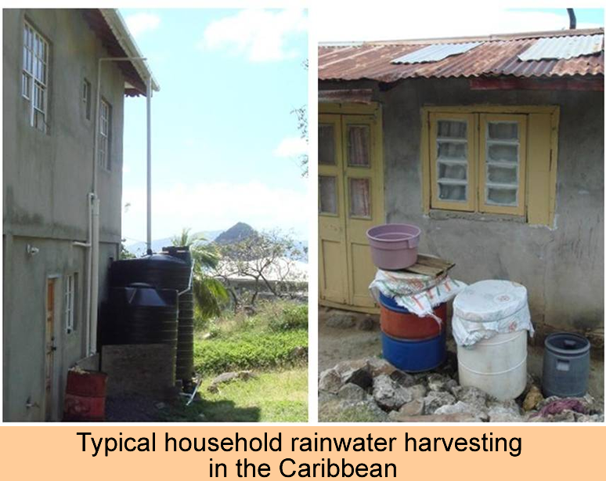
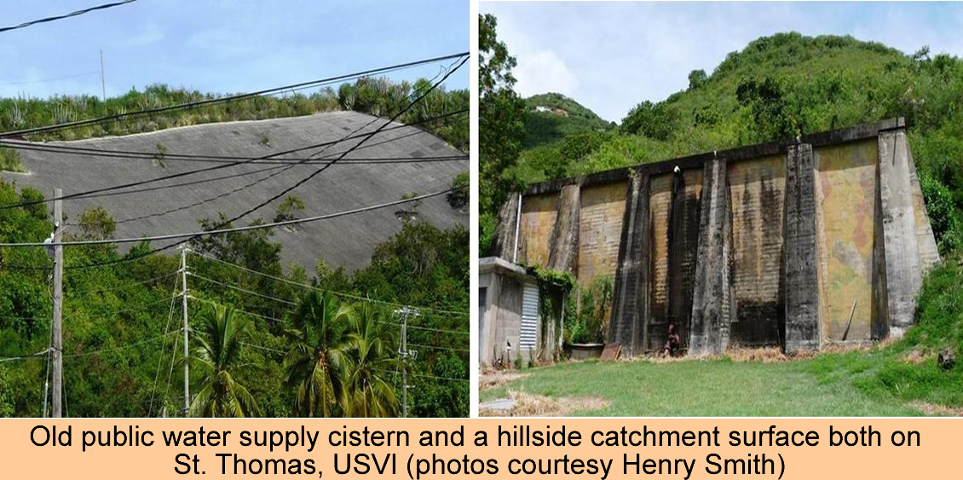
Storing water above ground or underground reduces vulnerability to intermittent supply
Typical household rainwater harvesting in the Caribbean
Old public water supply cistern and a hillside catchment surface both on St. Thomas, USVI (photos, courtesy Dr. Henry Smith)

Slide 21
Typical above ground tank configurations
potable supply
potable supply
float
overflow
consumption
consumption
In this set up, water flows into the tank from the piped system indefinitely. If the typical supply volume exceeds the storage volume, a lot of water and energy is potentially wasted. There should be a way to shut off or divert the incoming supply.
In this set up, when the float rises to the top, it closes off inflow from the supply. This saves water. But routine monitoring is required to keep the float in working order. if the float malfunctions, flooding of the above ground surfaces could occur.
Notes:
How how much water per hour is “normal?
How much water used per hour, how much water remains stored per hour?
How how much water use per day is “normal?
How much water used per hour, how much water remains stored per hour?
Hourly water use Calculation
* Level at the end of the hour – level at the start of the hour
Get a list of the activities/ What is primary water use?
How many in household? Who are they? How do they make money?
How do you get water (what means/sources)
What is household budget and biggest expense?
Rent
Food?
Show pictures of RWH options and gauge familiarity with two or three RHW options
Gauge entrepreneurship capability
Gauge digital literacy

Slide 22
Above ground and underground tank configurations
A
B
i
i
pumped potable supply
overflow
float
gravity feed to consumer
gravity feed to consumer
elevated
Gravity feed from roof or pump from under ground or ground source
ii
ii
float
consumption
pump to consumer
ground level
iii
iii
float
consumption
underground
Notes:
What is pumping cost associated with each configuration?
What is daily water journey around water? Need to understand this to get to additional services. Become the property manager?
How how much water per hour is “normal?
How much water used per hour, how much water remains stored per hour?
How how much water use per day is “normal?
How much water used per hour, how much water remains stored per hour?
Hourly water use Calculation
* Level at the end of the hour – level at the start of the hour
Get a list of the activities/ What is primary water use?
How many in household? Who are they? How do they make money?
How do you get water (what means/sources)
What is household budget and biggest expense?
Rent
Food?
Show pictures of RWH options and gauge familiarity with two or three RHW options
Gauge entrepreneurship capability
Gauge digital literacy

Slide 23
To enable food security
Why harvest water in the digital era?
What is food security?
Food security requires an available and reliable food supply at all times. At the global, regional and national levels, food supply can be affected by climate, disasters, war, civil unrest, population growth, lack of effective agricultural practices, and restrictions on trade.
At the household level, food security is essentially a matter of access to food and its appropriate use to ensure the health of individual family members.
As a Small Island Developing State and a Net Food Importing Developing Country, Jamaica is unable to produce sufficient quantities of food to support the growing demands of its population. Various factors have and continue to impact Jamaica’s agriculture development, food security and nutrition. These include, but are not limited to:
Increased frequency and intensity of extreme weather events resulting from climate change, such as droughts, hurricanes and floods;
Small size of landholdings;
Limited availability and use of appropriate technology;
Reduced availability of agricultural lands, due to urbanisation; and
High cost of capital

Slide 24
To ensure safe schools
Why harvest water in the digital era?
A joint grant by the Japanese government valued at $10 million was not a want, but a dire need.
That is how Veronica Gaynor, principal of the Iris Gelly Primary School in Kingston, described the donation which she received recently at the Ministry of Education's offices in downtown Kingston, as she explained the challenges that students have to endure on a daily basis due to inadequate water supply, which then results in poor sanitation.

Slide 25
School deployment case study

Slide 26
1. Why harvest water in the digital era?
Curriculum
Course Overview
Start
Start
2. Tools for managing water tanks
Start
3. How to always have water @ home
Start
4. How to always have water @ your farm
Start
5. How to always have water @ your school
Start

Slide 27
2. Tools for managing water tanks
Notes:
Speaker’s Notes
Water tanks are typically used when the source of water supply is uncertain
Uncertain sources of supply include rainfall, treated water from an intermittent piped system, water pumped from surface runoff (in a pond or dam)
Tools for managing water tanks depend on the source of supply. General categories – metrics supply monitoring (supply security), water audits (to assess water demand); manual vs digital
Overall goal: improve predictability and convenience

Slide 28
water tanks increase
the certainty of supply
1Billion
globally are served by uncertain & intermittent piped water supplies
Notes:
References:
Laspidou, C., Spyropoulou, A., 2017. Global dimensions of IWS - number of people affected worldwide, in: Dealing with the complex interrelation of intermittent supply and water losses. IWA Publishing, London, pp. 5–16.
Speaker’s Notes
Water tanks are typically used when the source of water supply is uncertain
Uncertain sources of supply include rainfall, treated water from an intermittent piped system, water pumped from surface runoff (in a pond or dam)
Tools for managing water tanks depend on the source of supply. General categories – metrics supply monitoring (supply security), water audits (to assess water demand); manual vs digital
Overall goal: improve predictability and convenience

Slide 29
Learning Objectives
2. Tools for managing water tanks
Upon completion of this module, the learner will understand the range of tools available to monitor and maintain water tanks
In this module you will
Learn about how to estimate the amount of water available to supply the tank and monitor this supply over the long term.
Learn about water quality and how to ensure the water in your tank is safe to drink.
Learn about checking for leaks and patching tanks and pipes once they have been identified.
Notes:
Notes
In this chapter, we focus on the effects of intermittent water supply and the value of harvested water in serving as a buffer in different contexts.
In the urban water supply context, harvested water helps to restore some of the convenience of a 24/7 constantly pressurized system,
In the farming context,

Slide 30
How to check water quality
2. Tools for managing water tanks
How to monitor supply
How to spot leaks

Slide 31
Monitor Supply
2. Tools for managing water tanks
What is the source of water that supplies your tank?
A Rooftop Rainwater
A
A Piped Water
B
A Surface Runoff
C
Notes:
FAQ
Where do I go for more information
What are examples of projects that I might want to do on my own
Do you have a recommended list of suppliers?

Slide 32
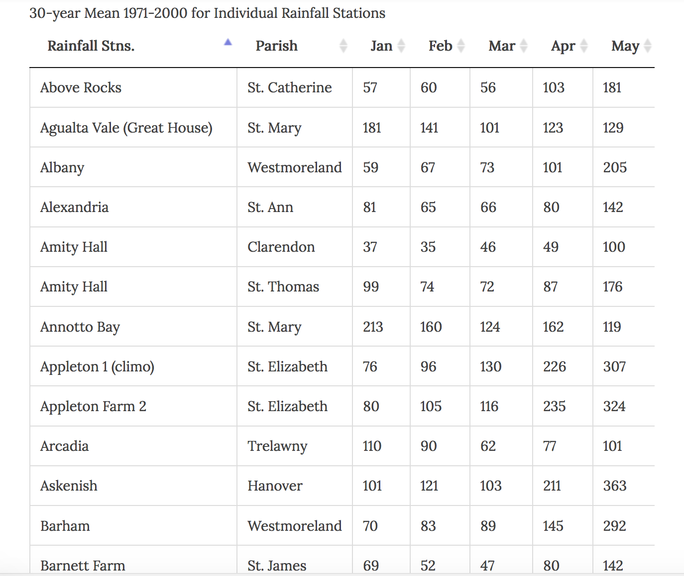
Do I have enough rain to invest in rooftop harvesting?
The size of your roof and location in Jamaica will determine how much rainwater you will be able to collect.
[in mm]
TOOLBOX
Go to http://bit.ly/myRain
If the reported monthly rainfall for the station closest to you greater than 100 mm per month and your roof is greater than 30 square meters, you should be able to harvest more than 1,000L per week.
Notes:
Map
of rainfall across Jamaica

Slide 33
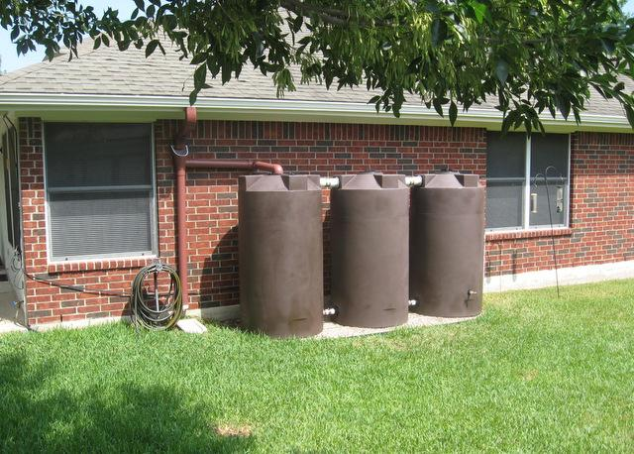
Three 250 gallon tanks placed in series for 750 gallons total of storage. The use of smaller tanks provides a design option that saves space. Dimensions per tank - 36" dia. x 67"H
Notes:
https://poly-mart.com/gallery/

Slide 34
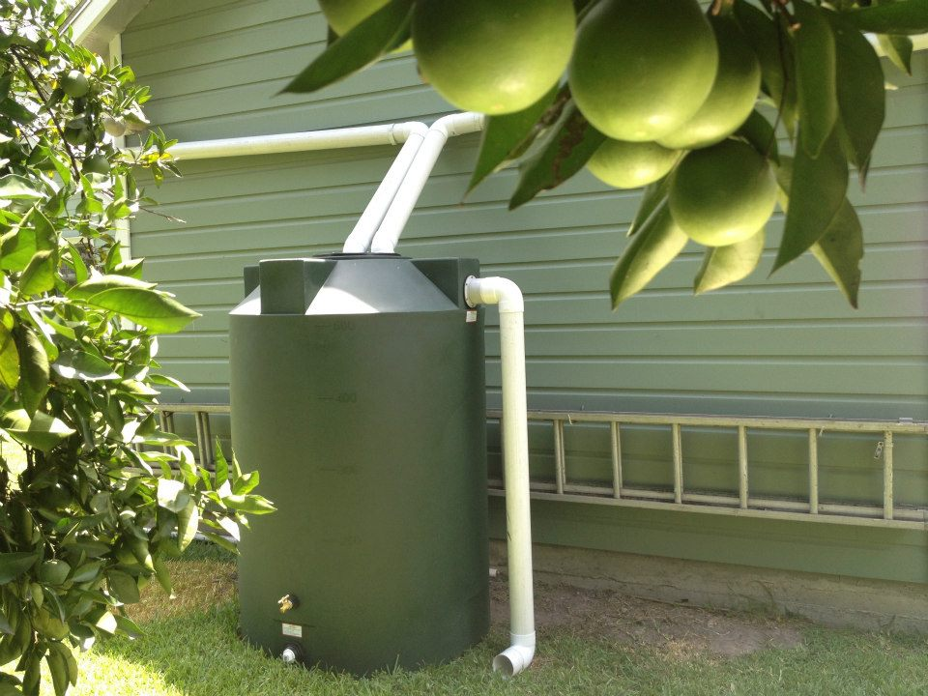
500 gallon tank. Dimensions per tank - 48" dia. x 67"H
Notes:
https://poly-mart.com/gallery/

Slide 35
How much piped water should I try to store?
Homeowners should aim to install at least 700 gallons (2,650L) of storage.
Draft Planning Guidelines for Rainwater Harvesting have been developed by Jamaica’s Ministry of Economic Growth & Job Creation. The guidelines offer minimum water storage tank recommendations that ensure homeowners and businesses have at least a week of supply on hand to serve as a buffer for when rain or piped water is not available.
1,500 gallons
1,000
gallons
700
gallons
Residential Use
Commercial + Industrial Use
Office Use
Notes:
Do you get piped water at least once per week?
Is it for residential or commercial use?
Try to get a tank that fits the minimum storage guideline

Slide 36
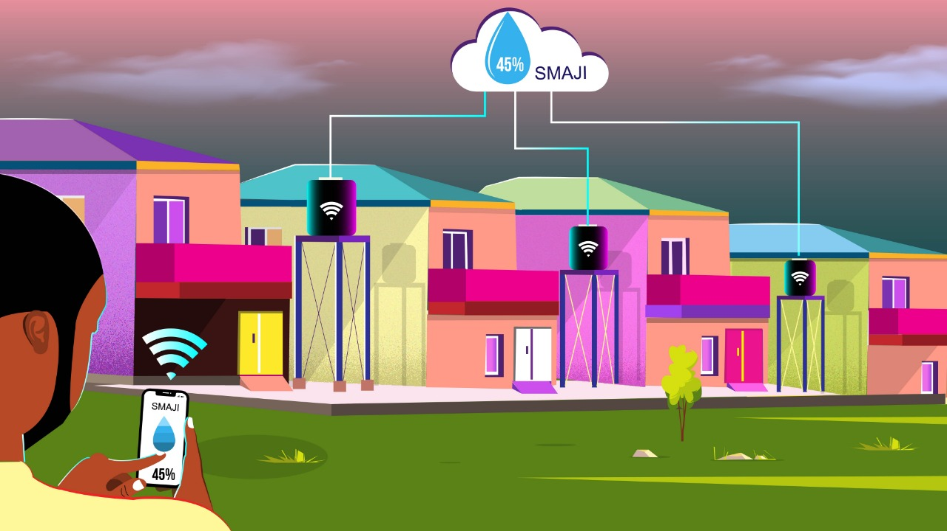
Digital Water Tank Management
Digital Water Tank Management is being used in Kenya to increase the predictability of the urban intermittent water supply system. In informal settlements, installing the tanks on kiosks provide the water utility with the visibility they lacked previously to respond quickly when tanks are running low. With is approach, those who use the communal supply will always visit a kiosk that has water. At homes with intermittent water supply, the system provides a simple way for homeowners to get alerts when tanks are running low and allows verified suppliers to respond know immediately where water needs to be delivered. See more at www.smaji.ai
Notes:
Do you get piped water at least once per week?
Is it for residential or commercial use?
Try to get a tank that fits the minimum storage guideline

Slide 37
How much surface runoff should I try to capture?
Notes:
Do you get piped water at least once per week?
Is it for residential or commercial use?
Try to get a tank that fits the minimum storage guideline

Slide 38
Check Water Quality
2. Tools for managing water tanks
Is the water in your tank safe to drink?
A Did you add chlorine?
A Did you add filtration?
A Are you testing the quality regularly?
Notes:
Water quality risks? High turbidity, low cholrine, faecal contamination
Indicators
How to mitigate

Slide 39
What water quality parameters should I check?
You should consider occasionally testing for pH, the chlorine residual, turbidity and faecal coliforms.
1
pH – typically ranges from 6 to 9 for drinking water. Treated water from the piped system will generally be in this range. pH has no direct impact on water consumers, but it is one of the most important operational water-quality parameters. For example, pH should be less than 8 to ensure proper disinfection with chlorine
Chlorine - Chlorine takes time to kill all the organisms. In water above about 18ºC the chlorine should be in contact with the water for at least 30 minutes. If the water is colder then the contact time must be increased. Properly disinfected water has a final, measurable residual of between 0.5 and 0.2 mg/l.
2
Notes:
https://youtu.be/_yi83kOB8ug
https://www.who.int/water_sanitation_health/dwq/chemicals/ph.pdf
https://www.who.int/water_sanitation_health/hygiene/envsan/chlorineresid.pdf

Slide 40
What water quality parameters should I check?
You should consider occasionally testing for pH, the chlorine residual, turbidity and faecal coliforms.
3
turbidity –
Faecal coliforms -
4
Notes:
https://youtu.be/_yi83kOB8ug
https://www.who.int/water_sanitation_health/dwq/chemicals/ph.pdf
https://www.who.int/water_sanitation_health/hygiene/envsan/chlorineresid.pdf

Slide 41
When do I need chlorine?
If your water is coming from rooftop harvesting, you should strongly consider adding chlorine/bleach.
It is important to add bleach to your tank or cistern regularly to eliminate microbial growth. The rule of thumb is 1 tablespoon of bleach per 100 gallons of water if the tank/cistern is clean. So you will need to know the size of your tank cistern. You can use a measuring stick to find the water line and calculate accordingly.
Notes:
http://www.chrishanley.com/news-info/cisterns-101-residential-water-supply-usvi/

Slide 42
Filtration Options
Notes:
Do you get piped water at least once per week?
Is it for residential or commercial use?
Try to get a tank that fits the minimum storage guideline

Slide 43
Fix Leaks
2. Tools for managing water tanks
What kind of tank has the leak?
A Plastic (Poly) Tanks
A
A Concrete Tank
B
A Steel Tank
C
Notes:
Leak risks? What causes leaks? Type of tank?? Does it matter
Indicators
How to mitigate
https://youtu.be/X3gMXrKPrDQ

Slide 44
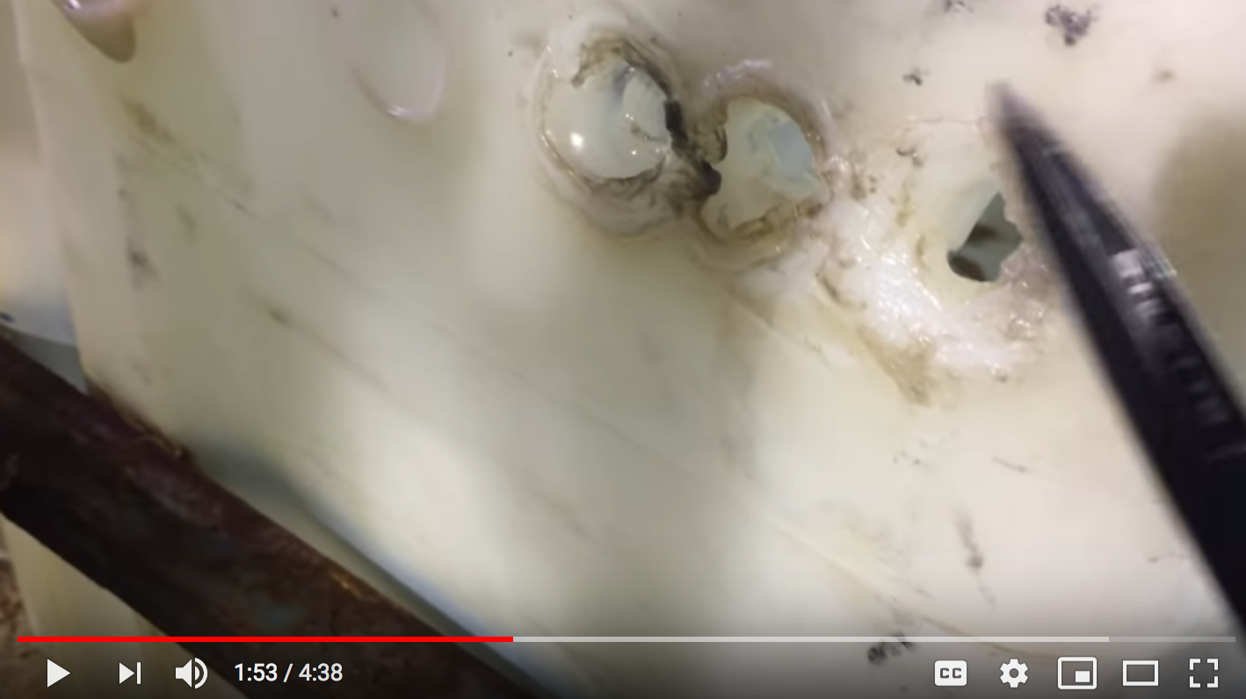
Meet Lee. He’s repairing a leak in a poly tank.
https://youtu.be/X3gMXrKPrDQ
Notes:
Other plastic welding pictures
https://youtu.be/Lqu3NVqFNCU
https://youtu.be/gRCMIDILfEI
https://blog.polyprocessing.com/blog/repair-vs-replacement-can-you-repair-a-polyethylene-tank

Slide 45
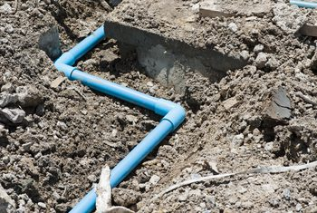
Fix Ieaks in plastic service lines
The service lines that deliver water to your tank may also develop leaks. Regular inspection and repair will reduce wasting water. Plastic pipes are easier to repair than copper pipes
PVC plumbing is a popular choice for residential plumbing. It is inexpensive and requires less skill to install compared to copper plumbing. It also has the advantage of having a long corrosion-free service life. Repairs are usually simple as well. When leaks or breaks occur, replacing defective fittings and/or pipes frequently requires only a few simple tools and readily available replacement parts.
You will need to cut out and replace the defective section
Notes:
https://homeguides.sfgate.com/repair-leak-pvc-pipe-plumbing-36577.html

Slide 46
Steps for repairing plastic service lines
1. Locate the Leak
Water can travel along the pipe a considerable distance from the source of the problem before falling as a drip. Wipe the area around the suspected leak dry with a clean cloth and look carefully for the source of the leak.
TOOLS
PVC cutters
PVC solvent
PVC glue
Clean rags
Replacement pipes and/or fittings
2. Determine which pieces you need to replace
There is no practical method for removing PVC pipe from glued fittings. When the leak is located at or within 2 inches of a joint, the simplest repair method is to remove a section of pipe along with the adjoining fitting(s).
Notes:
https://homeguides.sfgate.com/repair-leak-pvc-pipe-plumbing-36577.html

Slide 47
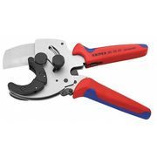
Steps for repairing plastic service lines
3. Turn off water supply to leaking pipe
If the house has an internal or local shut-off valve, use that. If not, you may need to turn off the main water supply valve.
4. Remove the defective section of plumbing
Use PVC cutters to remove at least 1 inch of piping on either side of the leak. The defect causing the leak may not be readily apparent with visual inspection. Removing a small amount of apparently sound material decreases the likelihood of the leak reappearing. Place the PVC cutters at the desired location, hold the cutter's jaws at a 90-degree angle to the pipe and make a straight cut through the pipe on either side of the leak.
Pipe and tube cutter ~ $120 USD
NOTE: It is possible to use a hacksaw to cut PVC pipes. However, pieces of the small “fuzzy” edges left over from this cutting method can clog the small valves of ice-makers, water filters and other automatic devices in your home.
Notes:
https://homeguides.sfgate.com/repair-leak-pvc-pipe-plumbing-36577.html
Pipe & Tube Cutter
https://www.zoro.com/knipex-pipe-and-tube-cutter-90-25-40/i/G0906188/feature-product?gclid=EAIaIQobChMIrsLH98z94AIVl9dkCh1r5AnHEAQYBCABEgI4N_D_BwE&gclsrc=aw.ds

Slide 48
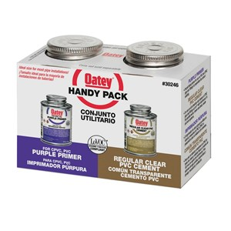
Steps for repairing plastic service lines
5. Loosely assemble the replacement parts and dry-fit them in position
Make any necessary adjustments to the parts before glue-up. Once all the parts are properly sized, disassemble them in preparation for primer and glue application.
6. Apply PVC primer solvent to the inside of each fitting and the outside of each pipe
Use the applicator brush attached to the underside of the container lid to apply a thin coat of solvent to all surfaces to be joined.
PVC Primer & Glue
~ $10 USD
Notes:
https://homeguides.sfgate.com/repair-leak-pvc-pipe-plumbing-36577.html
Pipe & Tube Cutter
https://www.zoro.com/knipex-pipe-and-tube-cutter-90-25-40/i/G0906188/feature-product?gclid=EAIaIQobChMIrsLH98z94AIVl9dkCh1r5AnHEAQYBCABEgI4N_D_BwE&gclsrc=aw.ds

Slide 49
Steps for repairing plastic service lines
9. Apply Glue
Start at one side of the exposed plumbing. Apply a coat of PVC glue to the outside of the pipe and the inside of the replacement fitting with the applicator brush attached to the container lid. Insert the pipe into the fitting with a twisting motion. This helps spread the glue inside the joint and helps the pipe slide completely into the neck of the fitting. Hold the newly formed joint together firmly for 10 seconds to prevent slippage.
Repeat this procedure until all missing pieces are replaced.
Allow the glue on the repaired plumbing to cure for at least 15 minutes. In warmer, drier conditions, the glue may not take this long to cure. However, applying pressure too soon can cause the new joints to fail.
10. Restore water pressure and check for leaks
Notes:
https://homeguides.sfgate.com/repair-leak-pvc-pipe-plumbing-36577.html
Pipe & Tube Cutter
https://www.zoro.com/knipex-pipe-and-tube-cutter-90-25-40/i/G0906188/feature-product?gclid=EAIaIQobChMIrsLH98z94AIVl9dkCh1r5AnHEAQYBCABEgI4N_D_BwE&gclsrc=aw.ds

Slide 50
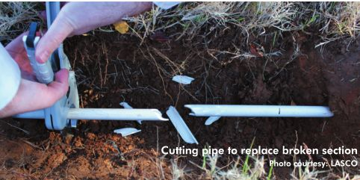
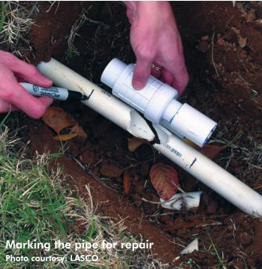
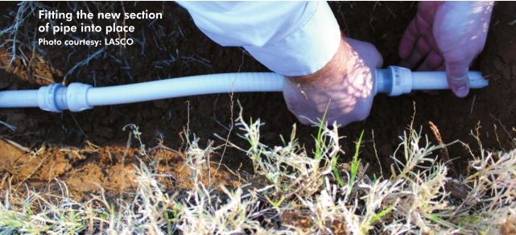
Repairing plastic service lines outside
Notes:
https://homeguides.sfgate.com/repair-leak-pvc-pipe-plumbing-36577.html
Pipe & Tube Cutter
https://www.zoro.com/knipex-pipe-and-tube-cutter-90-25-40/i/G0906188/feature-product?gclid=EAIaIQobChMIrsLH98z94AIVl9dkCh1r5AnHEAQYBCABEgI4N_D_BwE&gclsrc=aw.ds
https://igin.com/article-3830-the-simple-task-of-pipe-repair-may-not-always-be-so-simple.html

Slide 51
1. Why harvest water in the digital era?
Curriculum
Course Overview
Start
Start
2. Tools for managing water tanks
Start
3. How to always have water @ home
Start
4. How to always have water @ your farm
Start
5. How to always have water @ your school
Start

Slide 52
3. How to always have water @ home

Slide 53
Decide on the best tank for your situation
3. How to always have water @ home
Get it installed
Figure out maintenance
Notes:
Installation – find a professional or DIY
Maintenance

Slide 54
Decide on the best tank for your situation
3. How to always have water @ home
A I own my home and want to harvest rainwater
A
A I live in an apartment get piped water sometimes
B
A I run a guest house
C
Notes:
FAQ
Where do I go for more information
What are examples of projects that I might want to do on my own
Do you have a recommended list of suppliers?
I need help! What would be the right size cistern for a four person household and a green 1 acre garden (no lawn) on the East End of St. Croix? Thank you for your help!

Slide 55
3.A I’m a homeowner
I need help! What would be the right size cistern for a four person household and a green 1 acre garden (no lawn) in Clarendon? Thank you for your help!

Slide 56
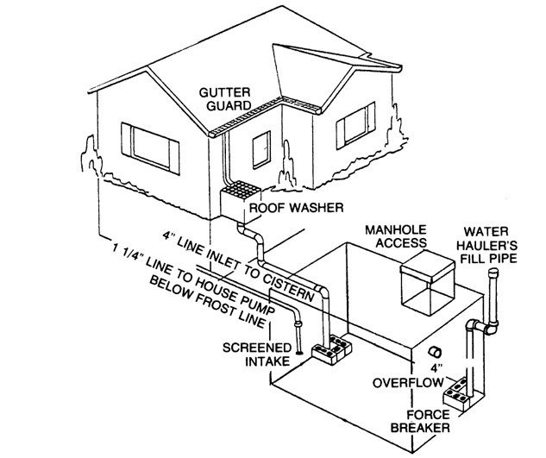
CISTERN SIZING
LOCATION
Clarendon
Minimum Recommended Size
5,000 gal
20,000 L
Estimated Cost
TBD
Key Considerations
Location must not be prone to flooding
Minimum separation distance

Slide 57
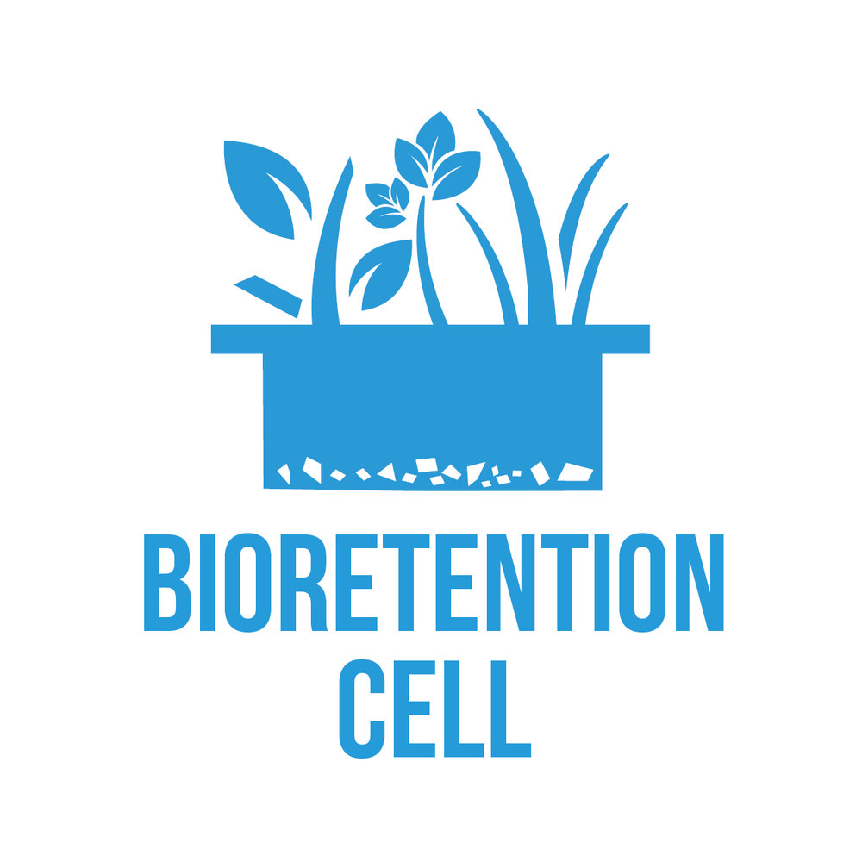
Rainscaping your yard
GREEN ROOF
RAIN GARDEN
Once you have storage for your home, consider how to also capture runoff from your yard.
Notes:
Show examples of typical configurations. Explain installation requirements and cost per syste,
https://www.spec-net.com.au/press/0708/wate_230708.htm

Slide 58
3.B. I live in an apartment

Slide 59
A closer look at storage tank recommendations
Notes:
STRATEGY
Use tank bring predictability back to water operations. When the piped system is intermittent this is the key service lost.
Consider sources of supply for tank
Use storage to pool multiple sources of supply
KEY METRIC
Supply Security - fraction of the total water demand met by the water source(s).
What’s your situation?
The approach you should take depends on your situation.
Are you a renter or the owner? Is it a single family or a shared building?

Slide 60
How HELLO RAIN sizes tanks
Three different approaches that can be used to size tanks – demand side, supply side & integrated approaches.
Both the demand side approach and the supply side approach require information on the rainfall pattern, which can be obtained from historical data. The demand side approach starts with a user’s daily water requirement, and sizes the tank according to the longest consecutive number of days without water supply or rainfall. The supply side approach is based on the premise that all the water delivered during the intermittent supply period [either a rainfall event or piped water delivery period] can be stored.
If only the demand side approach is considered, the storage tank purchased maybe too large and never filled. If only the supply side approach is considered, the tank purchased may either too large of too small for the end user.
With the integrated approach, we consider the source of supply - rainwater vs piped water – and the user’s demand. If rainwater harvesting is the ONLY source of supply, getting a storage tank may not be worth it if the rainfall is less than 1,000 mm per month and the home is smaller than 200 sq meters (like in Denham Town or Tivoli Gardens). Luckily, multiple intermittent sources of supply are typically available and can be pooled to deliver an acceptable level of reliability,

Slide 61
Set Supply Security Target
2. How to always have water @ home
90%
200
L per day
1,000 L
Get Recommended Storage Volume
1
2
3
Estimate Water Demands
This means the goal is to meet 90 percent of your water needs through tank storage. The other 10% is either forfeited (i.e you reduce consumption) or met by some other means.
200 L per day is the default estimate?
Washing Machine?
Water Heater?
[go to HELLO RAIN tank storage recommendations]
Notes:
Assumption – water is not available 24/7 and user requires aa tank to improve reliability
Supply Security - fraction of the total water demand met by the water source.
What’s your situation?
The approach you should take depends on your situation.
Are you a renter or the owner? Is it a single family or a shared building?

Slide 62
Suggested Tank Sizes
Minimum storage size for small family recommended by Planning Guidelines for RWH
Largest poly tank size available from roto tank
Minimum size needed for school with up to 150 individuals or a 1 acre farm
Smallest poly tank size available in Jamaica
825 gals
3,120 L
135 gals
2,000 gals
[7,571 L]
20,000 gals
[75,710 L]
v
v
v
370 gals
Minimum weekly storage recommended for a small family by HELLO RAIN

Slide 63
Get your tank installed
2. How to always have water @ home
Supplier/ installer list TBD
Notes:
FAQ
Where do I go for more information
What are examples of projects that I might want to do on my own
Do you have a recommended list of suppliers?

Slide 64
The way your storage is set up might be costing you money
potable supply
potable supply
float
overflow
consumption
consumption
In this set up, if the typical supply volume exceeds the storage volume, a lot of water and energy is potentially wasted. There should be a way to shut off or divert the incoming supply.
In this set up, if the float malfunctions, flooding of the above ground surfaces could occur if levels are not properly monitored.
Notes:
How how much water per hour is “normal?
How much water used per hour, how much water remains stored per hour?
How how much water use per day is “normal?
How much water used per hour, how much water remains stored per hour?
Hourly water use Calculation
* Level at the end of the hour – level at the start of the hour
Get a list of the activities/ What is primary water use?
How many in household? Who are they? How do they make money?
How do you get water (what means/sources)
What is household budget and biggest expense?
Rent
Food?
Show pictures of RWH options and gauge familiarity with two or three RHW options
Gauge entrepreneurship capability
Gauge digital literacy

Slide 65
Maintenance Requirements for Tanks
2. How to always have water @ home
TBD. Will refer to the tools section for more information.
Notes:
FAQ
Where do I go for more information
What are examples of projects that I might want to do on my own
Do you have a recommended list of suppliers?

Slide 66
Conduct a Water Audit for greater insights on how you use water
LEAKS
“normal “water use across the diaspora = 20 – 50 L per person per day
SHOWERS
USAGE
SINKS
BILLED USAGE
GREY WATER
[should be recycled]
WASH
STORAGE
TOILET
SEWER or
SEPTIC TANK
Notes:
How how much water do you use per day?
Get a list of the activities/ What is primary water use?
How many in household? Who are they? How do they make money?
How do you get water (what means/sources)
What is household budget and biggest expense?
Rent
Food?
Show pictures of RWH options and gauge familiarity with two or three RHW options
Gauge entrepreneurship capability
Gauge digital literacy

Slide 67
1. Why harvest water in the digital era?
Curriculum
Course Overview
Start
Start
2. Tools for managing intermittent water supply
Start
3. How to always have water @ home
Start
4. How to always have water @ your farm
Start
5. How to always have water @ your school
Start

Slide 68
4. How to always have water @ your farm

Slide 69
ZERO HUNGER Brazil’s multi-pronged strategy approx. 30 different programs aimed at: providing secure access to food, supporting family-owned farms and income (income-generating activities), promoting partnerships and social mobilization.
Although Brazil has approximately 18% of the world’s total freshwater, only 28% of Brazil’s largest cities have adequate water availability. In 2003, a program called “Programa Um Milhão de Cisternas” (“One Million Cisterns”) was organized by a community group focused on improving the conditions for the residents in semi-arid Brazil - home to approximately 18 million people, half of whom live in rural areas. The project aims to provide one million homes with rooftop rainwater harvesting systems where rainwater can be collected and stored until the dry season. The simple, economic, and efficient system is comprised of a gutter, a pipe, and a 16,000L capacity collection tank.
Notes:
References:
http://www.momagri.org/UK/focus-on-issues/The-Zero-Hunger-strategy-in-Brazil_1227.html

Slide 70
1. Why harvest water in the digital era?
Curriculum
Course Overview
Start
Start
2. Tools for managing intermittent water supply
Start
3. How to always have water @ home
Start
4. How to always have water @ your farm
Start
5. How to always have water @ your school
Start

