Slide 1
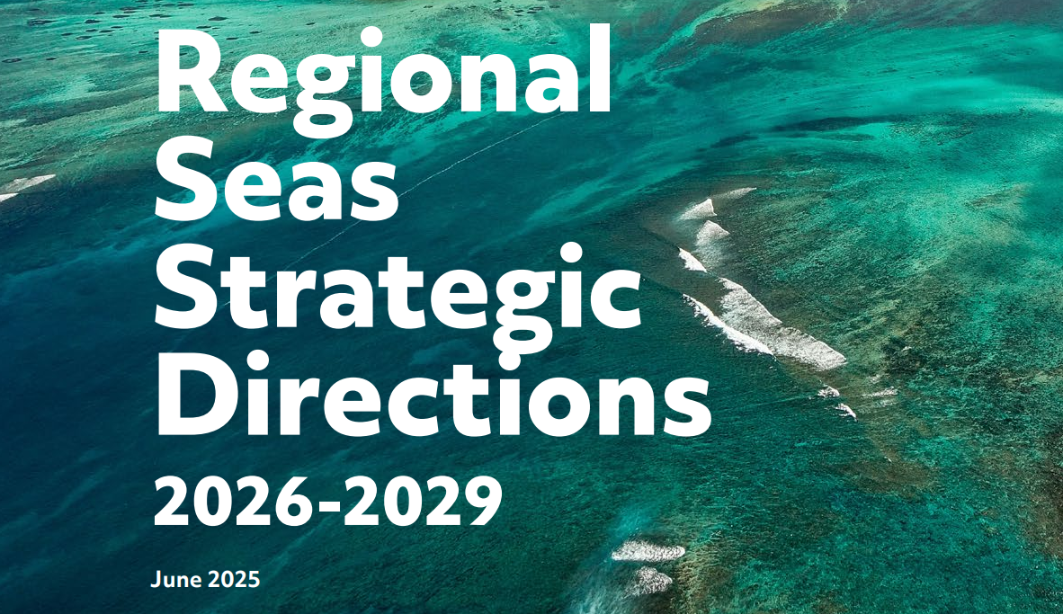


Slide 2
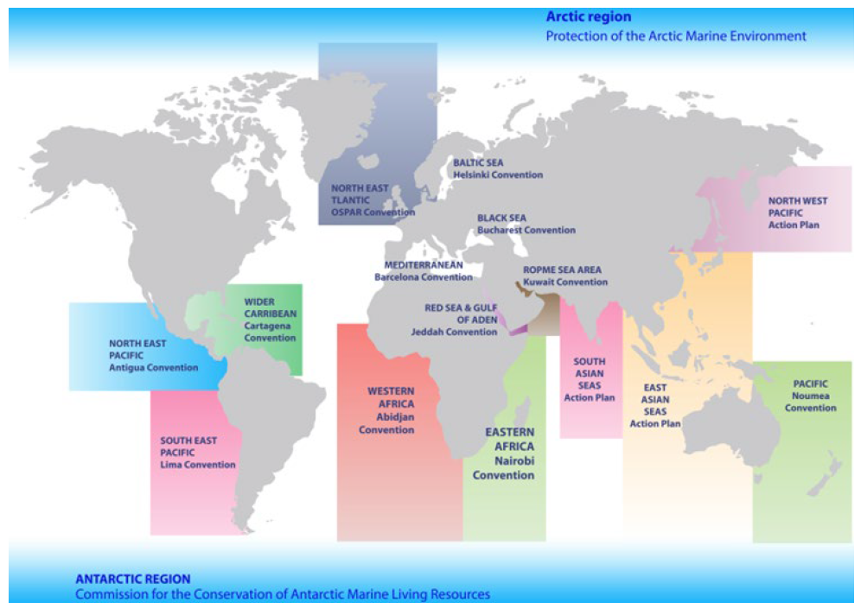
Regional Seas Programme
Established in 1974
18 Regional Seas Conventions and Action Plans
146 countries

Slide 3
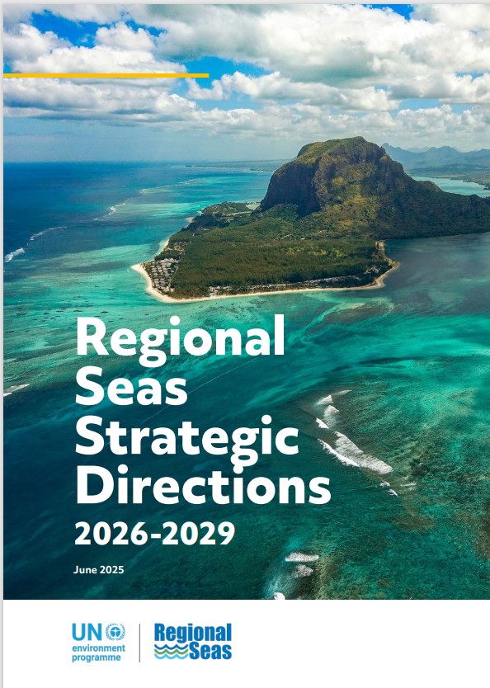
Aims of the
RSSD 2026-2029
Raise visibility and recognition of RS as a dynamic implementation platform for MEAs and other relevant international instruments
Highlight areas of work where the regional level plays an important role in communicating national needs to international policy processes and decision-making fora and vice versa
Identify opportunities for mutually beneficial link to UNEA (possibly regular reporting and receiving of guidance, prominently featuring RS in UNEP’s PoW, budget and MTS)
Post-2020 Biodiversity Framework and Beyond-2020 Framework for sound management of chemicals and waste as opportunity to strengthening RS positioning
Clarify alignment with the 2030 Agenda for Sustainable Development, particularly SDG 14 and emphasize synergies with other ocean-related goals and targets.
Emerging issues (marine plastic litter, microplastics, plastics instrument)
Notes:
The aims of this years work on the new RSSD was to
Raise visibility and recognition of Regional Seas as a dynamic implementation platform for MEAs and other relevant instruments
Highlight areas where the regional level functions as a communication link between national needs and international policy fora.
Also to identify areas where the relationship with UNEA could be mutually beneficial, and to highlight where the Regional Seas could help implement the role of the two post-2020 frameworks being developed for biodiversity and chemicals, as well as the 2030 agenda
Finally to also highlight emerging issues that Regional Seas could help address.

Slide 4
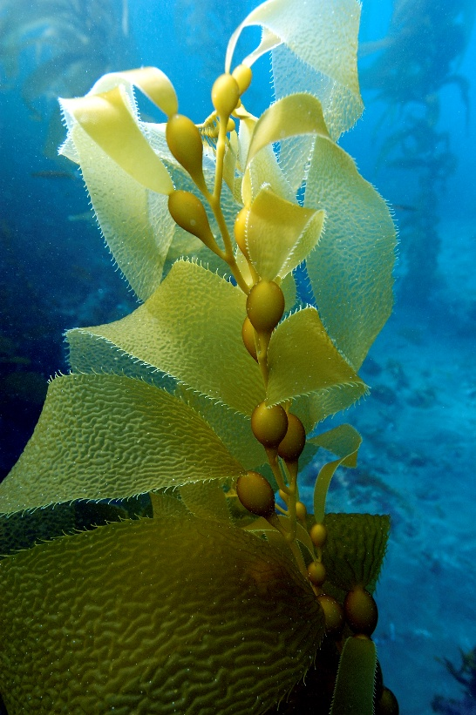
Multilateral frameworks and other bodies reviewed
  Biodiversity: CBD/GBF, BBNJ, Ramsar, CMS and CITES
  Pollution: BRS and Minamata conventions, GFC, ILBI on plastics pollution, London Protocol, MARPOL and GPA
  Climate: UNFCCC and Paris Agreement
  Other frameworks: 2030 Agenda, ABAS and UNEA
  Ocean governance and marine science: RFMOs, IOC and GOOS
  UN bodies: UNEP, FAO, WHO and IMO
  Financial mechanisms/institutions: GEF
Notes:
the multilateral frameworks and other bodies reviewed to identify relevant decisions calling for international ocean action that have been integrated throughout the RSSD. As you can see, the number of frameworks now includes the BRS, Minamata and IMO conventions have been included, and of course, updates include the adopted Global Biodiversity Framework and the BBNJ agreement.
These agencies and Secretariats have all been outlined as partners under the relevant goals and sub-goals.

Slide 5
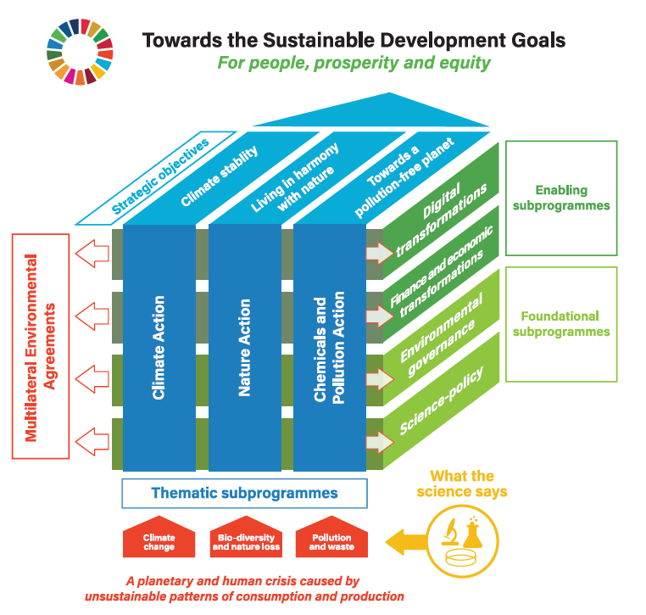
Goal I:
Secure biologically diverse, productive and climate resilient marine and coastal ecosystems:
Goal I: Three sub-goals to reflect triple planetary crisis
  Protect biodiversity to maintain ocean and coastal ecosystem functions
  Reduce ocean and coastal pollution
  Secure ocean and coastal climate resilience to reduce climate change impacts and disaster risk
Notes:
Goal I (updated) has 3 subgoals to more clearly reflect the triple planetary crisis, namely to protect biodiversity, reduce pollution, and secure climate resilience towards reducing the impacts of climate change and disaster risk. This has been the key framework guiding UNEP’s work since 2022, so more emphasis is given to it now

Slide 6
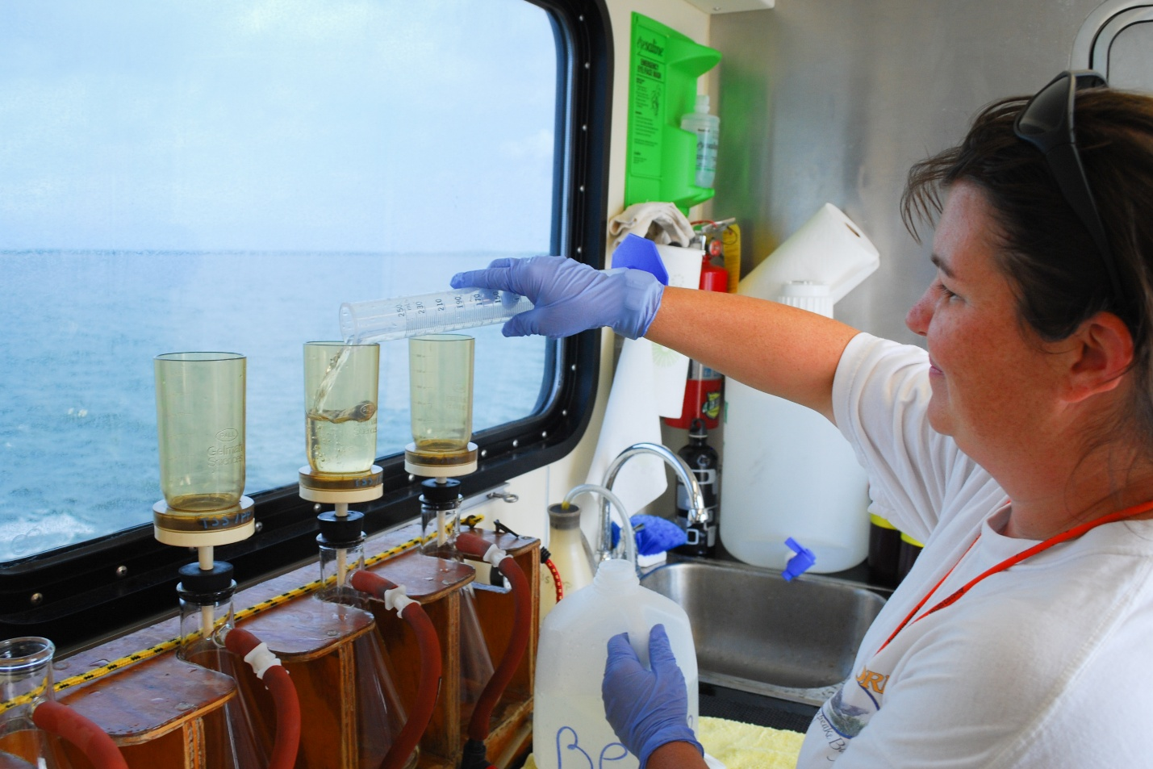
Goal II:
Support knowledge management and science-policy dialogue on marine and coastal issues
Knowledge Management:
Regionally harmonized data collection, assessment and monitoring of ocean-related indicators supported
Capacity promoted across all regions to enhance knowledge management on marine and coastal issues
Synergies across reporting requirements to reduce duplication of efforts fostered
Research and Science-Policy Dialogue
Research fostered to deepen understanding of marine environments in sync with existing global assessment platforms
Science-policy dialogue enhanced on marine and coastal issues
Notes:
Goal II seeks to provide the tools to facilitate cooperation and achievement of Goals I-III through improved knowledge management and enhanced science-policy dialogue. These activities remain similar to the current RSSD and also retains the two groupings shown here.
Goal II is to be achieved by supporting regionally harmonised data collection, assessment and monitoring of relevant indicators, as well as capacity-building for knowledge management, and fostering synergies across reporting requirements.

Slide 7
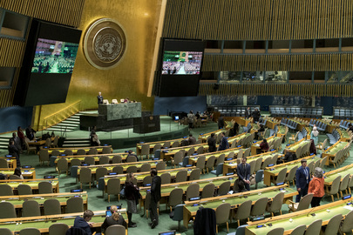
Goal III:
Elevate the global profile of the RSP through outreach, advocacy and partnerships
Strengthened relationship with UNEA and elevated RSP profile for advancing ocean-related SDGs
Enhanced cooperation with UN bodies, MEAs, financial institutions, philanthropies, and other processes
Improved collaboration and knowledge exchange among Regional Seas, notably through the RSP Annual Meeting
Strengthened legal and policy frameworks to align RSP delivery with the GBF and other global frameworks
Integration of RSP activities into national planning processes
Promotion of equitable and participatory ocean governance
Notes:
Goal III is about elevating the global profile of the RSP and these activities also remain similar to the current RSSD, focusing on the RSP’s relationship with UNEA, cooperation with partners, and collaboration between RSCAPs.
Focus is also placed on strengthening legal and policy frameworks, mainstreaming RSP activities into national planning processes, and of course, equitable and participatory governance of oceans.

Slide 8
Thank you
www.unep.org
Notes:
With that, on behalf of the University of Wollongong, Karen, Niko and I would like to thank everyone for your assistance in developing the draft RSSD for 2026-2029 and I hand the floor back for comments and next steps.

Slide 9
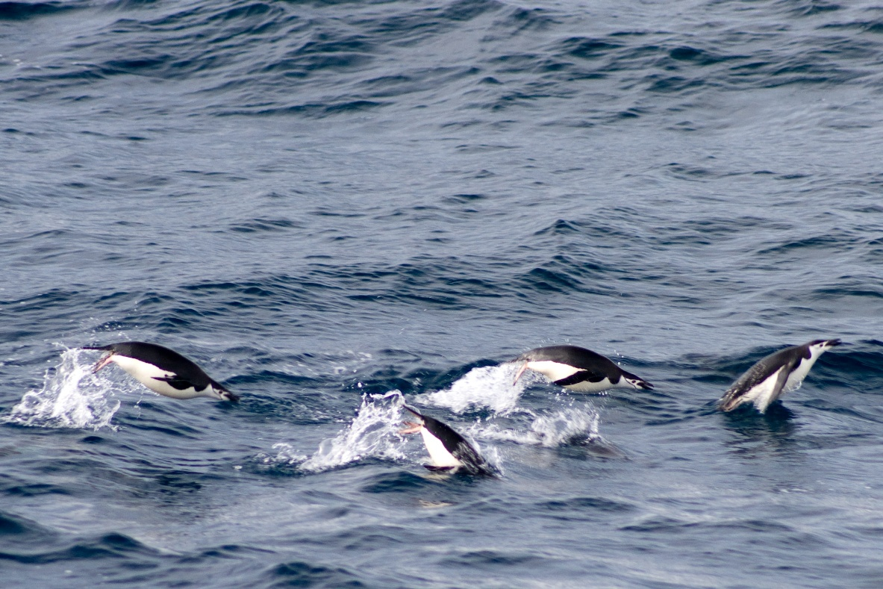
Vision
(New)
Prosperous and climate resilient seas and their respective coastal regions with biologically diverse, healthy, productive, conserved, restored and effectively used marine and coastal ecosystems for the benefit of people and nature.
Section II: Vision and objective
Objective
(Updated)
Secure healthy, productive marine and coastal ecosystems leading to a more sustainable ocean economy, supporting human health and livelihoods while also tackling the interlinked and mutually reinforcing effects of biodiversity loss, pollution and climate change.
Notes:
A new vision was added in Section II for: a “Prosperous and climate resilient seas and of their respective coastal regions with biologically diverse, healthy, productive, conserved, restored and effectively used marine and coastal ecosystems for the benefit of people and nature.”
Also, the objective was updated to: “Secure healthy, productive marine and coastal ecosystems leading to a more sustainable ocean economy, supporting human health and livelihoods while also tackling the interlinked and mutually reinforcing effects of biodiversity loss, pollution and climate change.”
<<
Previous objective: “to achieve a diverse, resilient and pollution-free ocean that supports equitable sustainable livelihoods. This includes climate stability, living in harmony with nature, ocean sustainability and operating within planetary boundaries.”
>>

Slide 10
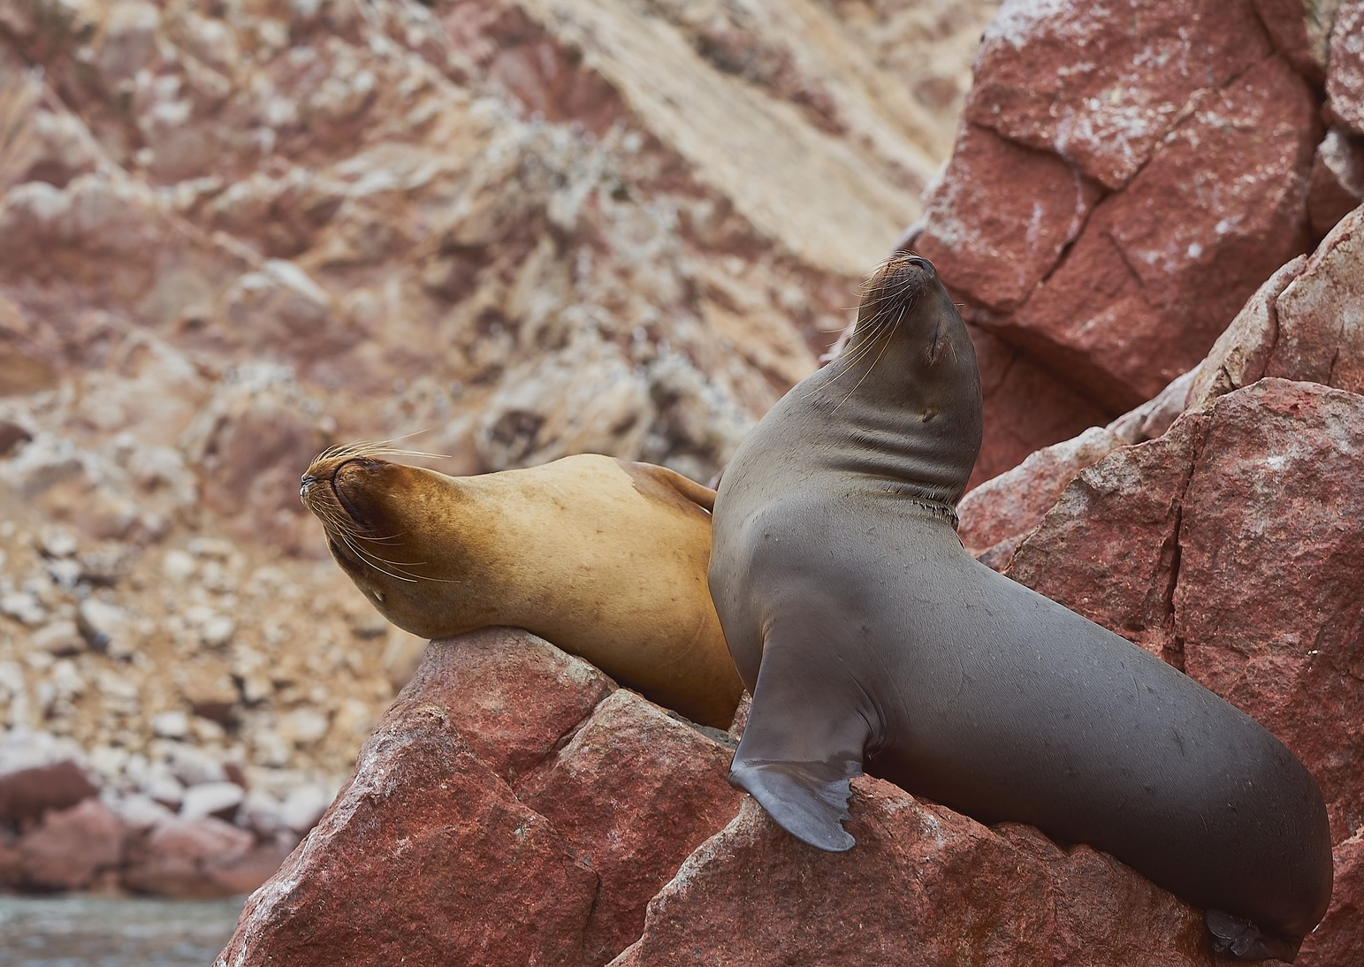
Suggestions for improving the next RSSD from the survey
Align more closely with regional strategies, MTS, and PoWs
Improve alignment with GBF indicators, inclusion of BBNJ, and simplify integration across SDGs and other MEAs
Recognize the challenge of alignment due to RSCAPs’ accountability to national priorities
Facilitate technical exchange among RSCAPs during implementation to address common challenges
Notes:
There were suggestions that the RSSD should align more closely with regional strategies already in place, as well as UNEP’s MTS and PoWs.
We took note of the recommendation to improve alignment with GBF indicators and to simplify integration across the SDGs and other MEAs. Therefore, when we propose indicators, we indicate how they align with both SDG and GBF indicator frameworks.
But it was noted that there were challenges in aligning with the RSSD because of RSCAPs accountability to national priorities of Member States.
UNEP support was called for with a suggestion to fund at least one RSSD-related activity per year, as well as to facilitate technical exchange among RSCAPs to address common challenges for implementation.

