Slide 1
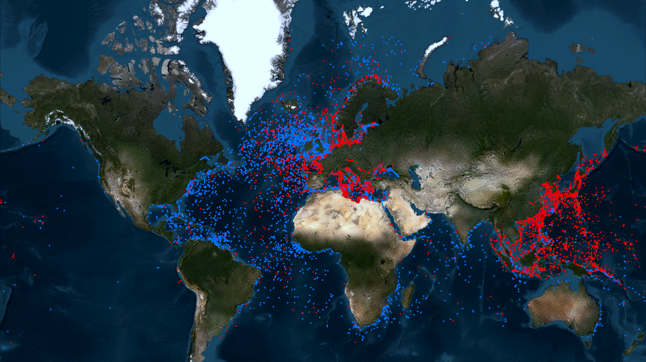

THE MALTA MANIFESTO
A CALL TO ACTION ON
POTENTIALLY POLLUTING WRECKS
https://www.lrfoundation.org.uk/publications/the-malta-manifesto
Notes:
Talk about how the Manifesto came to be on this slide – what Project Tangaroa is - workshop programme etc. – why it’s called The Malta Manifesto!

Slide 2

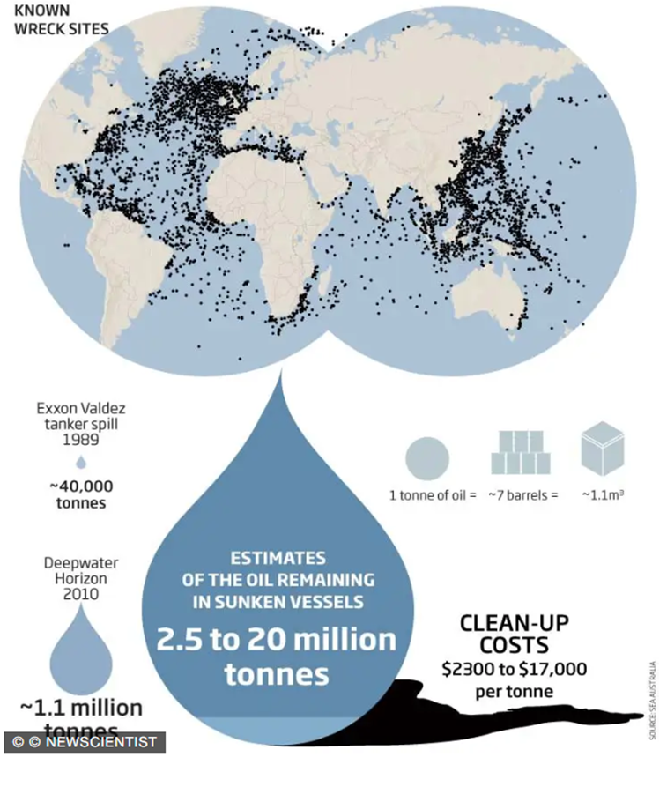
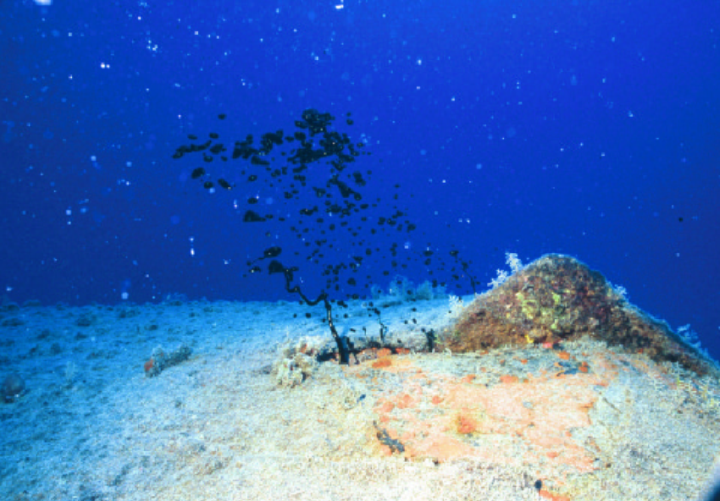
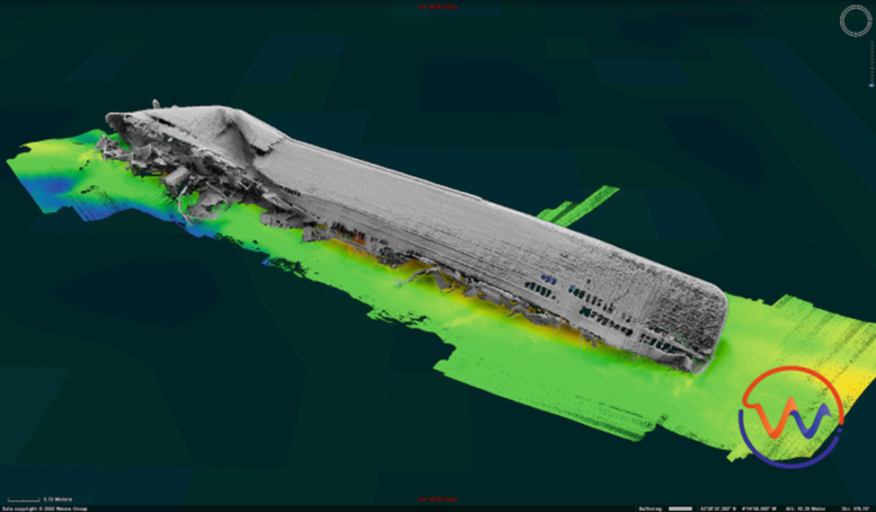
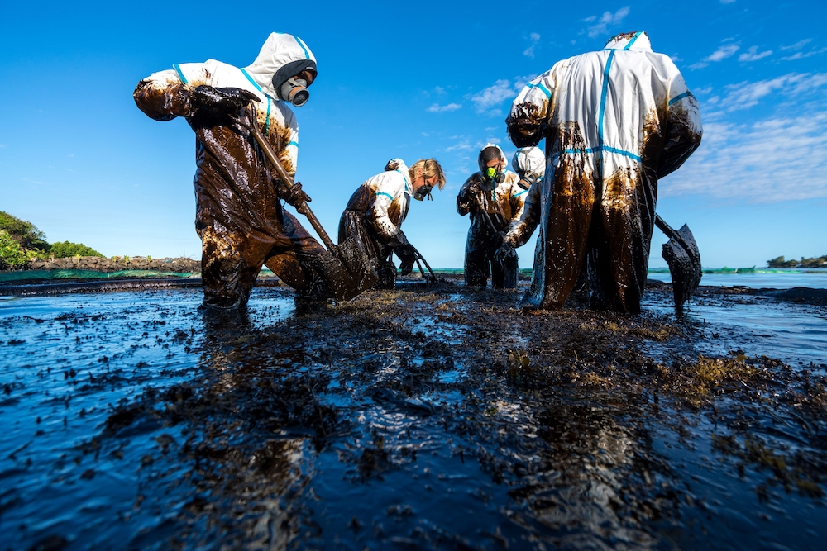
OUR SHARED OCEAN.
OUR SHARED CHALLENGE.
Notes:
The point of this presentation is not to go over the issue itself in great detail – it’s focused on the manifesto CTAs – but worth taking a couple of minutes to give a summary overview of the challenge, bot qualitatively and quantitatively, for those in the audience who may be less familiar (many but not all will be familiar with the issue).

Slide 3

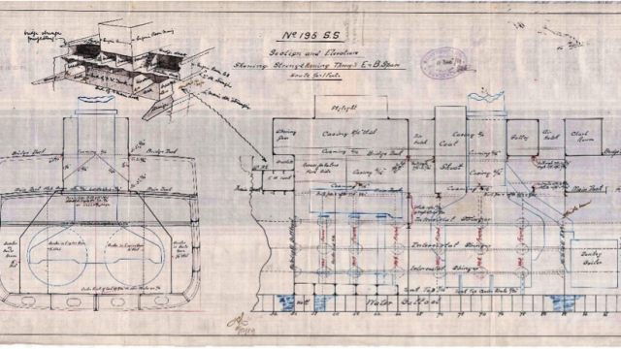
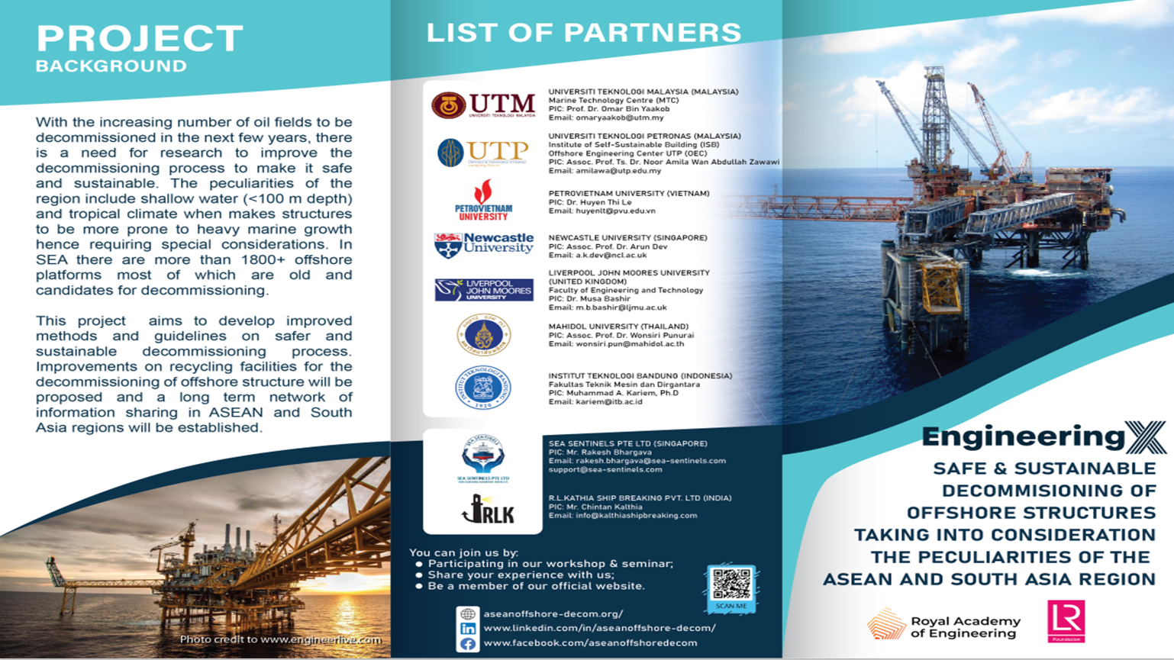





TITLE
TEXT

Slide 4
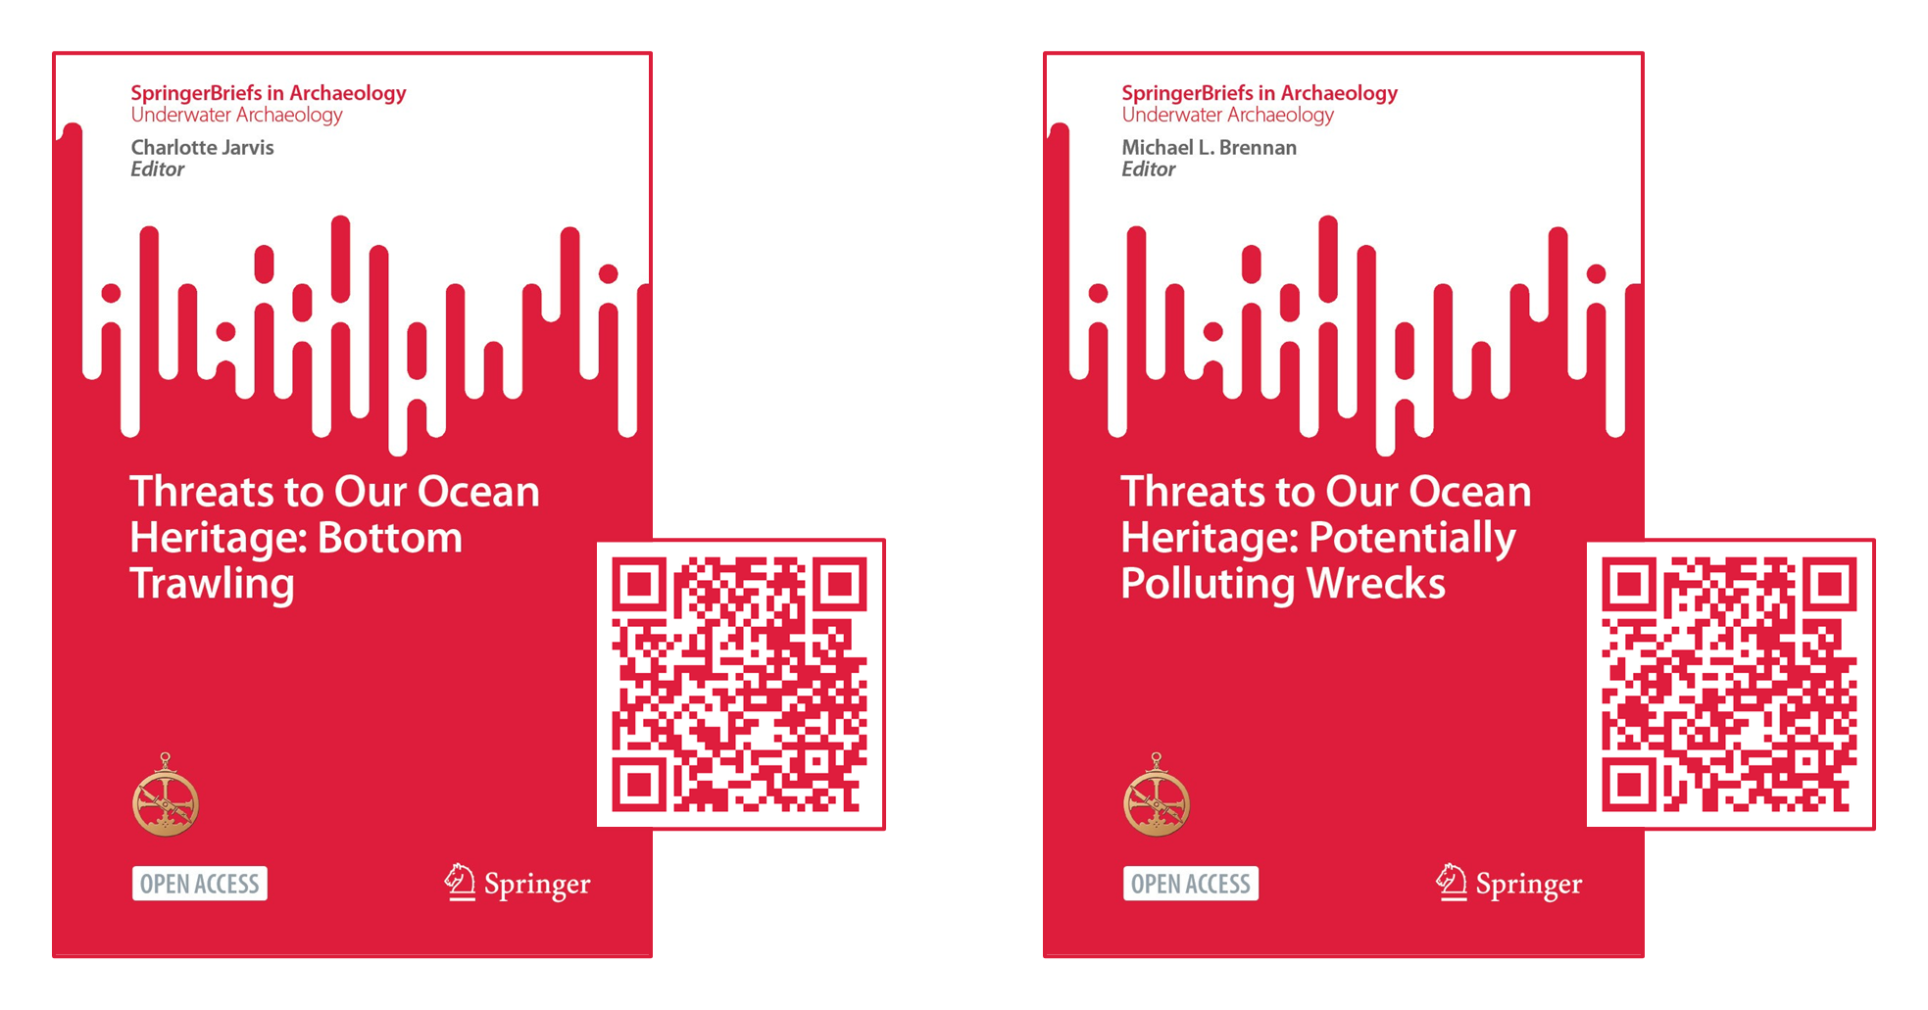
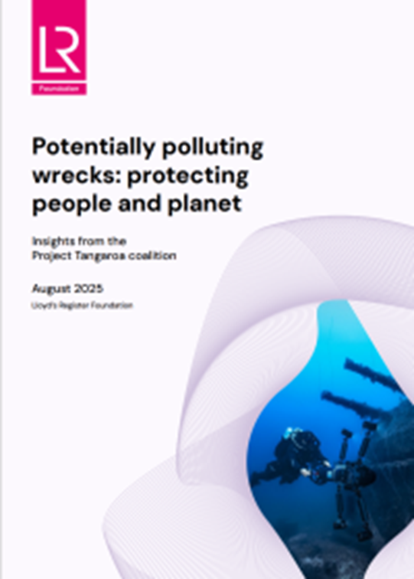
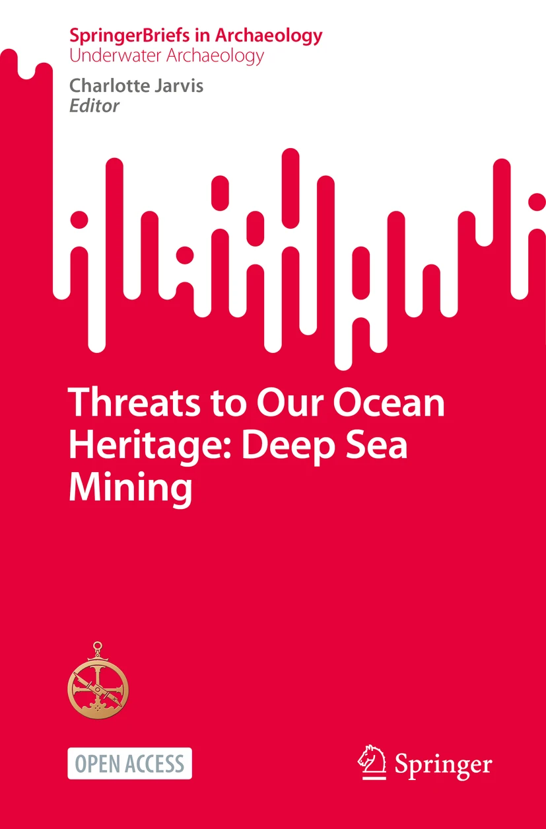

Threats to Our Ocean Heritage: Open Access
https://www.lrfoundation.org.uk/publications/the-malta-manifesto

Slide 5
OUR
PRINCIPLES.
A Precautionary Approach
Global Responsibility, Local Agency
Global Expertise, Local Knowledge
Equitable Burden-Sharing
Sustainable Solutions
Notes:
Don’t need to go into too much detail on these – remember you only have 15 minutes, and you’ll want to give each of the CTAs that follow sufficient attention.

Slide 6
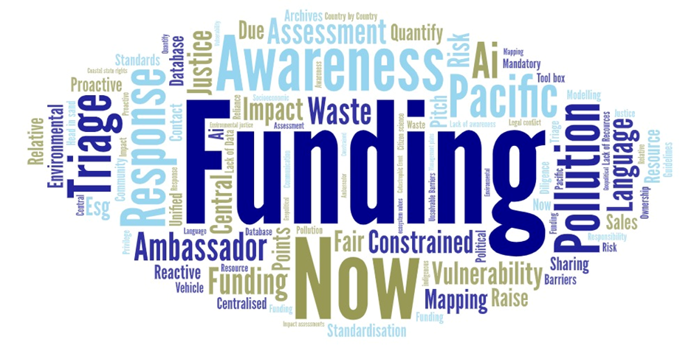

Slide 7
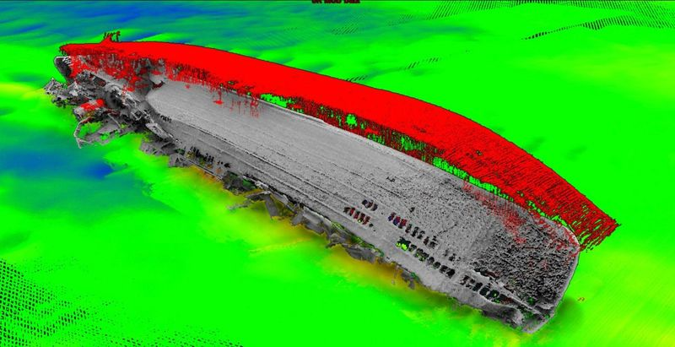

Slide 8
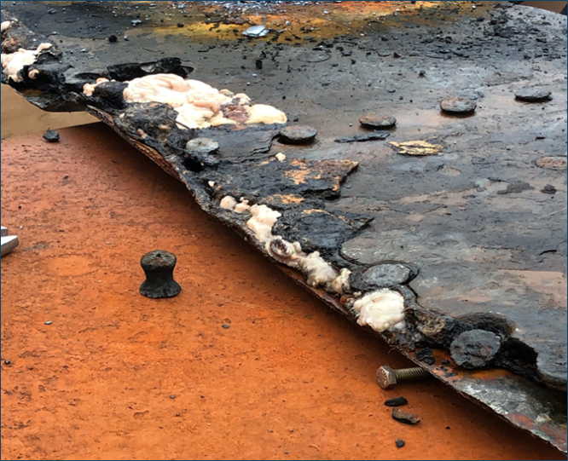

Slide 9
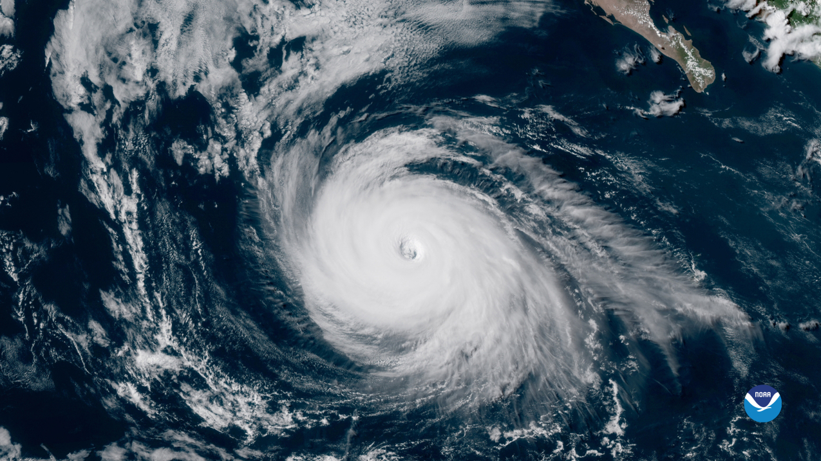

Slide 10
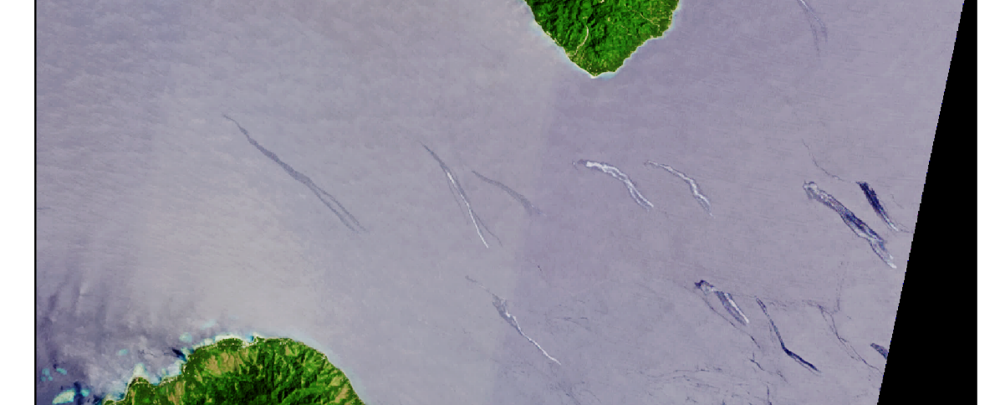
Satellite data – discovery and monitoring
“Wishbone” oil slick shape.
Related to water body movement post-Earthquake?
Metallic colouration, Bonn Code 3. Oil thickness: ~5µm to 50µm
Landsat-8 - 8th December 2016
Notes:
Reference BONN code explanation

Slide 11

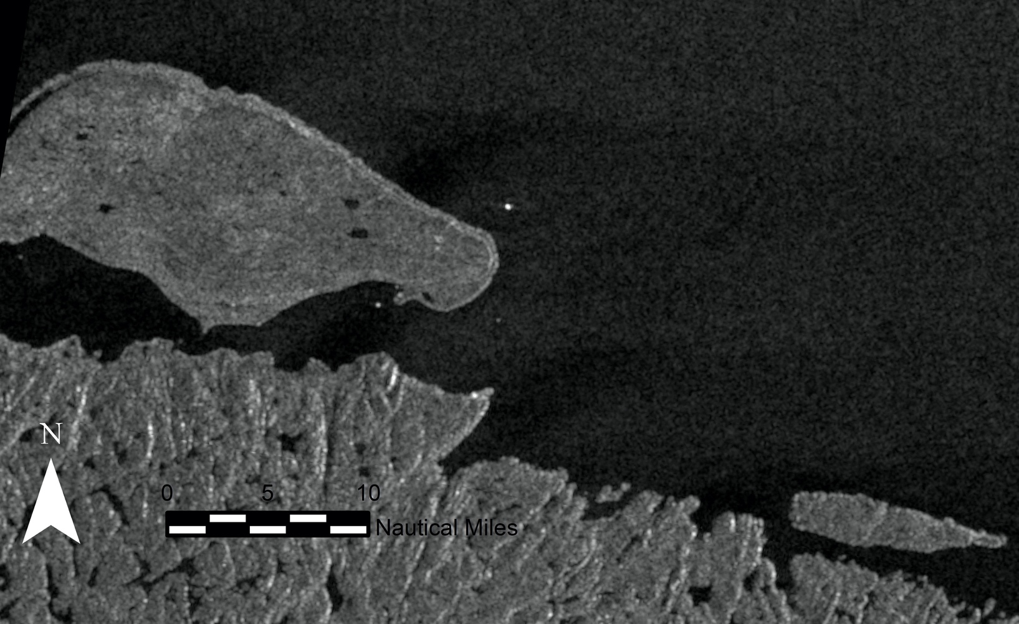
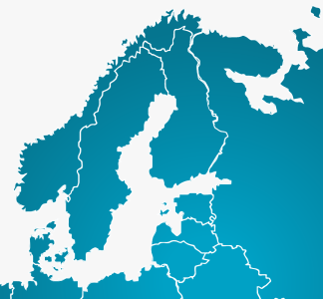
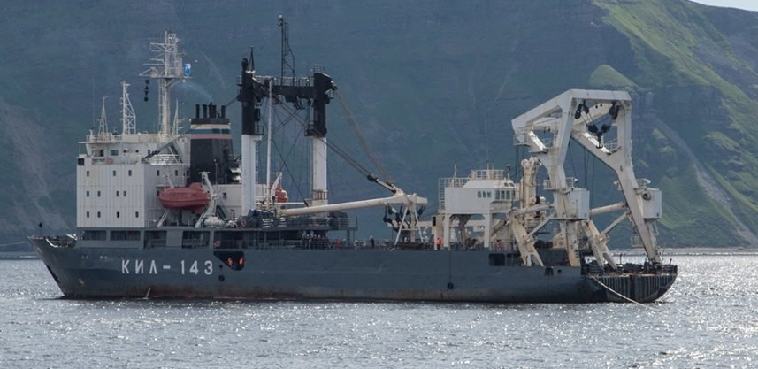
Satellite monitoring in the Arctic
2nd Oct 2022
Since 2010 the Russian Northern Fleet has material from two US ships: SS Thomas Donaldson and SS Ballot under the guise of military training.
The operations were conducted without permission from the US Navy.
After the invasion of Ukraine in 2022 the Maritime Observatory detected salvage work restarting.
Kil 143 position over SS Ballot wreck during salvage operations. Electro-optical imagery (Sentinel-2) on 2nd Oct 2022 Courtesy of Mast and The Maritime Observatory

Slide 12
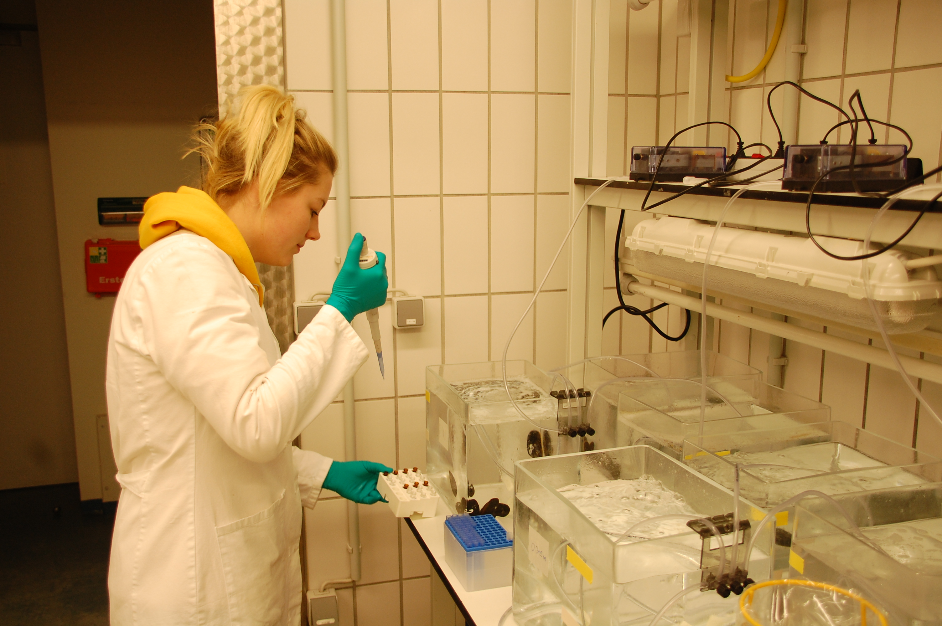
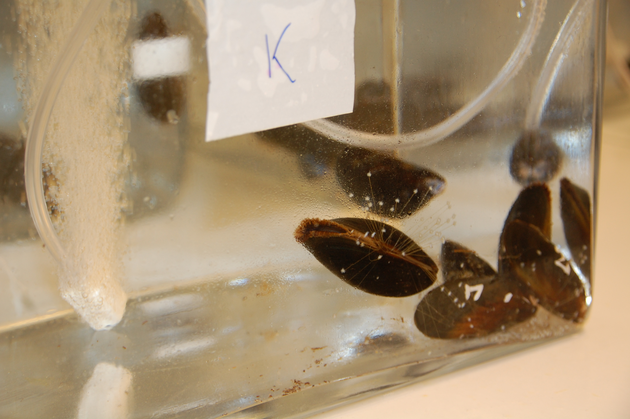
REMARCO
Lab study - Toxicity of dissolved TNT on exposed blue mussels under rising temperature
Blue mussels were exposed to 3 different temperature regimes while in parallel exposed to differing concentrations of dissolved explosives.
Preliminary results
Mussels experience stress on stress effects when exposed to dissolved TNT in combination with rising temperatures.
Conclusion
Warming waters will increase solubility of explosives leading most likely to higher background contaminations. Further, higher temperature increases stress response especially of temperate organisms such as blue mussels. Effects of temperature and TNT exposure are negatively synergistic.

Slide 13
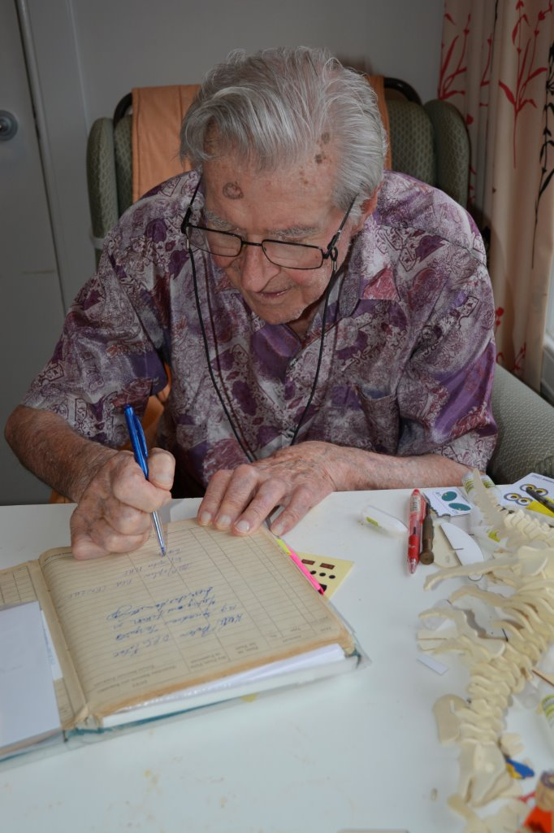
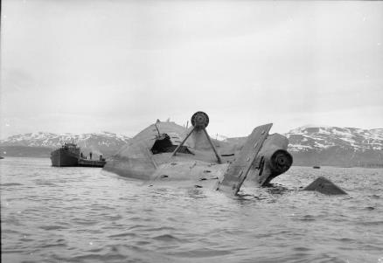
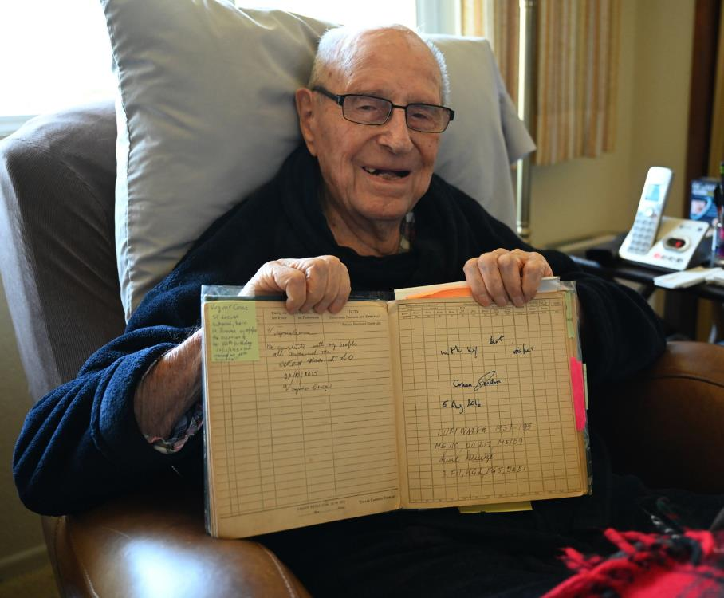
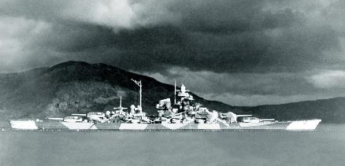
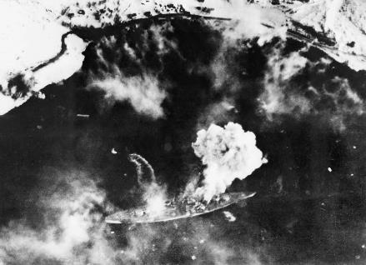
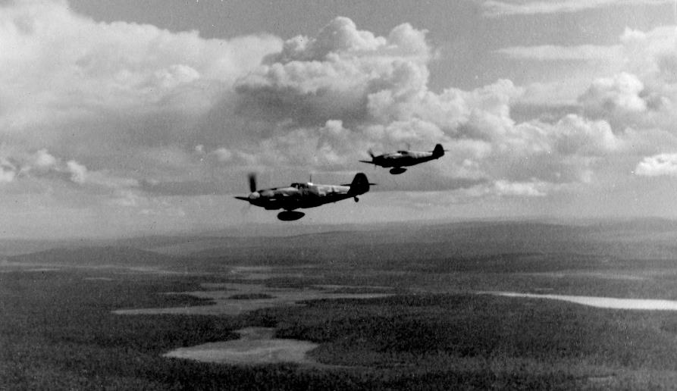
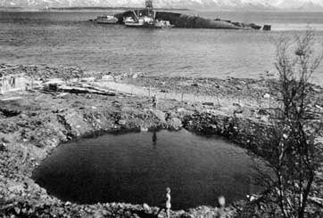

Kurt Schulze, Luftwaffe
Bf109 pilot, 1./KG2, 8./JG5, 10/JG5, 1./JG51, 16./JG5
Flew mission to try defend Tirpitz
F/O Arthur Joplin, RNZAF
Lancaster pilot, No 617 ”Dambusters” Squadron, flew ME561 in the raid that sunk Tirpitz

Slide 14
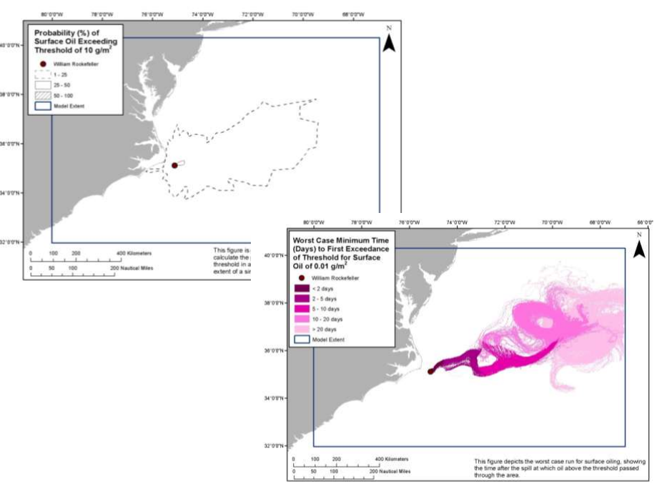
PPWs and MPAs – what is the risk?
William Rockefeller
150,000 Barrels , Bunker C

Slide 15
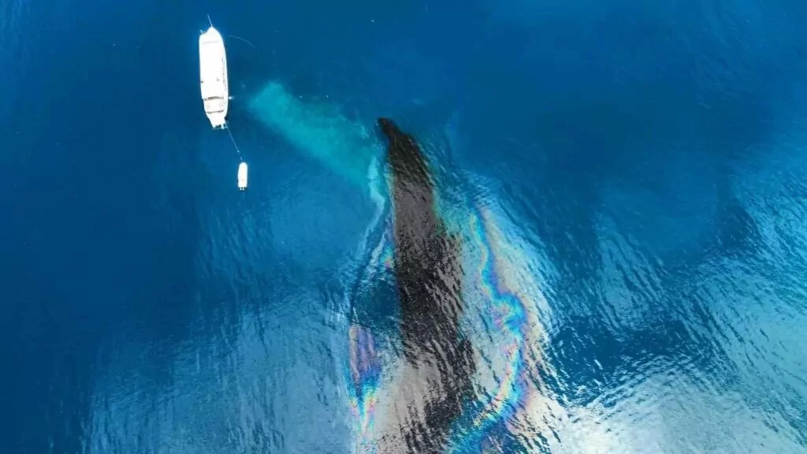
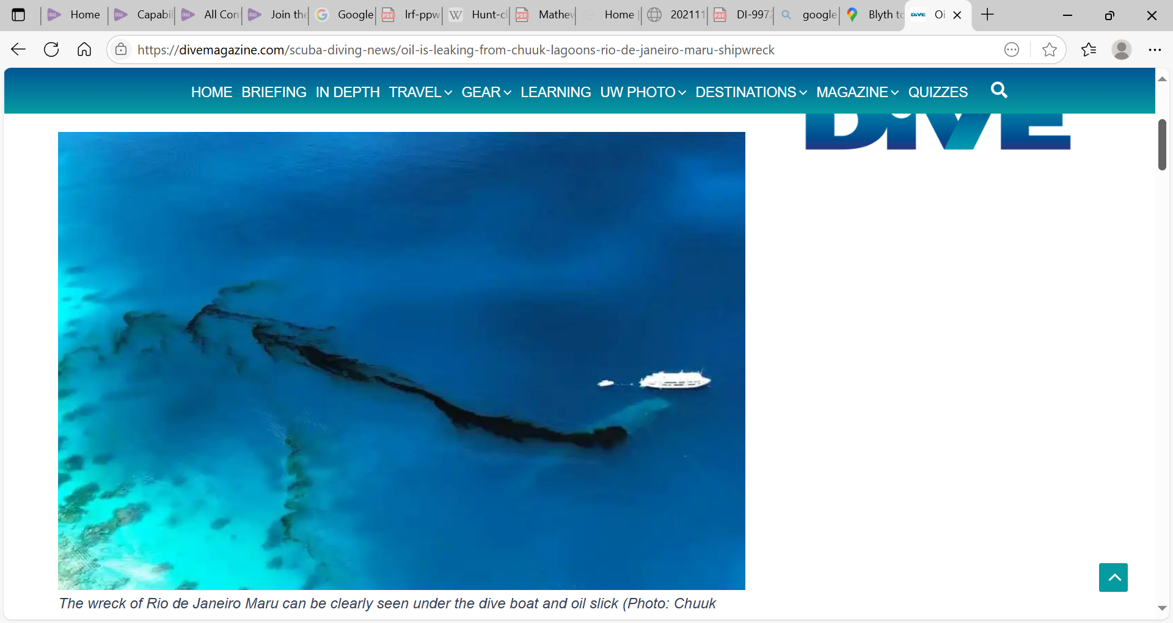
Governor Narruhn has called on both Japan and the US to help clear the oil, which he says is threatening the future food security of the island nation.

Slide 16
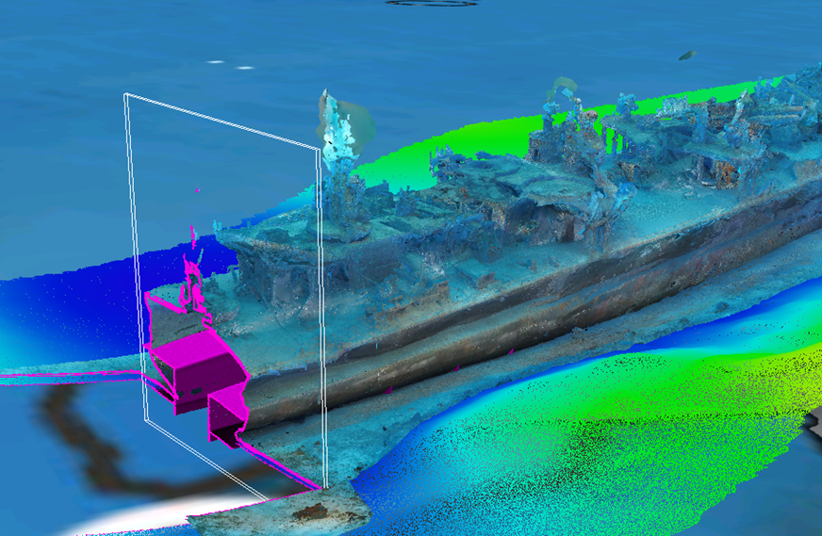
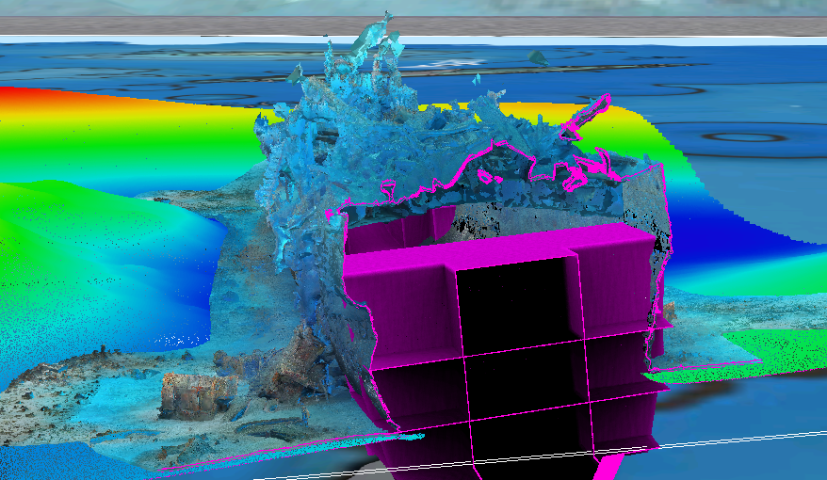

Condition and oil volume assessment
Image examples provided from ongoing MPF project in Bikini Atoll World Heritage Site

Slide 17
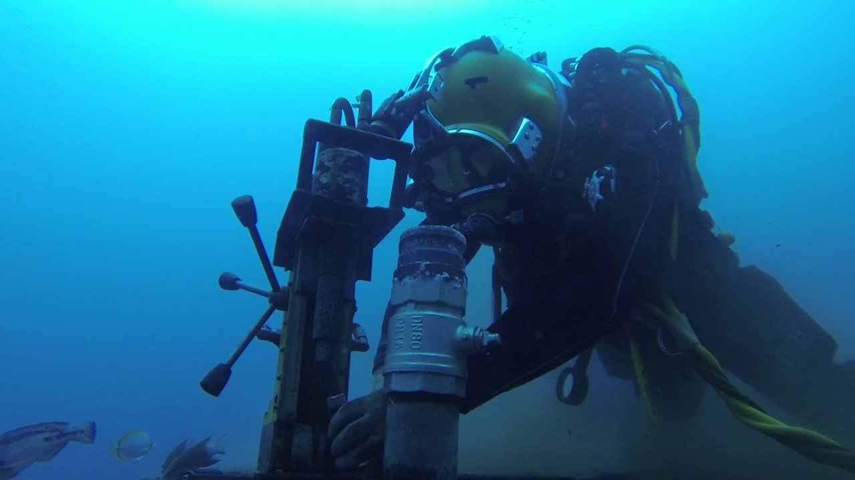

Slide 18
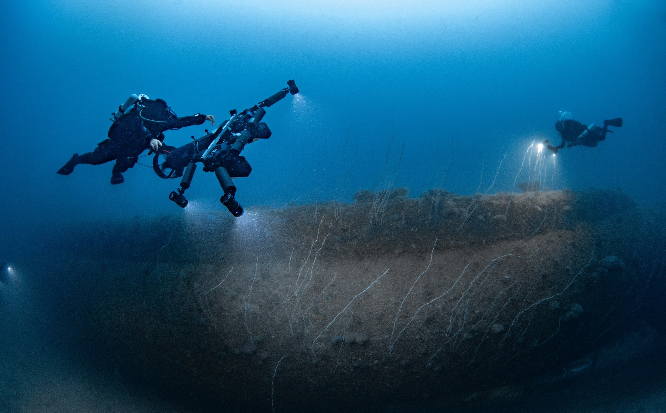

Slide 19
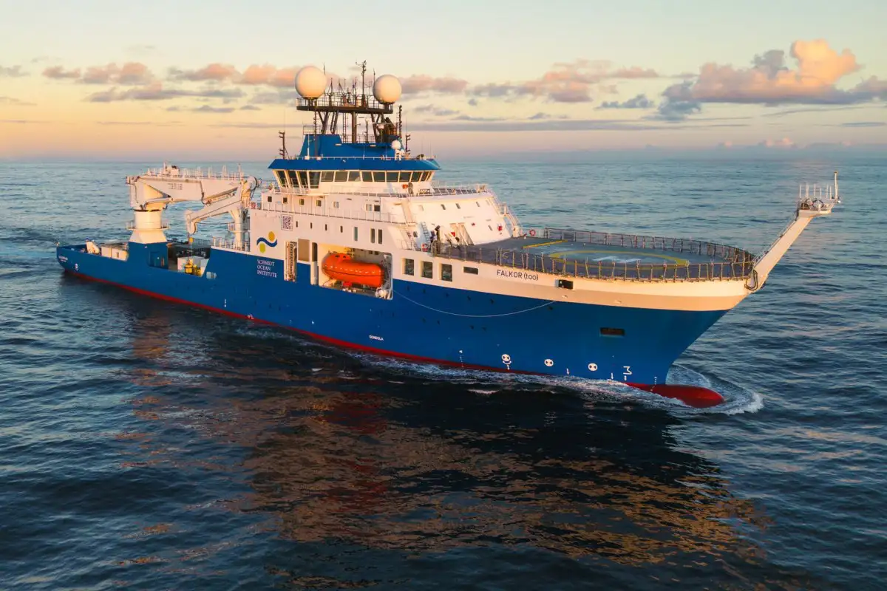
“UNESCO appeals for ships to sign up to scientific mission to track health of world’s oceans”

Slide 20
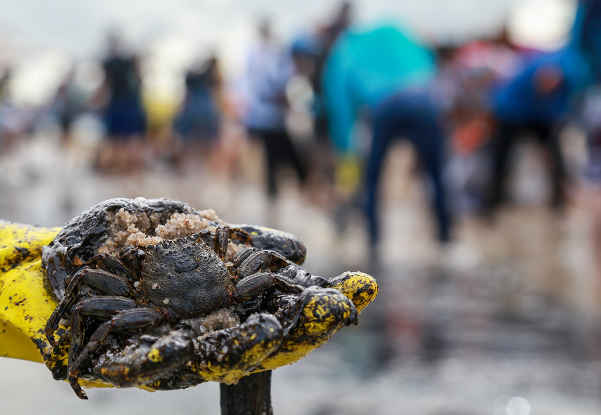

Slide 21
Recommendations
The Cartagena Convention actively engage with Project Tangaroa to address the threat of PPWs in the Caribbean.
Existing regional planning (through the Protocol Concerning Co-operation and Development in Combating Oil Spills in the Wider Caribbean Region) should include operational provisions for emergency spill response to PPW-sourced pollution. Longer-term management and workforce development plans should be implemented to minimise or prevent disasters from PPWs.

Slide 22
Recommendations
PPW management should be integrated into broader ocean stewardship, coastal management and marine spatial planning frameworks, risk assessments and related policy development associated with The Protocol Concerning Specially Protected Areas and Wildlife in the Wider Caribbean.
PPWs should be recognised and assessed as a risk-factor potentially requiring mitigation in connection with matters such as blue investments, habitat restoration projects and planning and management of marine protected areas.

Slide 23
OUR
VISION.
We envision a world where international
cooperation has transformed these environmental and safety hazards into a
dynamic inventory of managed sites, where communities and ecosystems vulnerable to these threats are protected through timely assessment, monitoring and intervention.
“If you look after me, then I will look after you…”
Notes:
From here the presentation mirrors the structure of the manifesto document – you may want to read out key parts of the text but definitely not all – talk to the remaining slides in your own words.

