Slide 1


Kunming-Montreal Global Biodiversity Framework
and the
SOI Global Dialogue
with Regional Seas Organizations and Regional Fishery Bodies
Joe Appiott
Secretariat of the
Convention on Biological Diversity

Slide 2
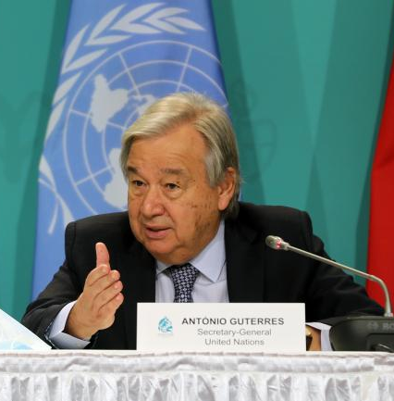

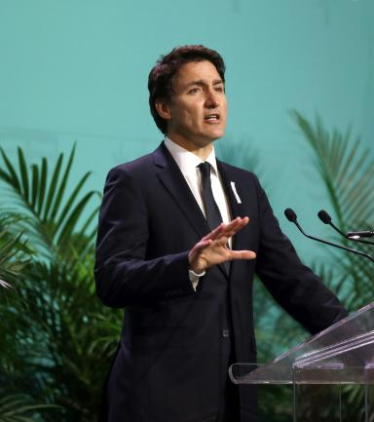
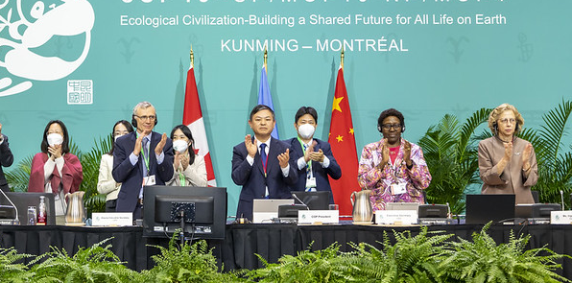

Kunming-Montreal Global Biodiversity Framework

Slide 3









Ensure that all areas are under participatory integrated biodiversity inclusive spatial planning and/or effective management processes addressing land and sea use change, to bring the loss of areas of high biodiversity importance, including ecosystems of high ecological integrity, close to zero by 2030, while respecting the rights of indigenous peoples and local communities.
Ensure that by 2030 at least 30 per cent of areas of degraded terrestrial, inland water, and coastal and marine ecosystems are under effective restoration, in order to enhance biodiversity and ecosystem functions and services, ecological integrity and connectivity.
Marine spatial planning
Marine and coastal restoration
2030 TARGETS
1. Reducing threats to biodiversity
Ensure and enable that by 2030 at least 30 per cent of terrestrial, inland water, and of coastal and marine areas, especially areas of particular importance for biodiversity and ecosystem functions and services, are effectively conserved and managed through ecologically representative, well-connected and equitably governed systems of protected areas and other effective area-based conservation measures, recognizing indigenous and traditional territories, where applicable, and integrated into wider landscapes, seascapes and the ocean, while ensuring that any sustainable use, where appropriate in such areas, is fully consistent with conservation outcomes, recognizing and respecting the rights of indigenous peoples and local communities, including over their traditional territories.
MPAs and OECMs
Ensure urgent management actions to halt human induced extinction of known threatened species and for the recovery and conservation of species, in particular threatened species, to significantly reduce extinction risk, as well as to maintain and restore the genetic diversity within and between populations of native, wild and domesticated species to maintain their adaptive potential, including through in situ and ex situ conservation and sustainable management practices, and effectively manage human-wildlife interactions to minimize human-wildlife conflict for coexistence.
Ensure that the use, harvesting and trade of wild species is sustainable, safe and legal, preventing overexploitation, minimizing impacts on non-target species and ecosystems, and reducing the risk of pathogen spill-over, applying the ecosystem approach, while respecting and protecting customary sustainable use by indigenous peoples and local communities.
Sustainable fisheries
Threatened marine species
Eliminate, minimize, reduce and or mitigate the impacts of invasive alien species on biodiversity and ecosystem services by identifying and managing pathways of the introduction of alien species, preventing the introduction and establishment of priority invasive alien species, reducing the rates of introduction and establishment of other known or potential invasive alien species by at least 50 per cent, by 2030, eradicating or controlling invasive alien species especially in priority sites, such as islands.
Marine invasive alien species; ballast water management, etc.
Reduce pollution risks and the negative impact of pollution from all sources, by 2030, to levels that are not harmful to biodiversity and ecosystem functions and services, considering cumulative effects, including: reducing excess nutrients lost to the environment by at least half including through more efficient nutrient cycling and use; reducing the overall risk from pesticides and highly hazardous chemicals by at least half including through integrated pest management, based on science, taking into account food security and livelihoods; and also preventing, reducing, and working towards eliminating plastic pollution.
Minimize the impact of climate change and ocean acidification on biodiversity and increase its resilience through mitigation, adaptation, and disaster risk reduction actions, including through nature-based solution and/or ecosystem-based approaches, while minimizing negative and fostering positive impacts of climate action on biodiversity.
Ocean acidification;
sea-level rise; coastal adaptation
Marine and land-based pollution, including plastics, debris, noise, light

Slide 4
2030 TARGETS
9
Ensure that the management and use of wild species are sustainable, thereby providing social, economic and environmental benefits for people, especially those in vulnerable situations and those most dependent on biodiversity, including through sustainable biodiversity-based activities, products and services that enhance biodiversity, and protecting and encouraging customary sustainable use by indigenous peoples and local communities.
Benefits from sustainable fisheries
10
Ensure that areas under agriculture, aquaculture, fisheries and forestry are managed sustainably, in particular through the sustainable use of biodiversity, including through a substantial increase of the application of biodiversity friendly practices, such as sustainable intensification, agroecological and other innovative approaches contributing to the resilience and long-term efficiency and productivity of these production systems and to food security, conserving and restoring biodiversity and maintaining nature’s contributions to people, including ecosystem functions and services.
Responsible management of areas used for aquaculture and fishing
11
Restore, maintain and enhance nature’s contributions to people, including ecosystem functions and services, such as regulation of air, water, and climate, soil health, pollination and reduction of disease risk, as well as protection from natural hazards and disasters, through nature-based solutions and/or ecosystem-based approaches for the benefit of all people and nature.
Responsible management of areas used for aquaculture and fishing
2. Meeting people’s needs through sustainable use and benefit-sharing
12
Significantly increase the area and quality and connectivity of, access to, and benefits from green and blue spaces in urban and densely populated areas sustainably, by mainstreaming the conservation and sustainable use of biodiversity, and ensure biodiversity-inclusive urban planning, enhancing native biodiversity, ecological connectivity and integrity, and improving human health and well-being and connection to nature and contributing to inclusive and sustainable urbanization and the provision of ecosystem functions and services.
Blue spaces (e.g., beaches, coastal landscapes) for human well-being
14
Ensure the full integration of biodiversity and its multiple values into policies, regulations, planning and development processes, poverty eradication strategies, strategic environmental assessments, environmental impact assessments and, as appropriate, national accounting, within and across all levels of government and across all sectors, in particular those with significant impacts on biodiversity, progressively aligning all relevant public and private activities, fiscal and financial flows with the goals and targets of this framework.
Mainstreaming biodiversity into all sectors
18
Identify by 2025, and eliminate, phase out or reform incentives, including subsidies, harmful for biodiversity, in a proportionate, just, fair, effective and equitable way, while substantially and progressively reducing them by at least 500 billion United States dollars per year by 2030, starting with the most harmful incentives, and scale up positive incentives for the conservation and sustainable use of biodiversity.
Harmful fisheries subsidies

Slide 5

Translating KMGBF into National Action;
Reporting and Assessing Progress at COP 17
IMPLEMENTATION
Revision of NBSAPs* and/or development of national targets reflecting KMGBF
Preparation of
national reports
Preparation of global report
Adoption of KMGBF
CBD COP 15 (2022)
Submission of national targets
CBD COP 16 (2024)
Global review of progress
CBD COP 17 (2026)
Feb 2026
*National Biodiversity Strategy and Action Plan - The main national policy document which sets out how country it intends to implement the Convention.

Slide 6

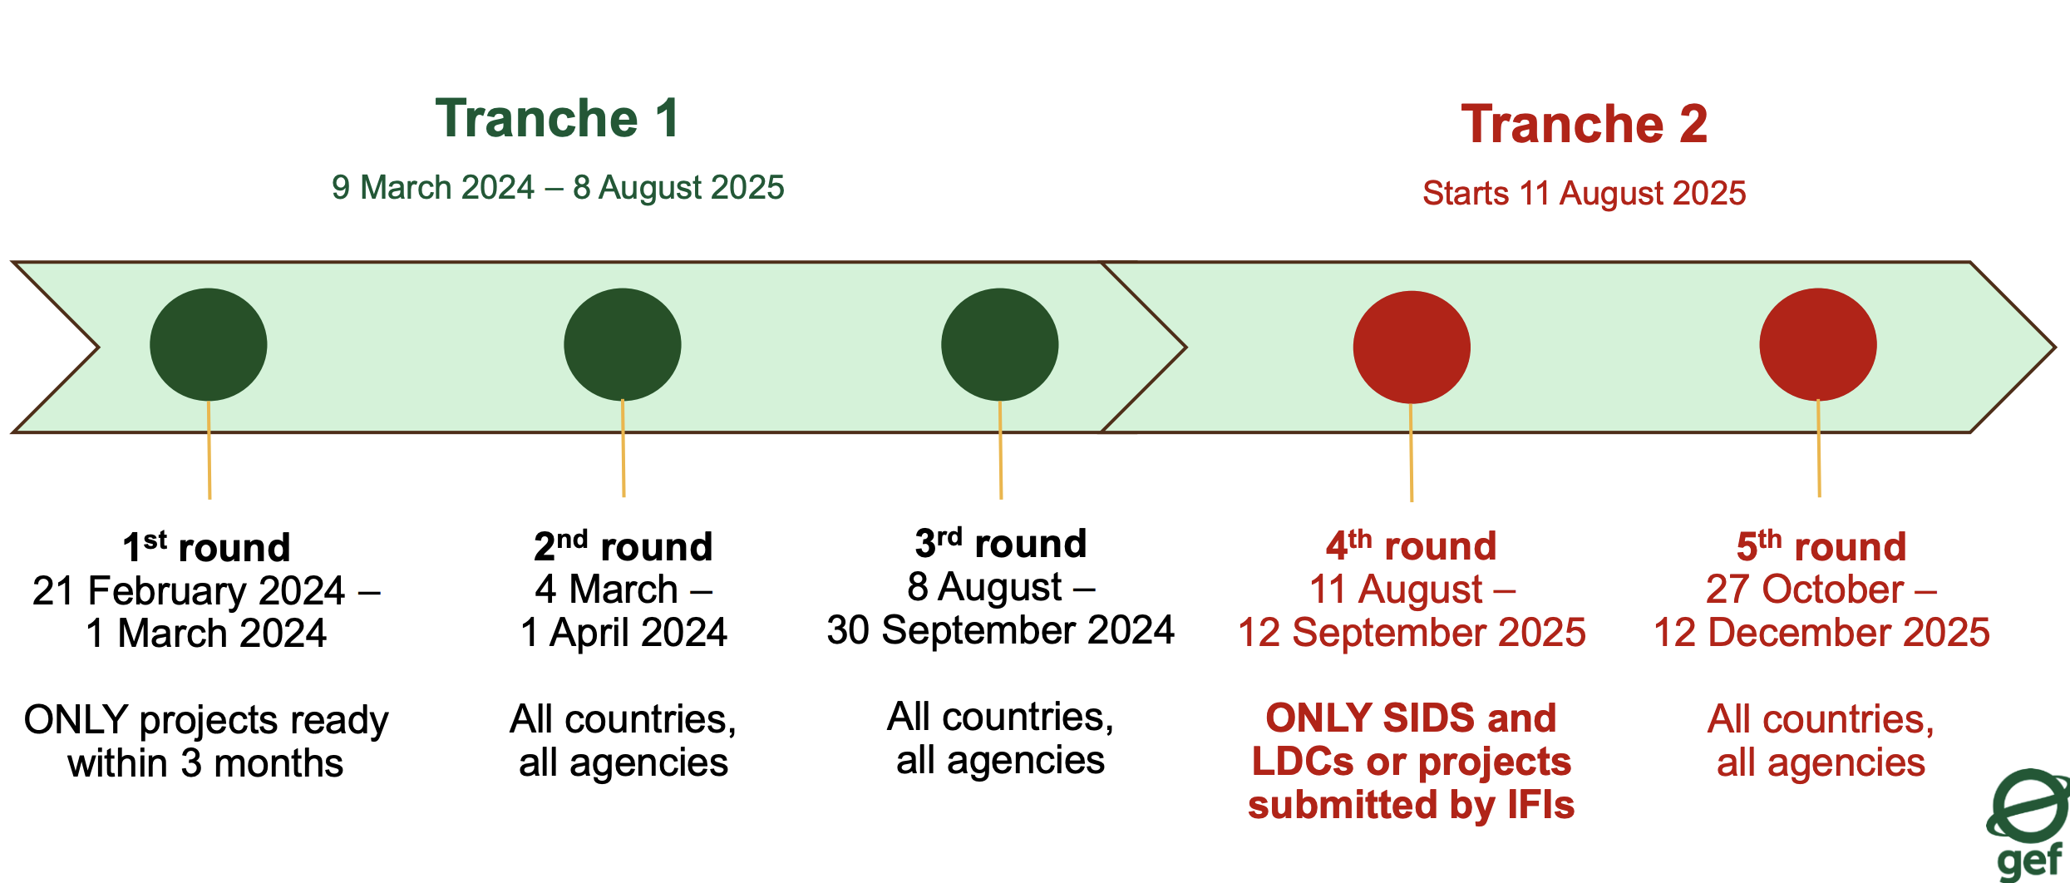
GEF Global Biodiversity Framework Fund
Established on 28th May 2024
Co-chaired by China and UNEP
Currently supporting 7 ongoing projects
  4 of them multi-country and 3 country-specific.
Regional projects with multiple countries were welcomed, particularly for Small Island Developing State (SIDS) and large cross-boundary ecosystems
Established in August 2023 at 7th GEF Assembly in response to requests from the CBD COP15
The GBFF aims to help countries achieve the KMGBF, with a focus on strengthening national-level biodiversity management, planning, policy, governance, and finance.
As of June 2025, a total of $386 million has been pledged to the GBFF

Slide 7
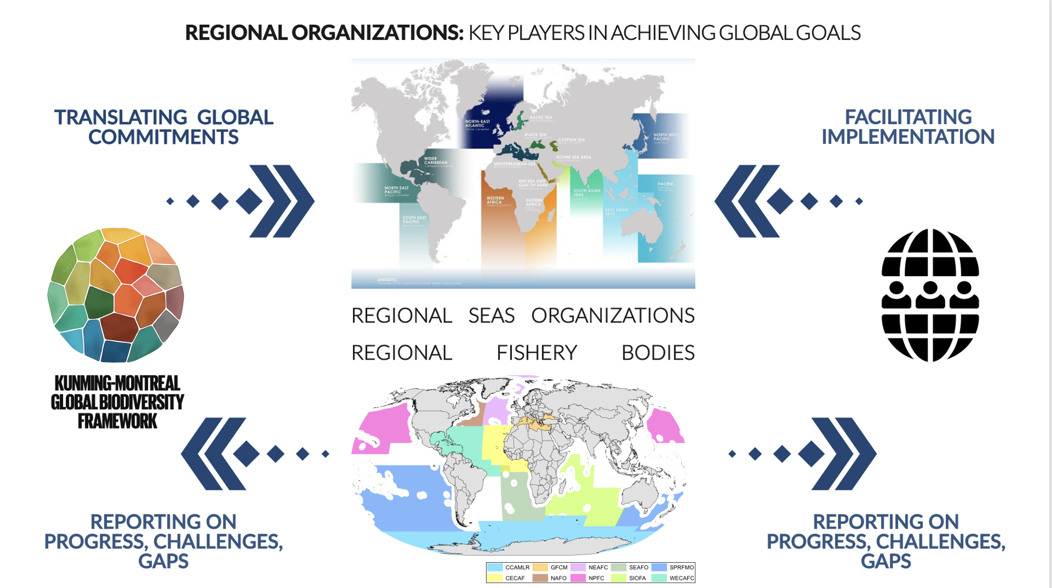


2

Slide 8






Sustainable Ocean Initiative Global Dialogue
with Regional Seas Organizations and Regional Fishery Bodies
Global Dialogue
Participants
Representatives of regional seas organizations, regional fishery bodies, UN agencies, global and regional initiatives, NGOs, and governments
2
1
Sharing experiences within respective processes of RSOs and RFBs
Sharing experiences in joint/ collaborative approaches
3
4
Identifying opportunities and approaches for collaboration between RSOs and RFBs
Ways to measure progress towards
global goals and targets

Slide 9
Sustainable Ocean Initiative Global Dialogue
with Regional Seas Organizations and Regional Fishery Bodies
Global Dialogue
Benefits for the Cartagena Convention
Enhancing awareness and understanding of your work and achievements globally
Identifying opportunities to build stronger linkages with regional organizations
Learning from other regions that are facing similar challenges
Identifying opportunities to benefit from sources of support
How can these benefits be enhanced?
Continued engagement of Secretariat in SOI Global Dialogue
In advance of each SOI Global Dialogue meeting, identify key priorities and questions to bring to the meeting
Use SOI Global Dialogue meetings as key opportunities to progress tangible collaboration
Consider how to integrate outcomes of each SOI Global Dialogue meeting into planning

Slide 10
What’s needed
Global Biodiversity Framework
  Finalize national targets and NBSAP revision
  Submit national reports by Feb 2026, with all indicators addressed
  Engage in global review process
  Make use of new funds, incl. at regional scale
SOI Global Dialogue
  Support continued engagement
  Use SOI Global Dialogue to enhance cooperation with other key bodies and to better align with global processes (e.g., BBNJ, KMGBF)

Slide 11
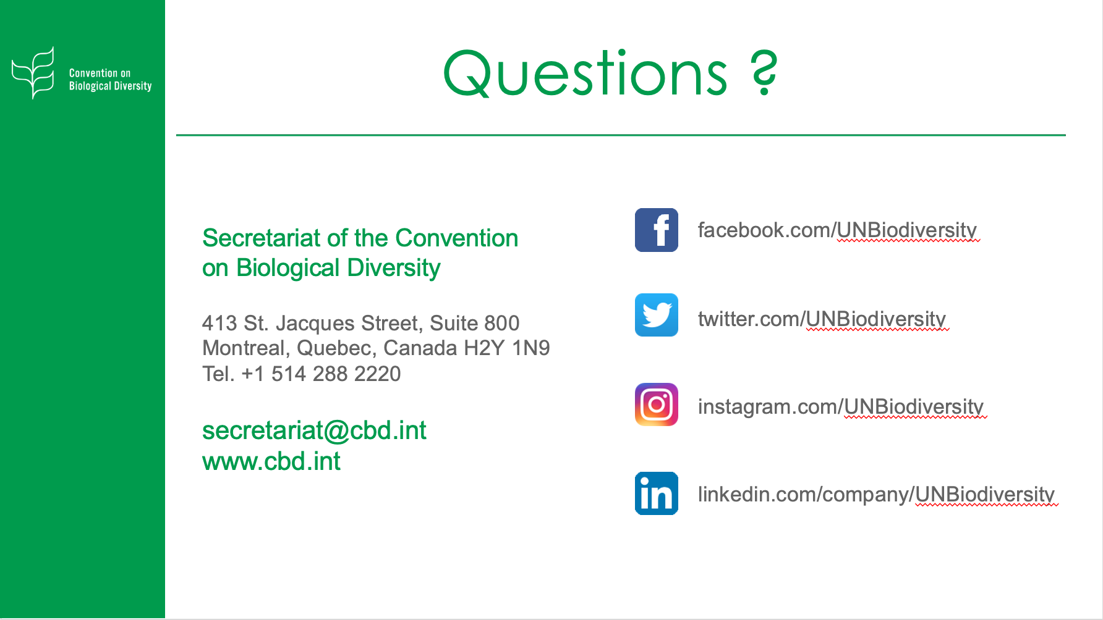
Thank you

