Slide 1
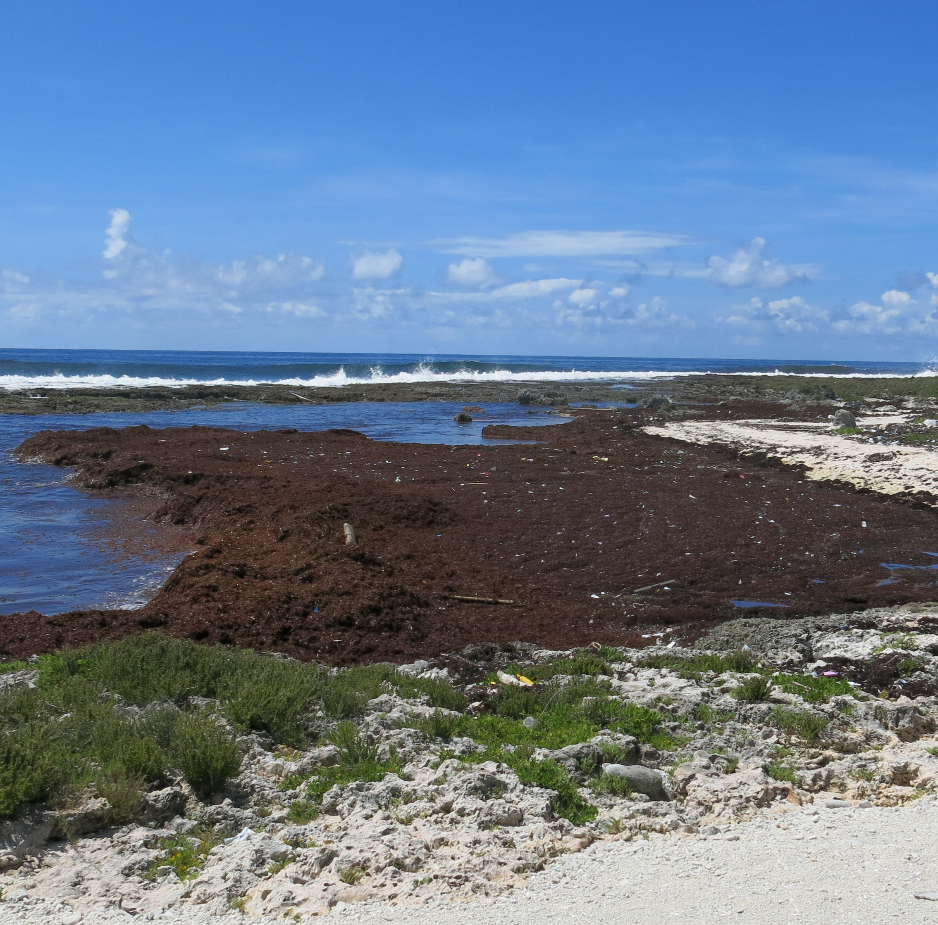
Draft Cartagena Convention Action Plan on Sargassum Inundation
Agenda 6.7
UNEP(DEPI)/CAR WG.45/INF.27 Rev.3

Slide 2
Five Components:
Cooperation, Coordination and Governance.
Research
Response
Communication and awareness
Sustainable Financing Resources

Slide 3
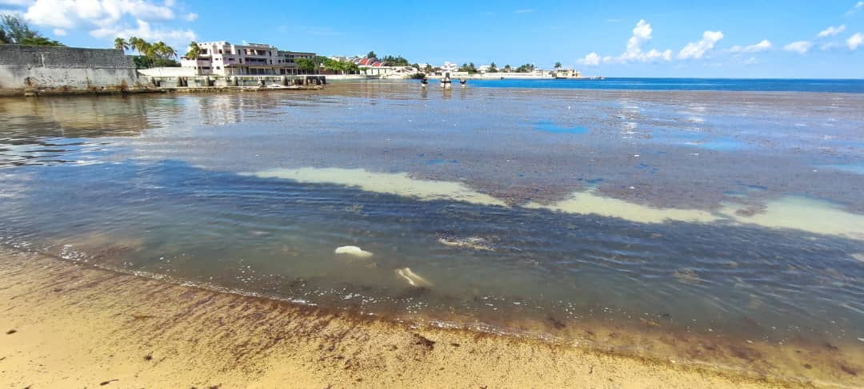
COP 18 may wish to:
Taking into account endorsement by LBS COP7 & SPAW COP 13 and edits proposed, Approve the Cartagena Convention Action Plan on Sargassum Inundation as a framework to strengthen regional cooperation, coordination, and capacity for the effective management of Sargassum events.

Slide 4
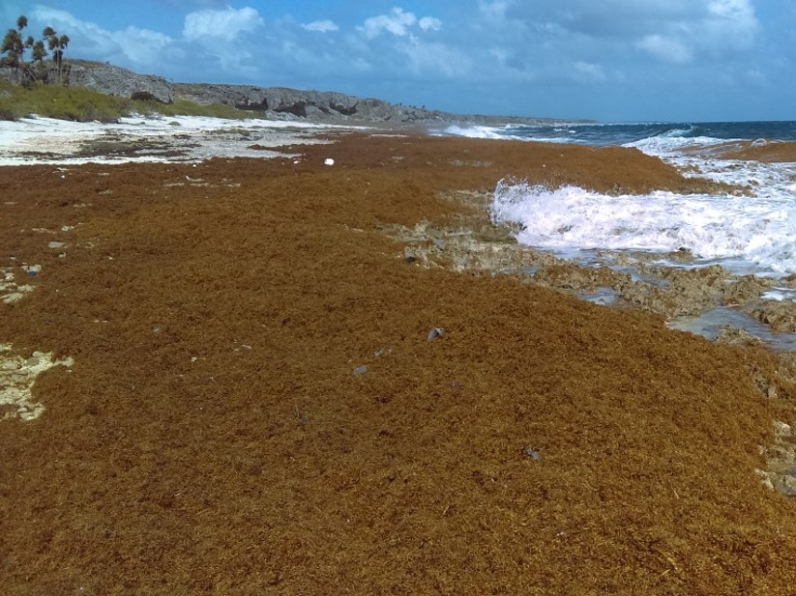
Proposal for a Cartagena Convention Established Working Group on Sargassum
UNEP(DEPI)/CAR IG.49/INF.14
Introduction

Slide 5
COP 18 may wish to:
Establish a Cartagena Convention-level Sargassum Working Group;
Request the Sargassum Working Group to support the implementation of the Sargassum Action Plan, ensuring alignment with activities under the SPAW & LBS Protocols;
Further requests the Sargassum Working Group to update the Sargassum White Paper, incorporating new data, best practices, & policy recommendations for consideration by the relevant STACs and COPs.
Request Parties to actively participate in discussions on the draft Sargassum Resolution submitted by Dominican Republic for UNEA 7 and consider co-sponsoring as appropriate.

Slide 6
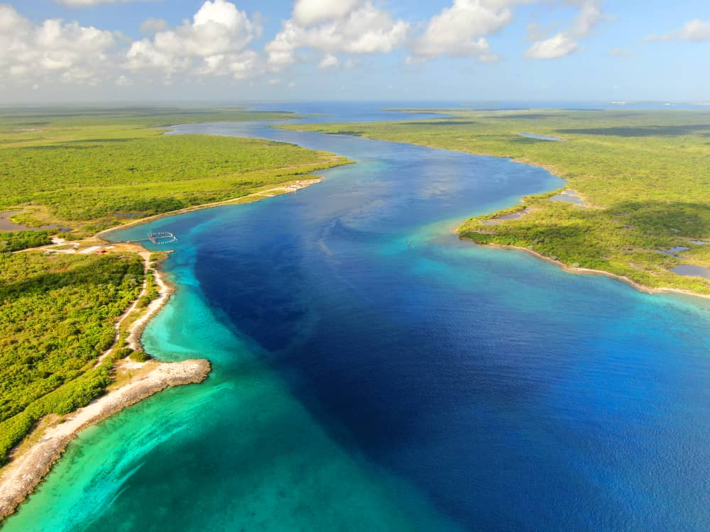




Thank you
United for a Resilient Caribbean Sea: Strengthening Cooperation, Action, and Impact
Photo courtesy of Noel Lopez & Freepiks
UNEP Cartagena Convention Secretariat and Caribbean Environment Programme
(876) 922-9267-9
unep-cartagenaconvention@un.org
www.unep.org/cep
@unep_cep

