Slide 1
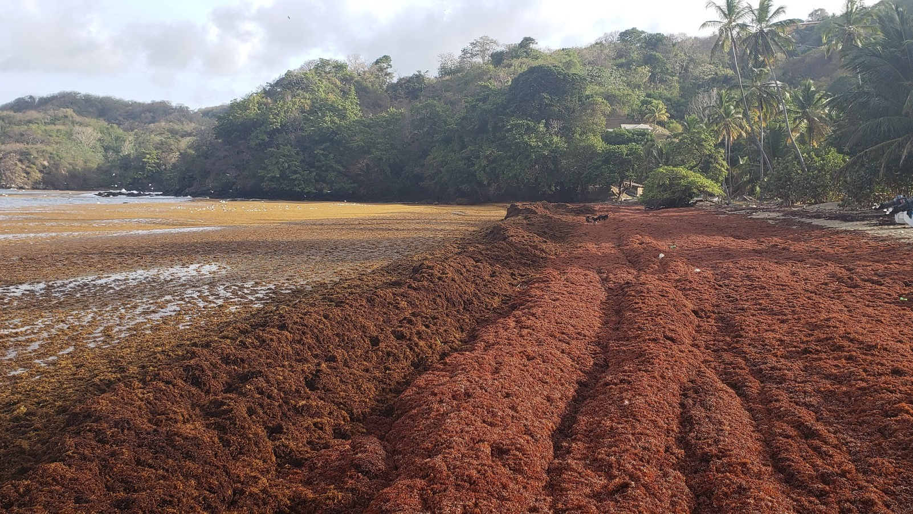
Improving National Sargassum Management Capacities in the Caribbean
The project aims to support the enhancement of national capacity to collect, remove and dispose of sargassum seaweed by providing equipment, expertise and technical knowledge to countries.
Beneficiaries: Barbados, St. Kitts and Nevis, St. Lucia, St. Vincent and the Grenadines, and Trinidad and Tobago.
Duration: 3 years (2022-2025)
Value: US$12,339,473.00
Trinidad and Tobago will benefit from an allocation of US$1.99 M, specifically for equipment.
Presented by: Rahanna Juman, Institute of Marine Affairs

Slide 2

Regional Project: Outputs and Activities
EXPECTED OUTPUTS | PLANNED ACTIVITIES
Output 1: Increased capacity of the Governments of participating countries to effectively remove, transport and dispose of sargassum invasions. (acquisition of equipment and machinery) | Activity 1.1: Procurement of equipment for the removal of sargassum in the nearshore for five countries.
 | Activity 1.2: Procurement of equipment for the removal of sargassum onshore (beach/coastline) for five countries.
Output 2: Enabled national environments for managing, protection, restoration and sustainable use of coastal and marine resources | Activity 2.1: Supporting scientific monitoring technologies such as UAS Drones to evaluate the quantity of sargassum influx on pilot sites.
 | Activity 2.2: Site-specific Sargassum Collection and Management Plans to minimise beach erosion and sea turtle nesting sites.
Output 3: Catalysing actions across all sectors for the movement, protection, storage and restoration of coastal and marine natural resources. | Activity 3.1: Technical expertise provided for training and capacity improvement for the transport and disposal of sargassum in five countries
 | Activity 3.2: Providing a platform for regional dialogue, communications, sharing experiences and lessons learnt.
 | Activity 3.3: Technical and Operational Support*

Slide 3
Equipment List for Participating Countries
EQUIPMENT TYPE
Nearshore Equipment | Floating Booms and Barriers / Running meter
 | Aquatic Conveyor Sargassum Harvester (with pumps)
 | Workboats
Onshore Equipment | Machine Surface Rakes
 | Lightweight Tractors (Medium)
 | Lightweight Tractors (Small)
 | Dump Trucks
 | Sargassum Conveyor On-Beach System
 | ATVs
 | Trailers for ATVs
 | PPE (Overalls, Masks, Gloves)
 | Handheld Hydrogen Sulphide (H2S) Monitors

Slide 4
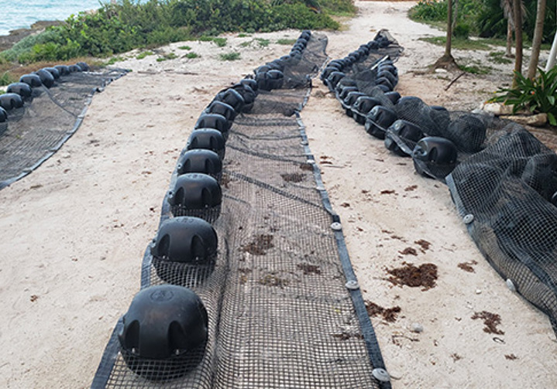
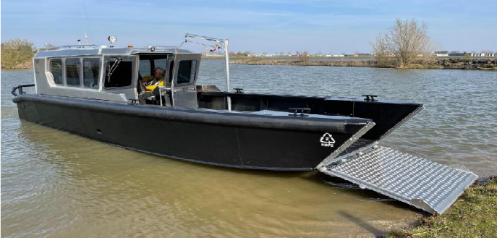
Equipment to be acquired
OFFSHORE
ONSHORE
Floating Booms and Barriers
Machine Surface Beach Rake
Walk-behind beach surface rake
Aquatic Conveyor Sargassum Harvester (in-water collection)
Lightweight tractor
Dump truck
Workboats/ barges/ water cranes (in-water removal)

Slide 5
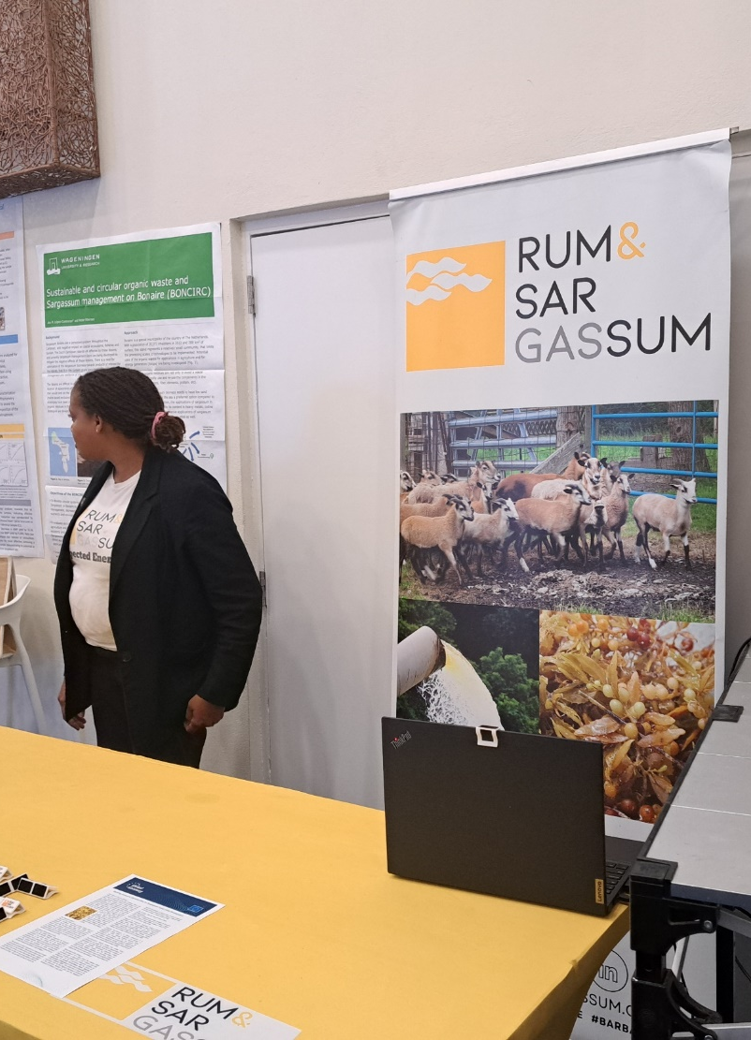
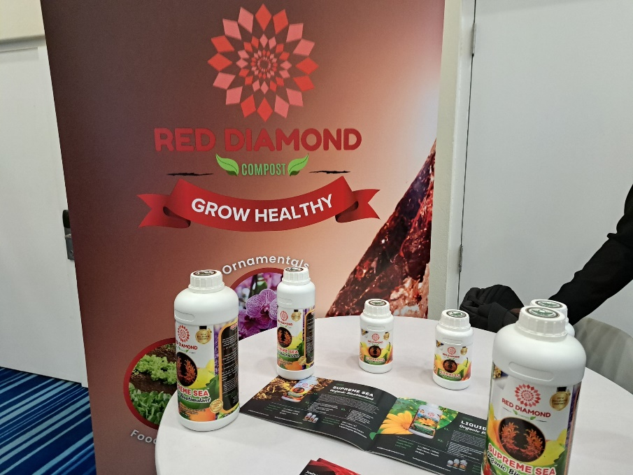
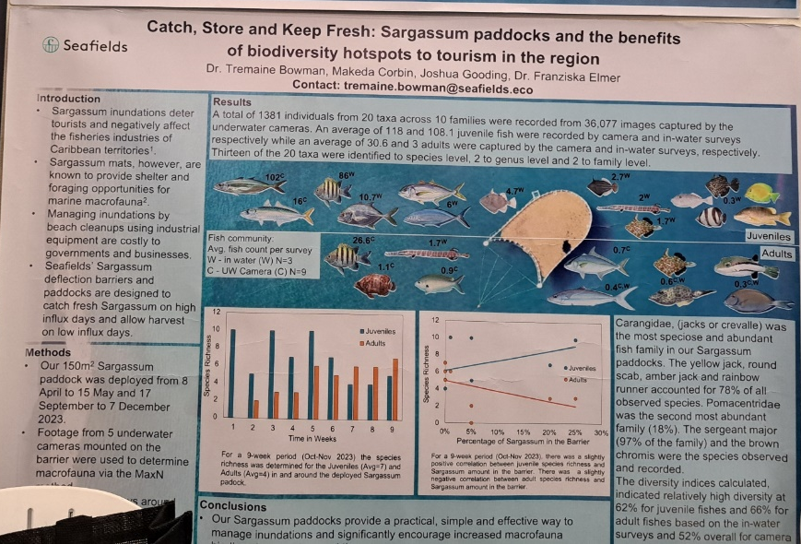
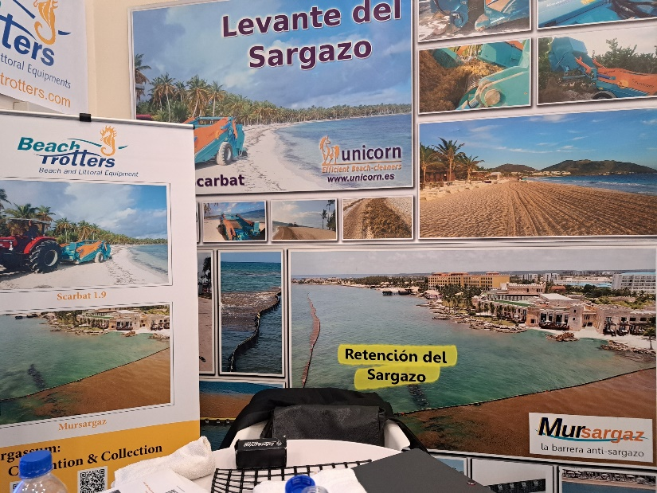
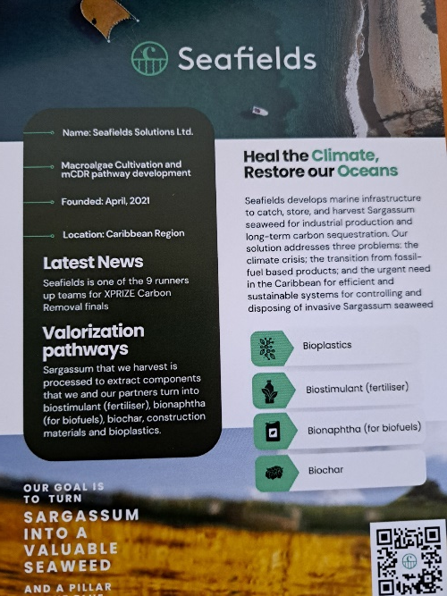
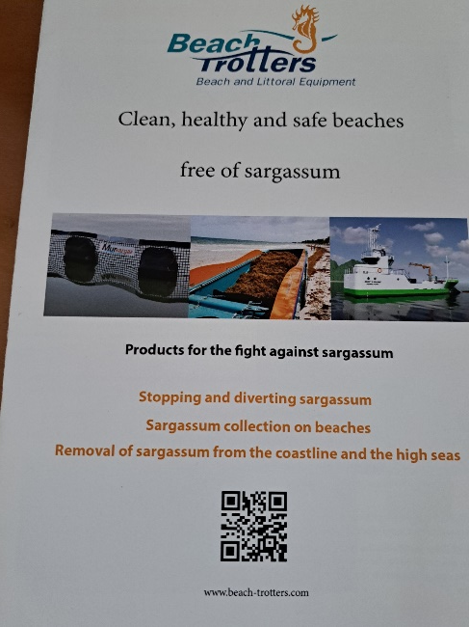
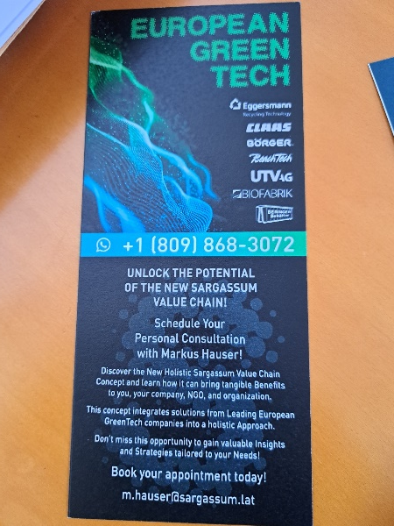
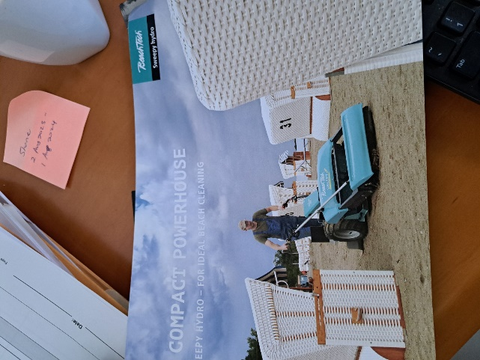

Second EU-Caribbean Global Gateway Conference on Sargassum- From Waste to Wealth!

Slide 7
Take away
Financial institution such as European Investment Banks, CAF, IDB, and World Bank are offering technical assistance, loans, grants, guarantee, equity investment and blended finance opportunity for sargassum investment.
  EIB will be launching Caribbean Green and Inclusive Facility to support national strategies to encourage sargassum investment
  World Bank-Pro Blue is a multi donor trust fund US $134 million
Many European based companies are developing products from sargassum such as bio-stimulants, emulsifiers, fucoidants, alginates, bio-leather, 3-D molded objects for counter tops, animal feed, bioplastic, and biogas
In the Caribbean there is a missing link from lab to market

Slide 8
Take away
There is still uncertainty regarding the continuous availability of sargassum
Sargassum in the open ocean provide habitats for fish, sequester carbon etc.
Only when it comes onshore, it is a problem
Need for monitoring sargassum influx and their impacts on marine ecosystems
Need for standardize response protocol – for collection, transport and disposal of sargassum
Need cohesive policies and legislations both nationally and regionally from collection- storage- valorization to commercialization
Public awareness and education is critical

Slide 9
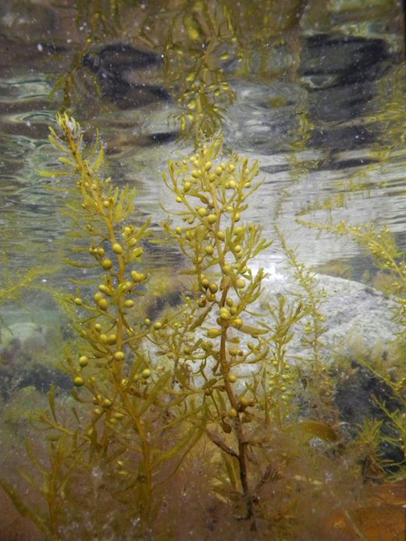
Thanks for your attention

