Slide 1
Agenda Item 5
REVIEW OF THE DRAFT WORKPLAN AND BUDGET OF THE SPAW SUBPROGRAMME FOR THE 2026-2027 BIENNIUM
UNEP(DEPI)/CAR WG.45/3 Rev.3
Photo courtesy of Noel Lopez
Susana Perera Valderrama
SPAW Programme Officer
Cartagena Convention Secretariat

Slide 2
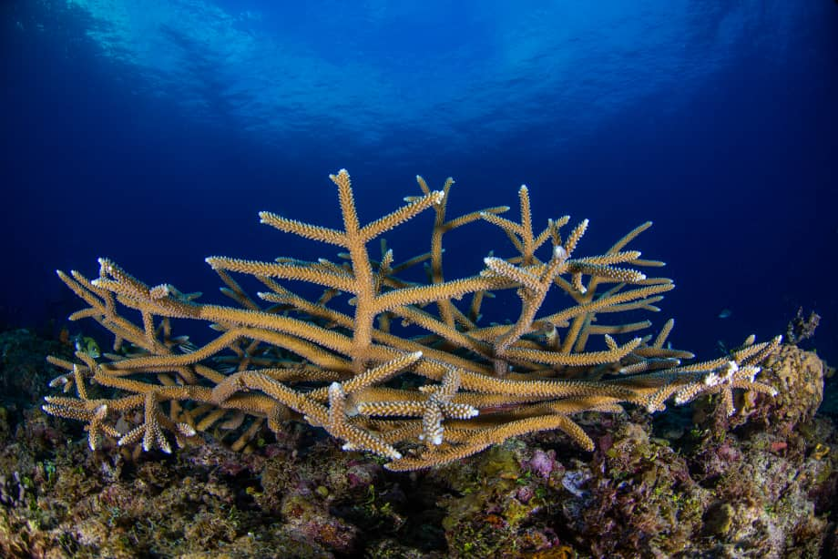
OBJECTIVES
SPAW Subprogramme
Expand and improve management of protected areas (PAs) in the Wider Caribbean.
Conserve threatened species and promote sustainable resource use.
Build regional capacity for information exchange, training, and technical support.
Coordinate with relevant international biodiversity treaties and initiatives.

Slide 3
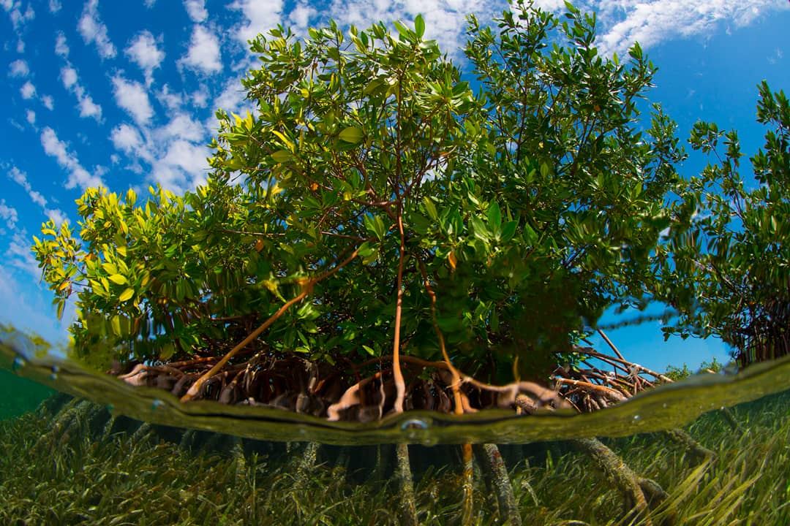
Objectives of the 2026-2027 SPAW WP
Continue and expand ongoing SPAW initiatives from the previous biennium.
Apply ecosystem-based management to protect critical coastal and marine services.
Support biodiversity conservation and sustainable use of marine resources.
Address sustainable development challenges through integrated, cross-sectoral action.

Slide 4
Work Plan Structure
FOUR THEMATIC AREAS
Programme Coordination and Strategic Partnerships
Strengthening Marine and Coastal Protected Areas
Conservation of Threatened and Endangered Species
Conservation, Restoration and Sustainable Use of Ecosystems
  For each: objectives, targets, activities, expected deliverables)
  Annexes: Projects, General Budget and Unfunded Activities

Slide 5
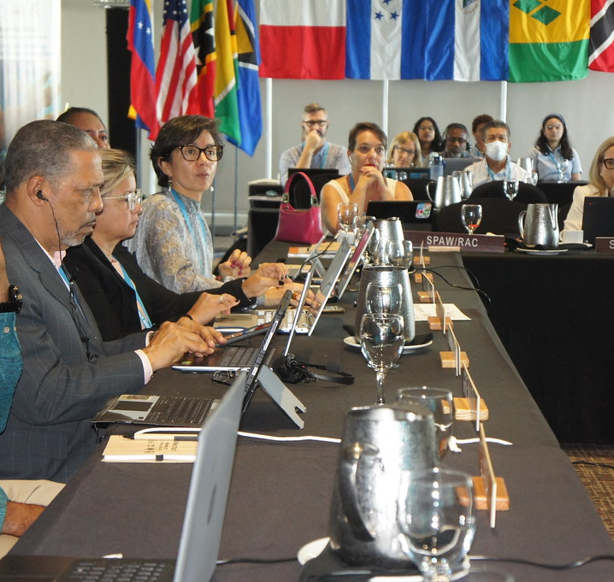
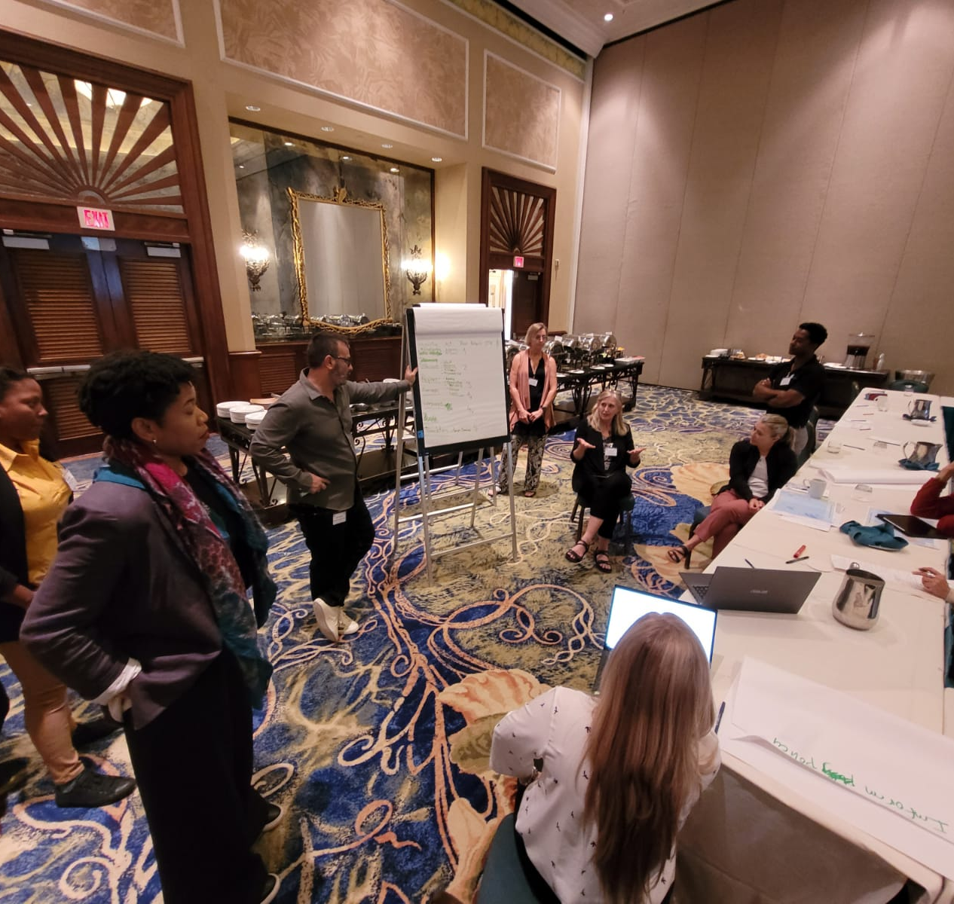
2.1. Programme Coordination and Partnerships
Key activities:
Outreach to promote ratification
Continue the implementation of the SPAW Protocol/Subprogramme, including the convening of the intergovernmental meetings for SPAW decision-making
Coordinate SPAW Working Groups (MPAs, Species, Sargassum, Exemptions)
Increase visibility of SPAW in regional policy spaces
Initiate the process for the potential development of SPAW compliance mechanism
Support (upon request) NBSAP updates aligned with the GBF/SPAW

Slide 6
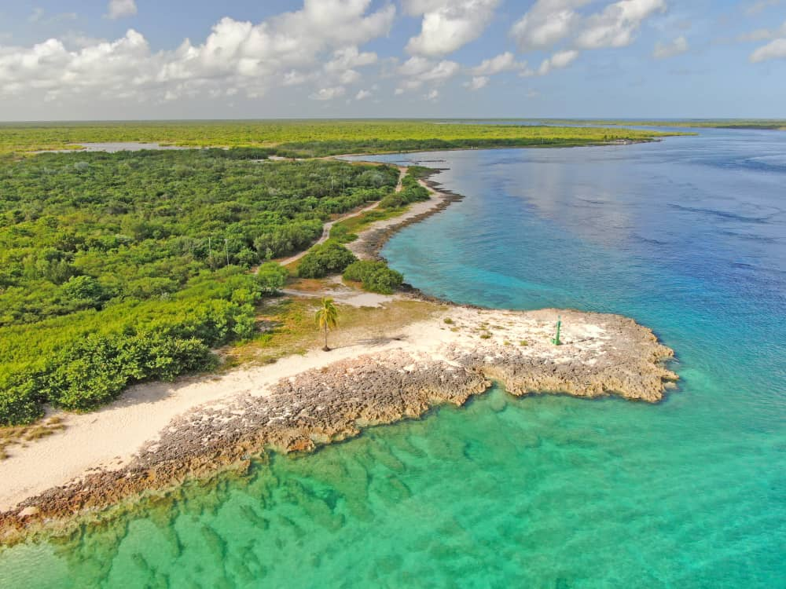
2.1. Programme Coordination and Partnerships
Key activities:
Ensure timely and coordinated project development and implementation:
  PROCARIBE+
  GoM LME
  CAMAC
  SARGCOOP
  SPAW Small Grants Programme - Subject to the availability of funding
  Regional support program for SPAW-listed protected area managers' network in the Wider Caribbean Region - Subject to the availability of funding
  Blue Growth through Green Restoration
  New project opportunities (GEF/GBFF)

Slide 7
2.1. Programme Coordination and Partnerships
Key activities:
Provide technical assistance and guidance to Contracting Parties for implementing the Cartagena Convention and the SPAW Protocol.
Undertake periodic reviews of bilateral cooperation with partner organizations to ensure alignment with SPAW’s mandate and enhance synergies supporting Protocol implementation.
Facilitate reporting on marine ecosystems targets and indicators.
Support Contracting Parties in integrating marine biodiversity and ecosystem services into national Blue Economy and ocean-based strategies.
Facilitate cooperation with relevant projects and mechanisms relating to marine biodiversity.
Strengthen collaboration with civil society organizations, particularly through the SPAW Consortium

Slide 8
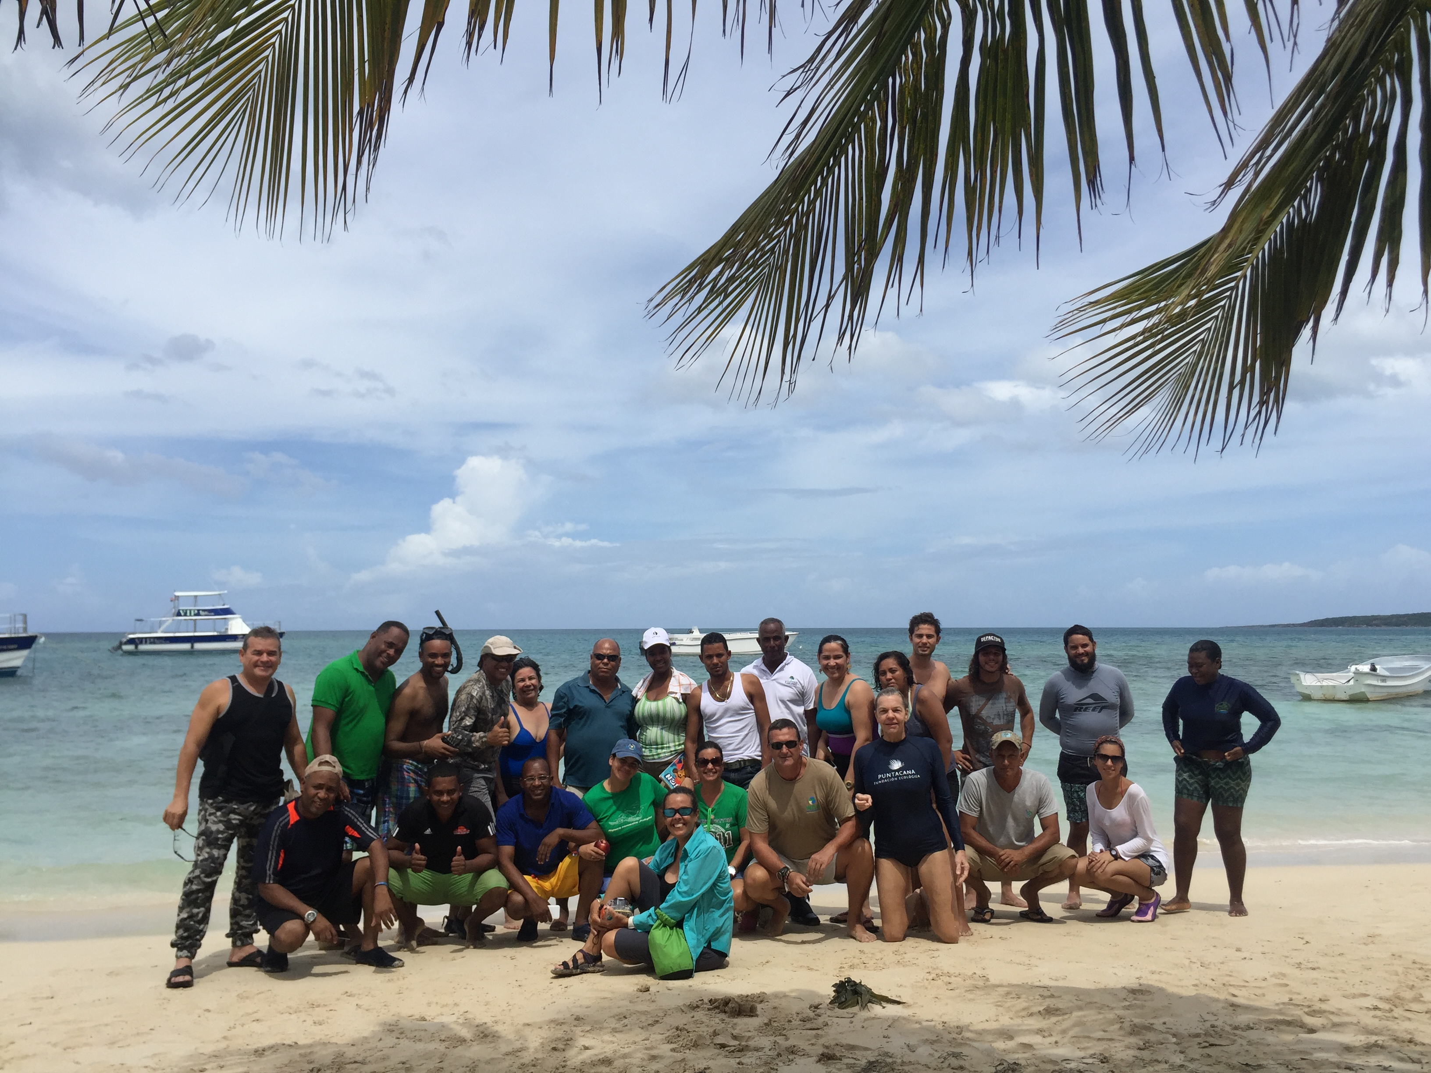
2.2. Strengthening of PAs
Key activities:
Support the operationalization of the SPAW-listed Protected Area Managers Network.
Deliver capacity building on MPA management through the CaMPAM Training of Trainers (ToT) programme.
Support the establishment and strengthening of PAs and OECMs with national and local partners.
Strengthen environmental monitoring and coral reef management within MPAs.
Support national implementation of the SPAW Protocol at the local level.
Enhance synergies and joint initiatives with Caribbean and global PA networks.
Promote sustainable tourism practices to strengthen PA management and encourage sustainable use of coastal and marine ecosystems.
Strengthen initiatives on MPAs and OECMs, including transboundary areas in the Caribbean Biological Corridor (CBC).

Slide 9
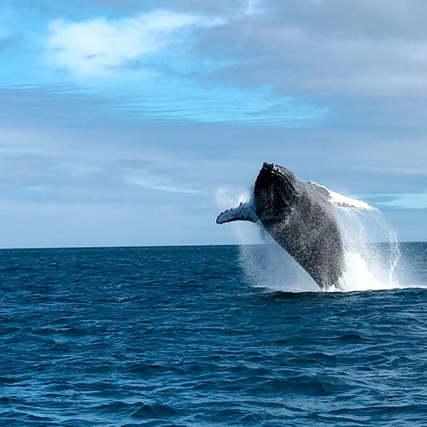
2.3. Conservation of Species
Key activities:
Support the conservation of marine megafauna
Support national implementation of the SPAW Protocol (species monitoring and conservation activities).
Communication and information on species listed in SPAW Annexes of the SPAW protocol.
Promote regional collaboration for the protection of manatee populations.
Strengthening initiatives on megafauna conservation in the region of the Caribbean Biological Corridor (CBC).

Slide 10
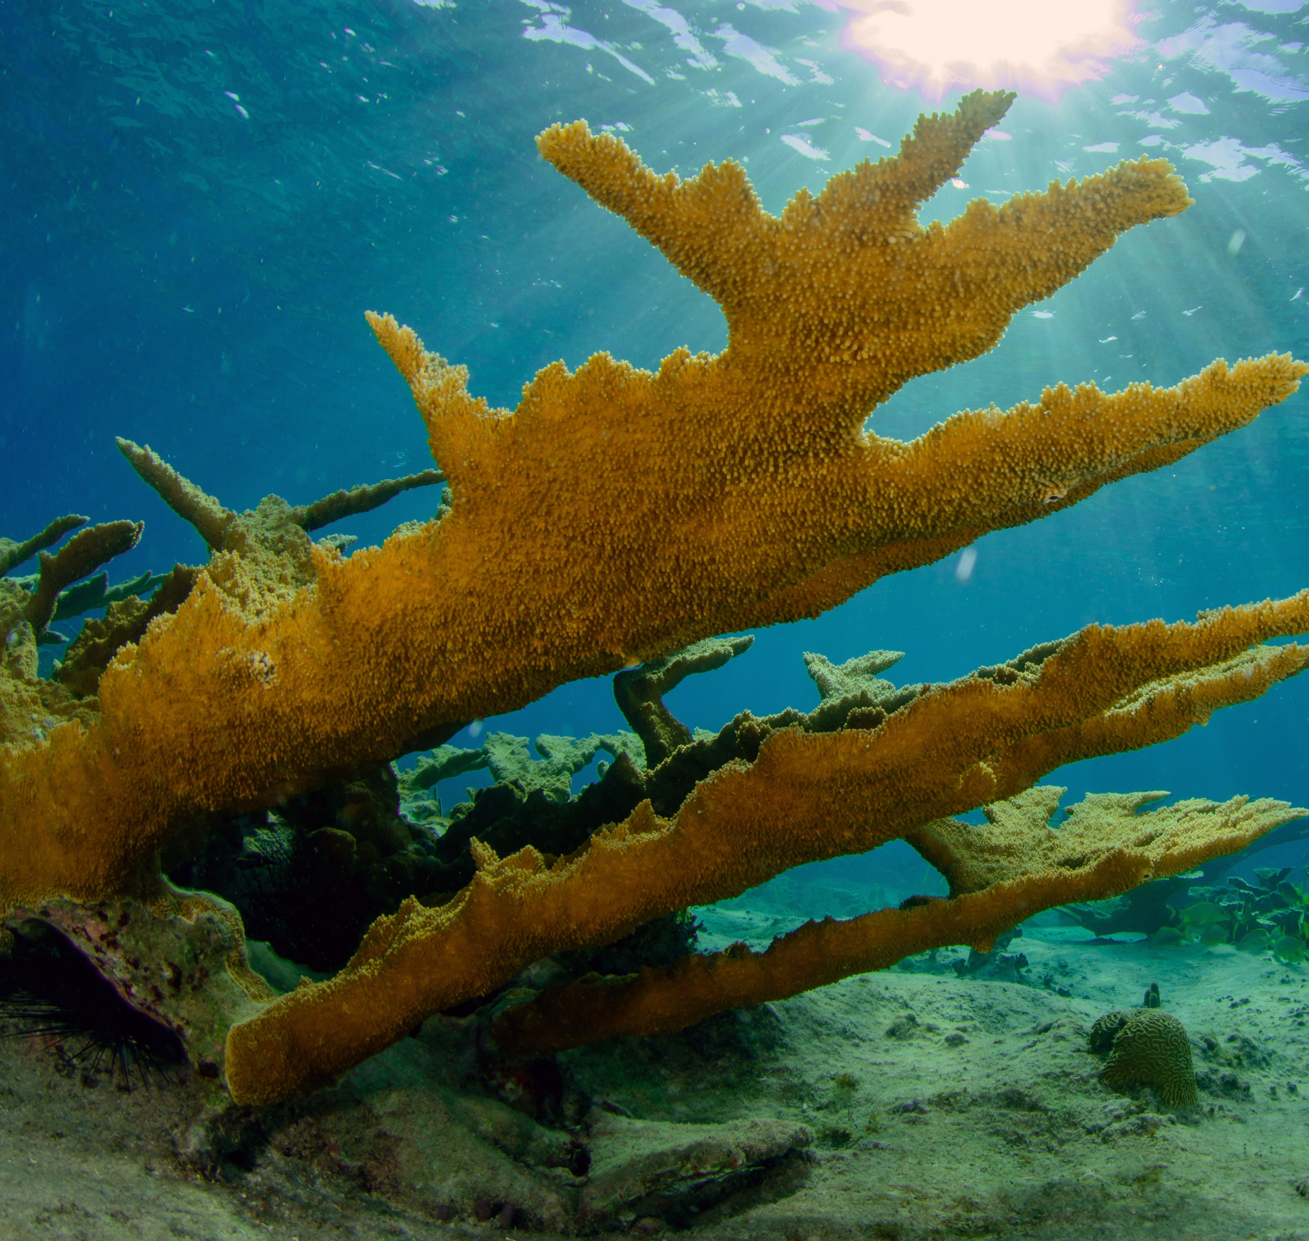
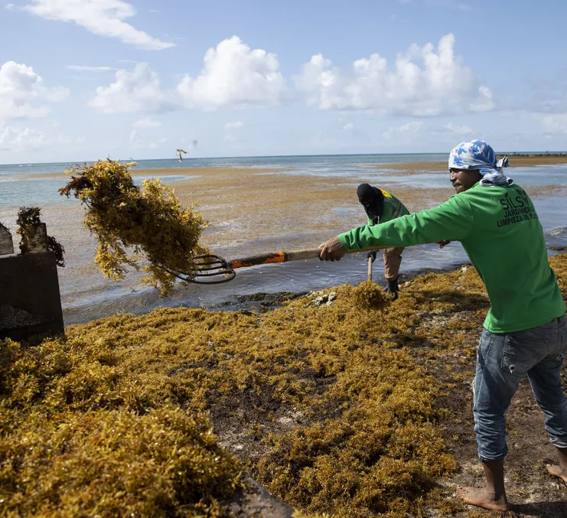
2.4. Conservation, Restoration and Sustainable Use of Ecosystems
Key activities:
Co-chair the GCRMN Caribbean node and advance coral reef conservation efforts.
Enhance understanding and awareness on Sargassum’s ecological impacts, and promote best management practices regionally.
Enhance coral reef conservation and resilience in the GOM-LME project area.
Support the sustainable use and conservation of mangroves, seagrasses, and other coastal ecosystems to enhance ecological resilience and long-term environmental benefits.
Contribute to the development and facilitate expert review of a Red List of Ecosystems (RLE) assessment for Caribbean coral reefs.

Slide 11
GENERAL BUDGET
Activity | 2026 |  |  | 2027 |  |  | Total
 | CTF | Other Contributions | Total cost | CTF | Other Contributions | Total Cost
Programme Coordination and Strategic Partnership | 250,860.00 | 456,500 | 707,360.00 | 330,516.00 | 524,300.00 | 854,816.00 | 1,562,176.00
Strengthening Marine Protected Areas in the WCR | - | 410,348.50 | 410,348.50 | - | 45,333.34 | 45,333.34 | 455,681.84
Conservation of Threatened and Endangered Species | - | 260,260.00 | 260,260.00 | - | 202,441.80 | 202,441.80 | 462,701.80
Conservation, Restoration and Sustainable Use of Coastal and Marine Ecosystems | - | 491,760.54 | 491,760.54 | - | 489,084.40 | 489,084.40 | 980,844.94
TOTAL (USD) | 250,860.00 | 1,618,869.04 | 1,869,729.04 | 330,516.00 | 1,261,159.54 | 1,591,675.54 | 3,461,404.58

Slide 12

SPAW 2026-2027 WORKPLAN
The COP may wish to:
Consider endorsing the SPAW Workplan for 2026–2027 to guide implementation of the Protocol’s priorities;

Slide 13
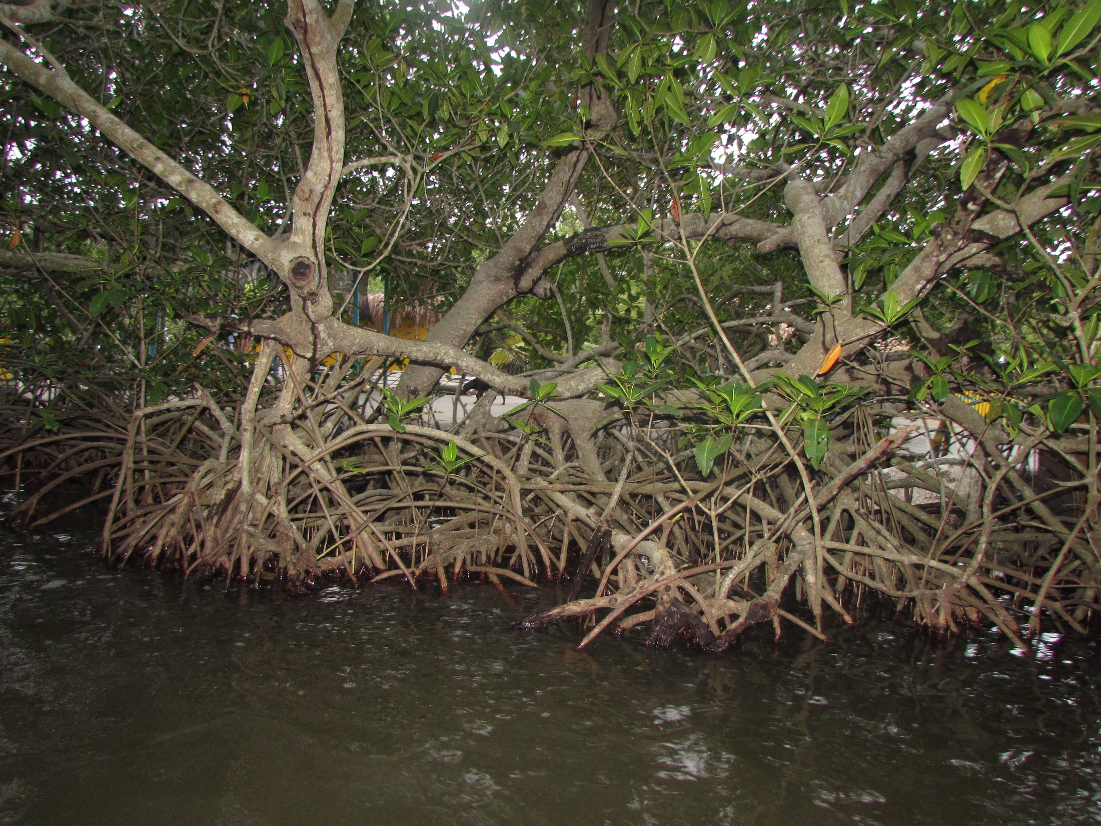




Thank You
UNEP Cartagena Convention Secretariat and Caribbean Environment Programme
(876) 922-9267-9
unep-cartagenaconvention@un.org
www.unep.org/cep
@unep_cep

