Slide 1
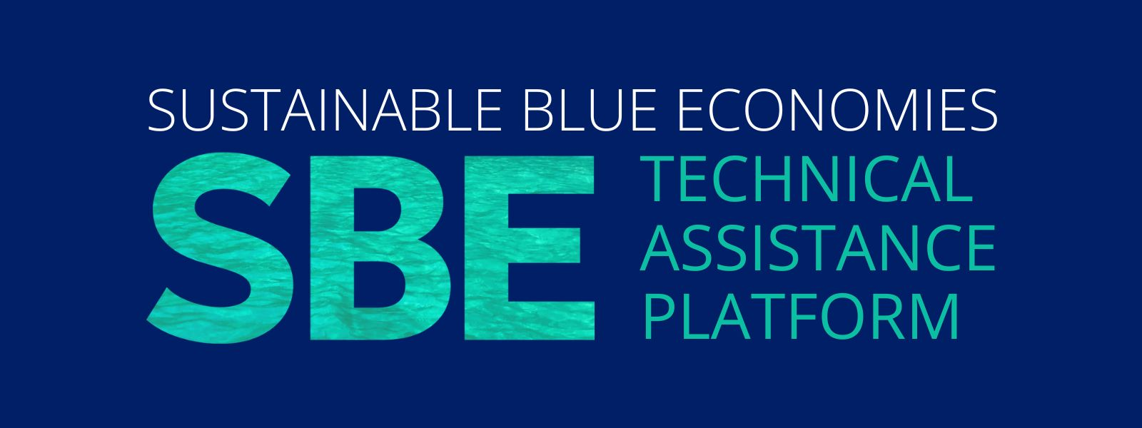


Dr Cristina Vina-Herbon - Cristina.Herbon@jncc.gov.uk
Dr Joe Kenworthy - Joe.Kenworthy@jncc.gov.uk

Slide 2
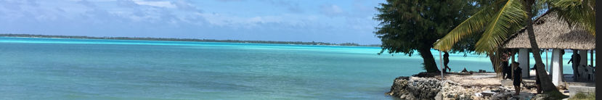
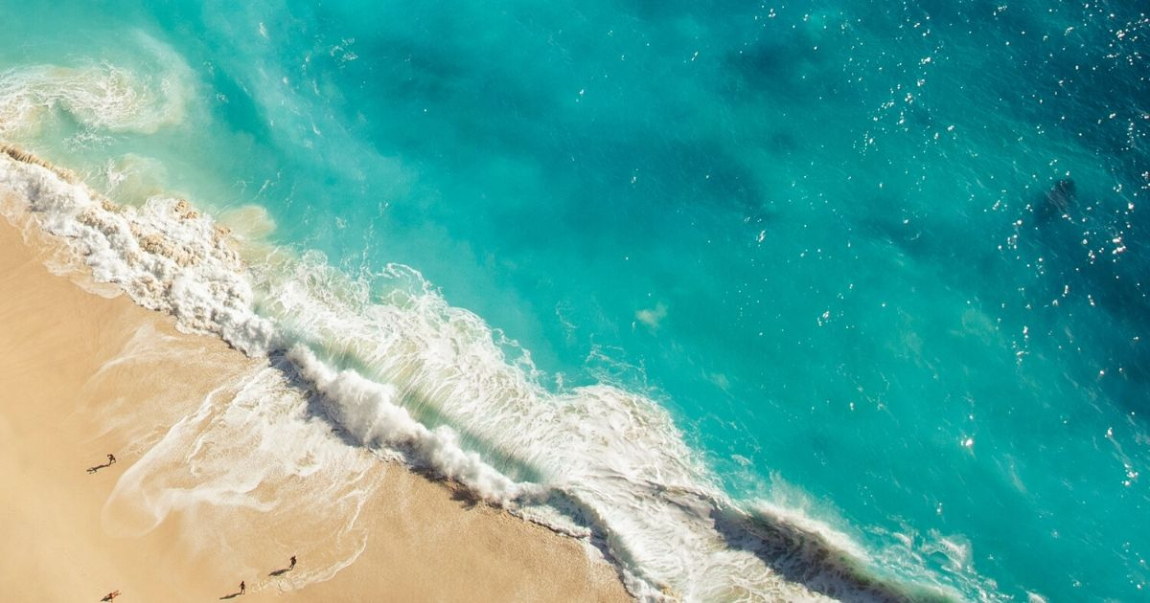
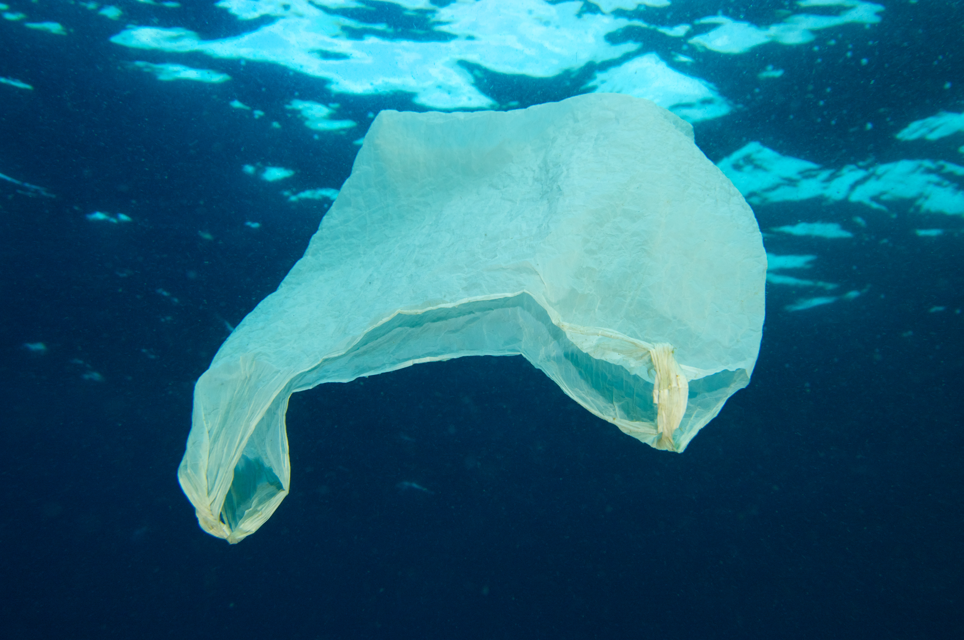
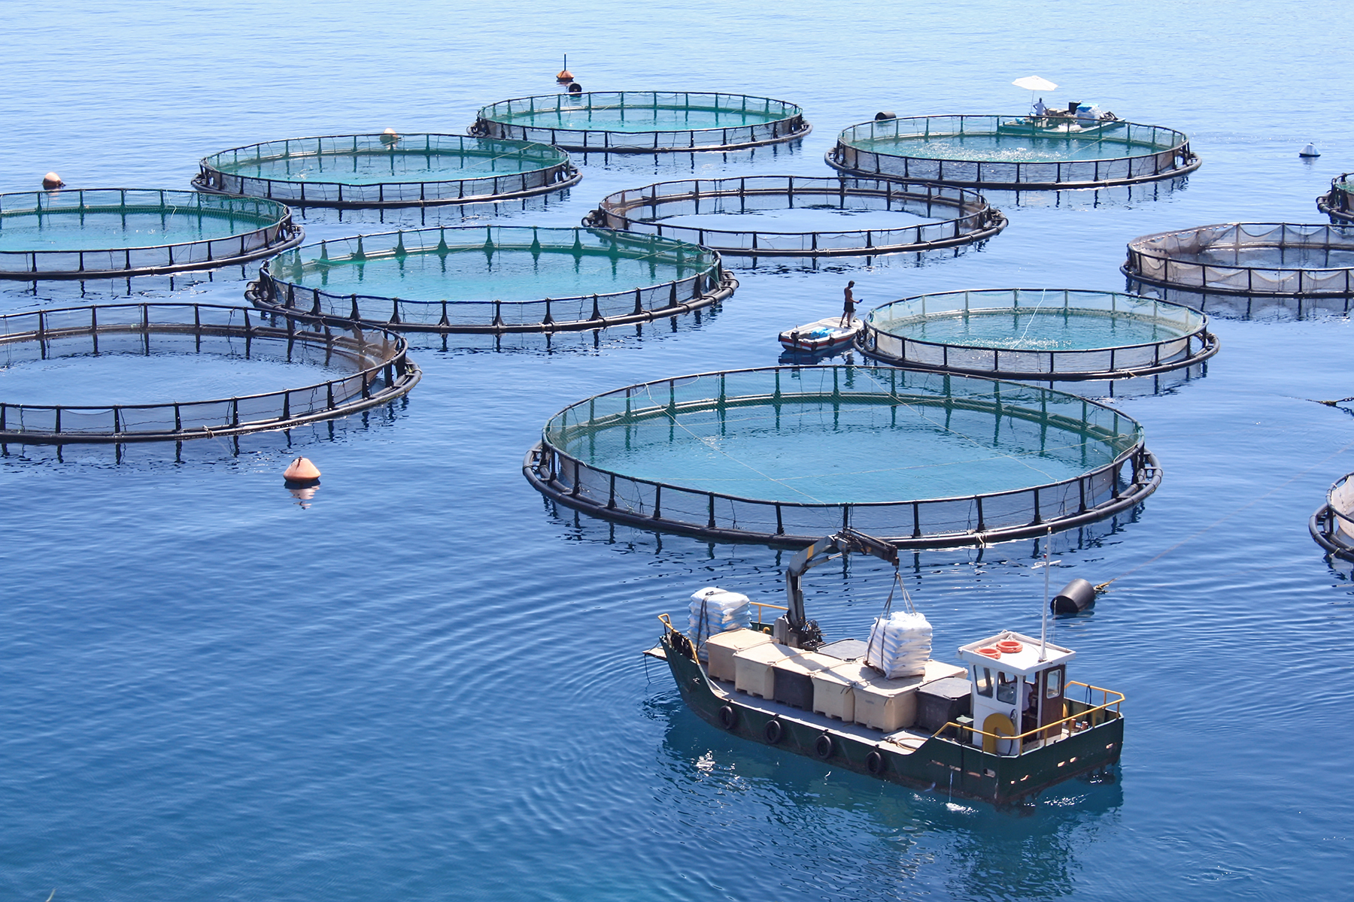
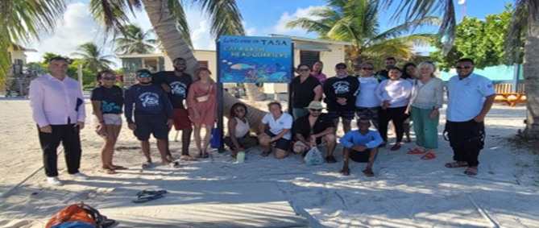
Joint Nature Conservation Committee (JNCC)
Who we are
The way we work
We are the only statutory nature advisor to all four countries of the UK.
For over 30 years our trusted expertise, dedication and skills have underpinned nature conservation and recovery.
We know that a thriving natural world is essential for humanity’s prosperity and wellbeing.
We work with partners throughout the UK, the UK Overseas Territories, and internationally.
Support implementation of biodiversity and marine international conventions, e.g. Convention on Biological Diversity and the OSPAR Regional Sea Convention
Implemented international projects in the Caribbean e.g. Belize Blue Bond commitments to Green List 3 MPAs by 2027.
We bring stakeholders together to drive innovative action in the interests of local and global nature conservation and recovery.
Sustainable Blue Economies Technical Assistance Platform

Slide 3
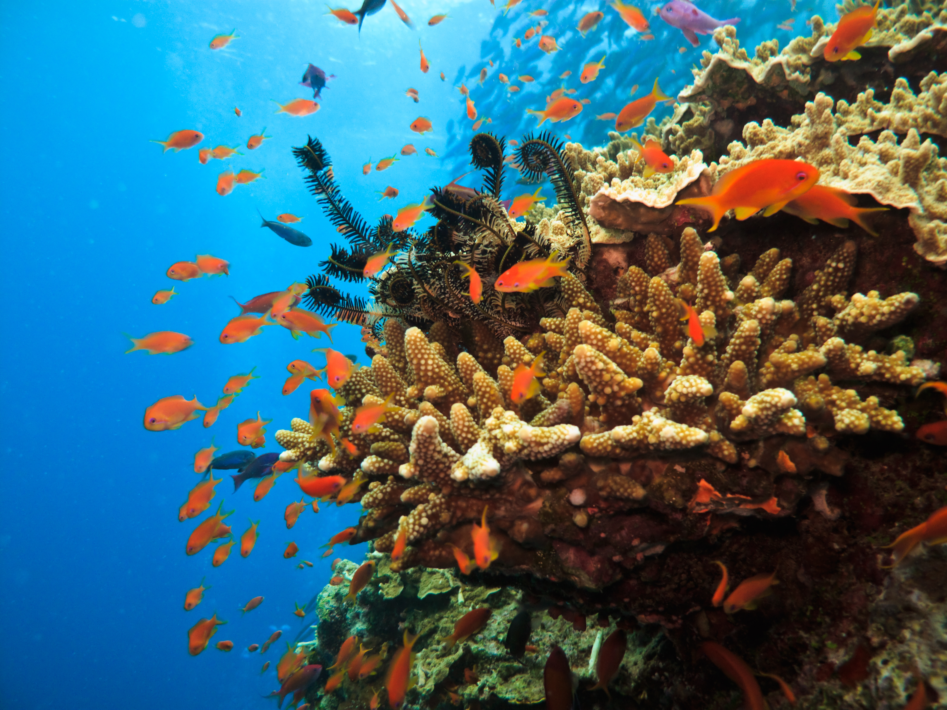
Sustainable Blue Economies
Technical Assistance Platform
Partnering with Small Island Developing States (SIDS) to co-develop the science, knowledge, tools and capability for equitable, climate resilient, sustainable blue economies.
SIDS are building their capacity and implementing actions so the 65 million people who live on these islands equitably benefit from their marine resources and are protected from human and environmental risks.
The UK is committed to partnering with the SIDS to achieve this goal.
JNCC is a partner under the SBE Technical Assistance Platform, providing specialist assistance on marine science, conservation and management.
Other SBE projects: https://sbe-platform.org.uk/projects
Sustainable Blue Economies Technical Assistance Platform

Slide 4
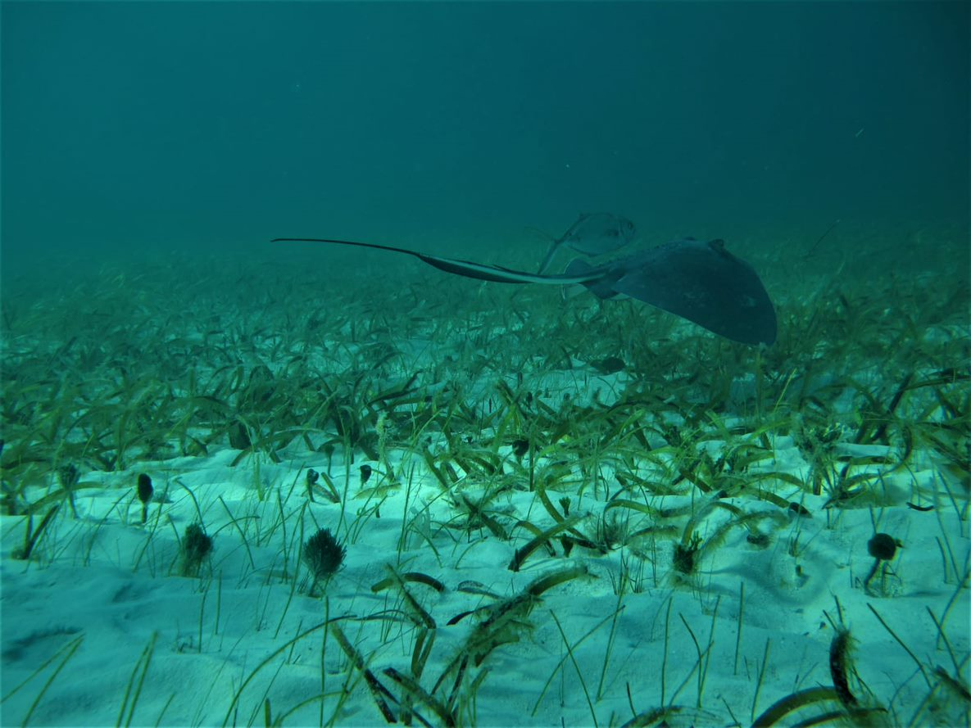
Blue Growth through Green Restoration: Cartagena Regional Seas Convention’s Capacity Building on Seagrass Ecosystems
Partners: JNCC and UNEP Cartagena Convention Secretariat
Six months project (end March 2026)
Aims to enhance technical capability, regional cooperation and knowledge sharing in restoration efforts on seagrass beds and its contributions to sustainable blue economies and local livelihoods.
Aligns with SIDS strategies and plans related to the restoration of degraded ecosystems as a key priority for ecosystem and economic resilience
Support workplans for the Cartagena Convention and implementation of the SPAW Protocol
Sustainable Blue Economies Technical Assistance Platform

Slide 5
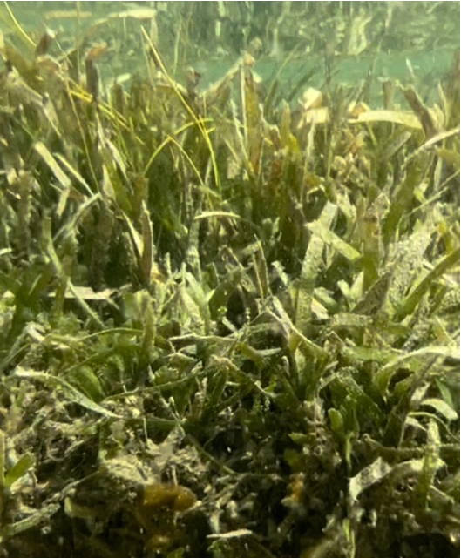
Blue Growth through Green Restoration: Cartagena Regional Seas Convention’s Capacity Building on Seagrass Ecosystems
Outputs
Development of Regional Guidance on seagrass beds restoration, including evidence on ecosystem services provided by restored habitats (blue carbon) and opportunities for economic benefits of restoration (e.g. carbon markets)
Technical advice on the approach, assess the effectiveness and monitor success of restoration projects
Case study exploring the integration of restoration in decision making, planning and local community engagement
Regional Workshops: Platforms to share the developed guidance and tools, present case studies, and foster regional dialogue and capacity building
Sustainable Blue Economies Technical Assistance Platform

Slide 6
Blue Growth through Green Restoration: Cartagena Regional Seas Convention’s Capacity Building on Seagrass Ecosystems
Approach
Expert consultation with SPAW Focal Points and managers to gather evidence and views
Combination of desk-based research, expert interviews and stakeholder engagement
Evidence on drivers of degradation, active and passive seagrass restoration techniques, limitations and challenges (success and failures)
Opportunities and barriers for voluntary carbon markets
Dissemination of information via communication plans, training and workshops
Sustainable Blue Economies Technical Assistance Platform

Slide 7
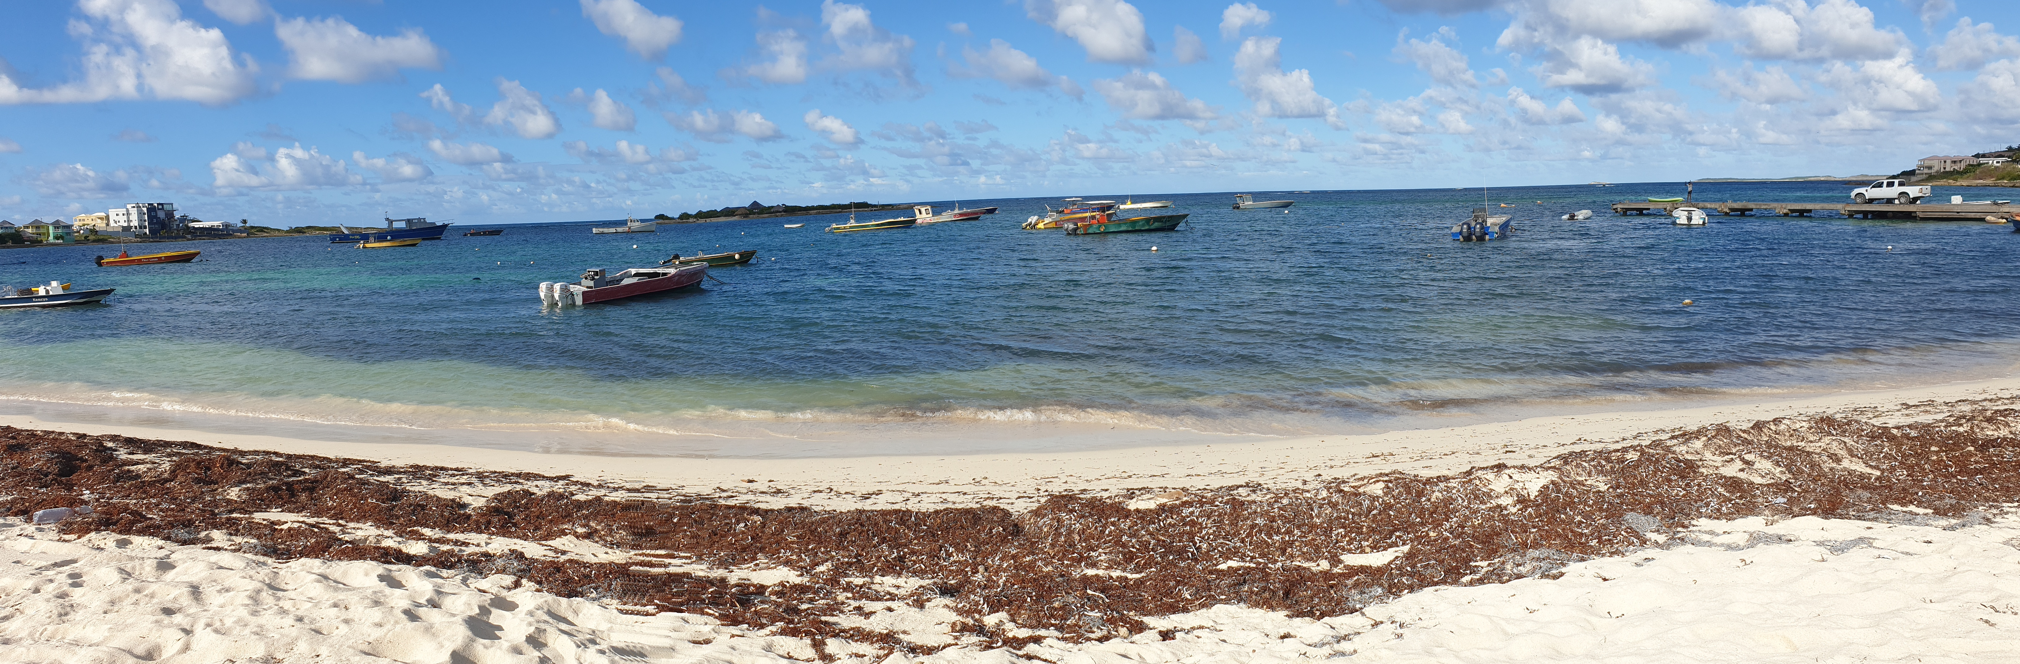

Blue Growth through Green Restoration: Cartagena Regional Seas Convention’s Capacity Building on Seagrass Ecosystems
Questions for you
Views on the approach
Support the evidence collection of the project
Encourage the participation and contribution of relevant national experts
Sustainable Blue Economies Technical Assistance Platform

Slide 8
Any questions?
Cristina.Herbon@jncc.gov.uk
Joe.Kenworthy@jncc.gov.uk

