Slide 1
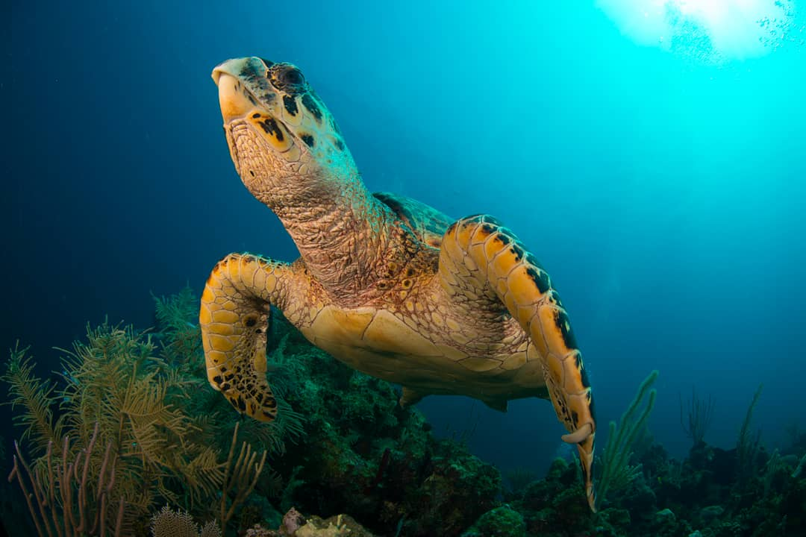



STATUS REPORT 2023-2024 (2025)
SPECIALLY PROTECTED AREAS AND WILDLIFE (SPAW) PROTOCOL
11th meeting of the Scientific and Technical Advisory Committee (STAC)

Slide 2

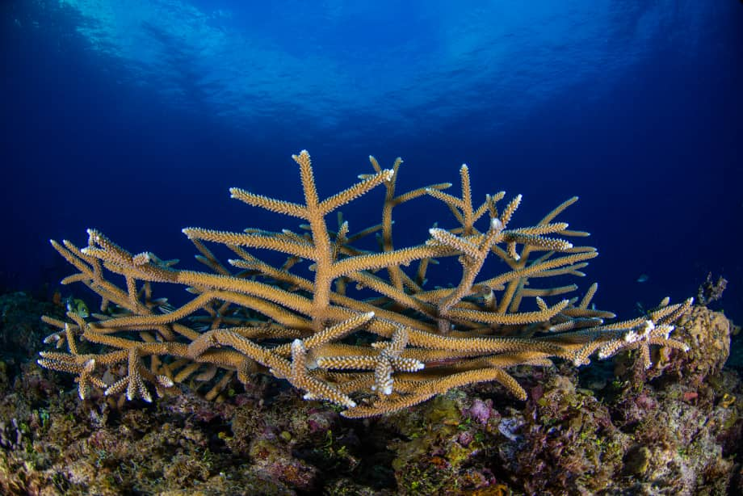
1. INTRODUCTION
SPAW Protocol entered into force: 18 June 2000 (25th Anniversary)
19 Contracting Parties (latest: Saint Kitts and Nevis in 2024).
SPAW Workplan and Budget for 2023–2024 approved by SPAW COP12 and IGM20/Cartagena Convention COP17, in October 2023.
Biennium extended through 2025.
Discussions on SPAW Protocol ratification ongoing with nine non-contracting parties

Slide 3
Expand and improve management of protected areas (PAs) in the Wider Caribbean.
OBJECTIVES
Conserve threatened species and promote sustainable resource use.
Build regional capacity for information exchange, training, and technical support.
SPAW Subprogramme
Coordinate with relevant international biodiversity treaties and initiatives.

Slide 4
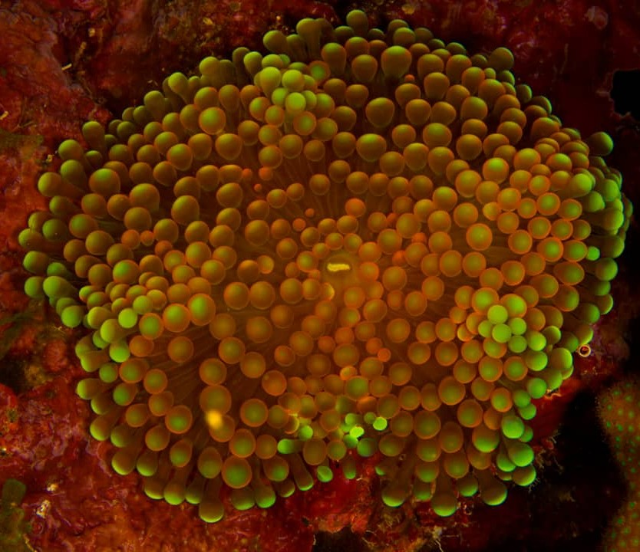
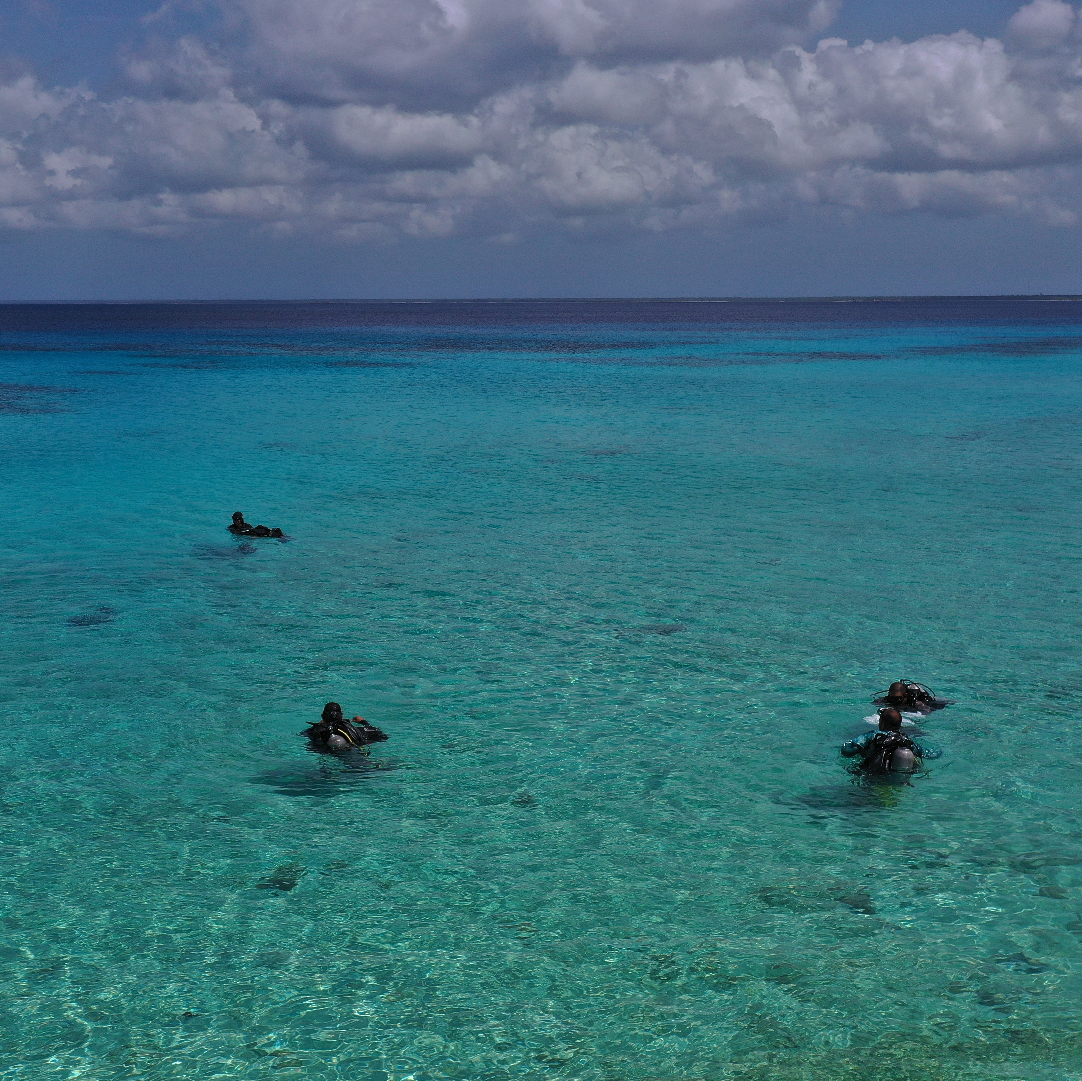
2023-2024 WP Structure
FIVE THEMATIC AREAS
Programme Coordination
Strengthening of PAs
Guidelines for PAs and Species Management
Conservation of Threatened and Endangered Species
Conservation and Sustainable Use of Coastal and Marine Ecosystems using the EBM approach
Annexes (General Budget, Projects, Unfunded Activities

Slide 5
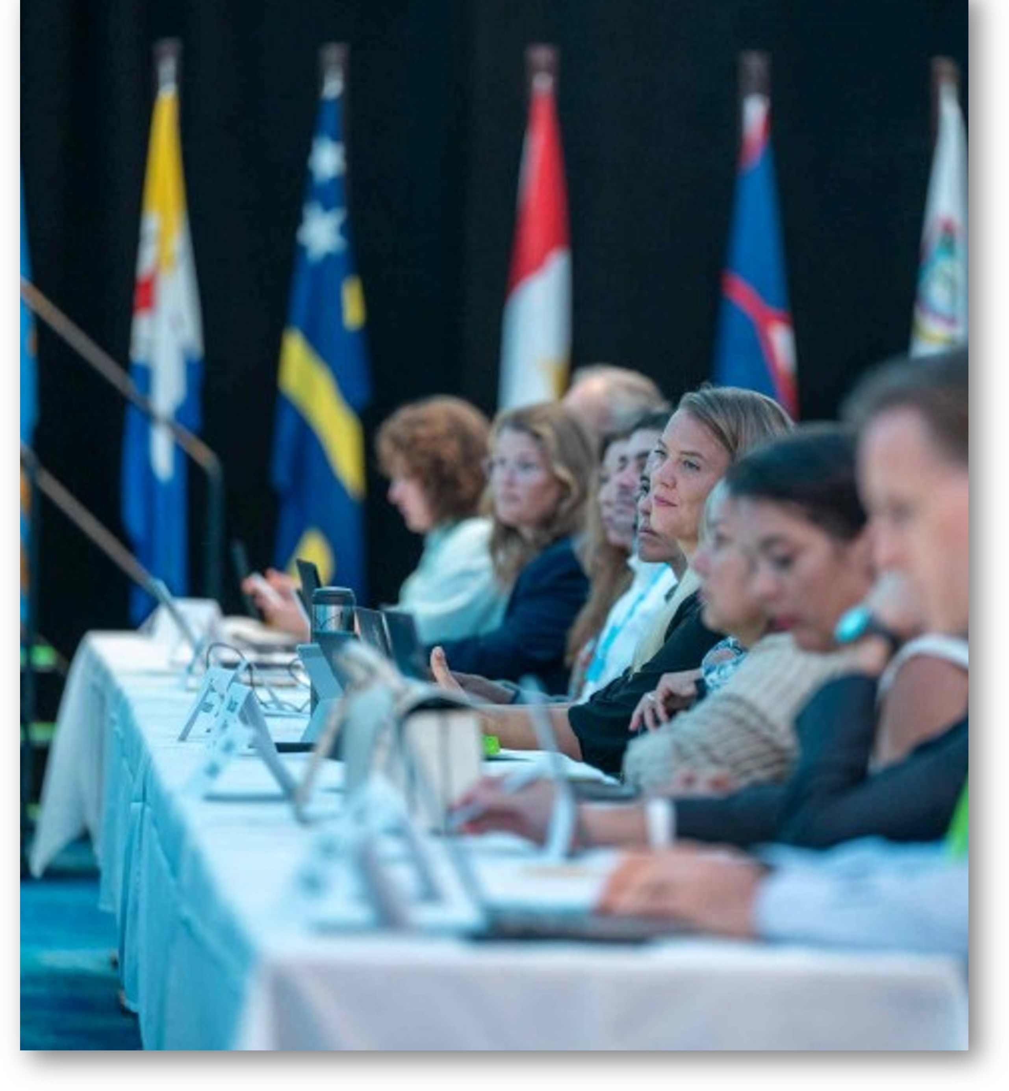
2.1. programme coordination
OBJECTIVES
Promote ratification and effective implementation of the SPAW Protocol.
Align programme activities with SPAW objectives and Contracting Parties’ needs.
Strengthen collaboration with relevant agreements and organizations.
Improve regional coordination on PAs and wildlife.
Oversee daily operations and coordination of SPAW projects and activities.

Slide 6
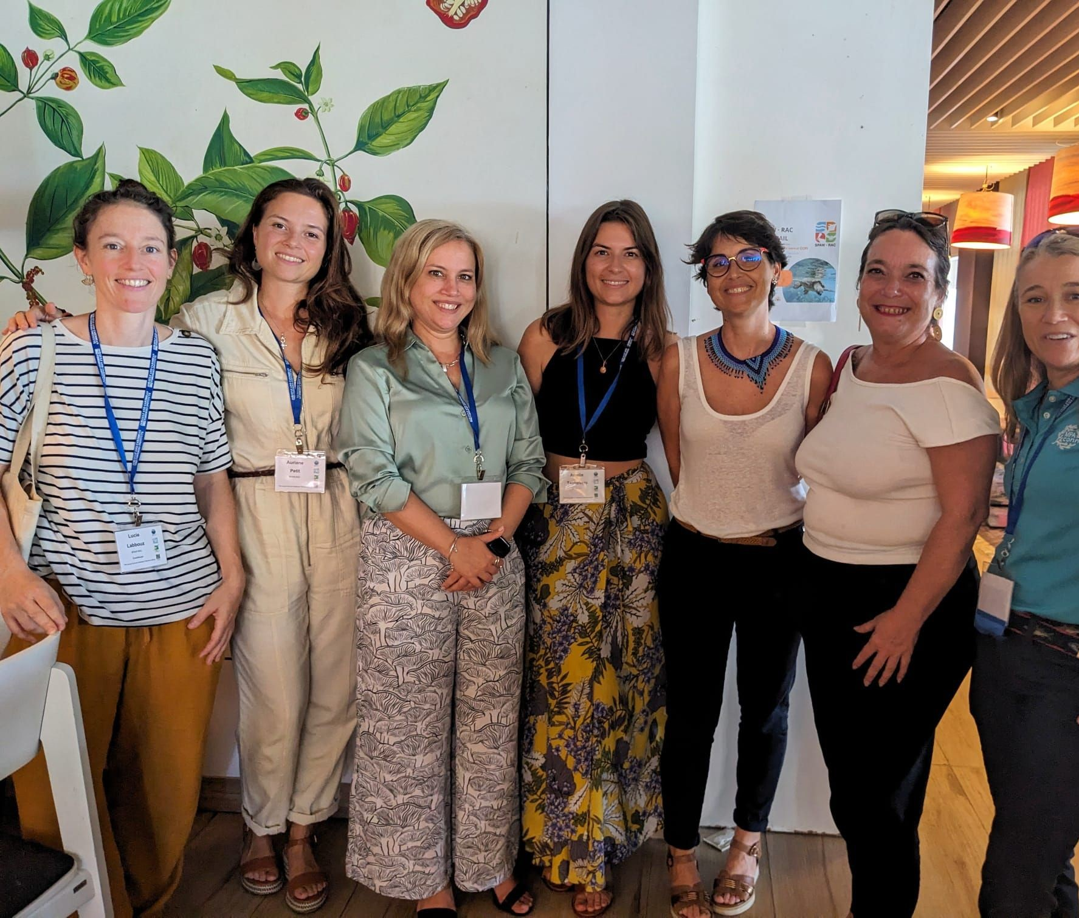

2.1. programme coordination
SPAW PERSONNEL
UNEP Cartagena Convention Secretariat based in Kingston, Jamaica
SPAW Programme Officer (Onboarded in June 2023) and SPAW Programme Assistant
JPOs, UNVs, and interns (when available).
SPAW-RAC based in Guadeloupe and funded by the Government of France.
Core team (Director, Deputy, Coordinator, Assistant)
Project staff funded through EU, France, and UNEP.

Slide 7

2.1. programme coordination
KEY ACTIVITIES
Continued implementation of major projects:
  ACP MEAs Phase III (USD 1.96M) – extended to Dec 2025
  GoM LME Project (USD 382K) – Aug 2024 to Dec 2025
  PROCARIBE+ (USD 957K) – Jan 2025 to Sep 2027
Maintained partnership with several global/regional/national organizations, including relevant MEAs.
Strengthened civil society engagement through the SPAW Consortium
LoI with IAC and the IWC, MOU with the OCM

Slide 8
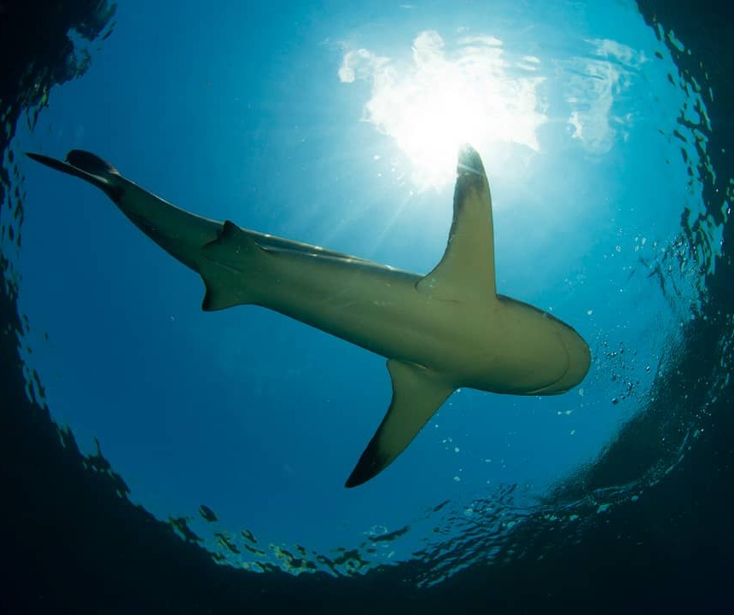
2.1. programme coordination
KEY ACTIVITIES
Strengthened collaboration with AMEP, including joint SPAW–AMEP Sargassum/Monitoring WG meeting (Trinidad and Tobago, March 2025).
Supported BBNJ ratification through outreach and regional events linking SPAW and BBNJ.
Developed multifocal project proposals integrating biodiversity, climate, and socio-economic goals; secured funds from UNEP HQ.

Slide 9
2.1. programme coordination
EXPENDITURE
Activity | 2023 Budgeted |  |  | 2024 (2025) Budgeted |  |  | Total
 | CTF | Other Contributions | Total cost | CTF | Other Contributions | Total Cost
Salary of Programme Officer/ Assistant (SMs) and other supporting costs | 240,800.00 | 0.00 | 240,800.00 | 383,400.00 | 0.00 | 383,400.00 | 624,200.00
COP12 and STAC10 meeting preparations¹ | 0.00 | 218,365.00 | 218,365.00 | 0.00 | 0.00 | 0.00 | 218,365.00
TOTAL (USD) | 240,800.00 | 218,365.00 | 459,165.00 | 383,400.00 | 0.00 | 383,400.00 | 842,565.00
1) Includes support for SPAW COP12 provided by the Government of the Kingdom of the Netherlands

Slide 10
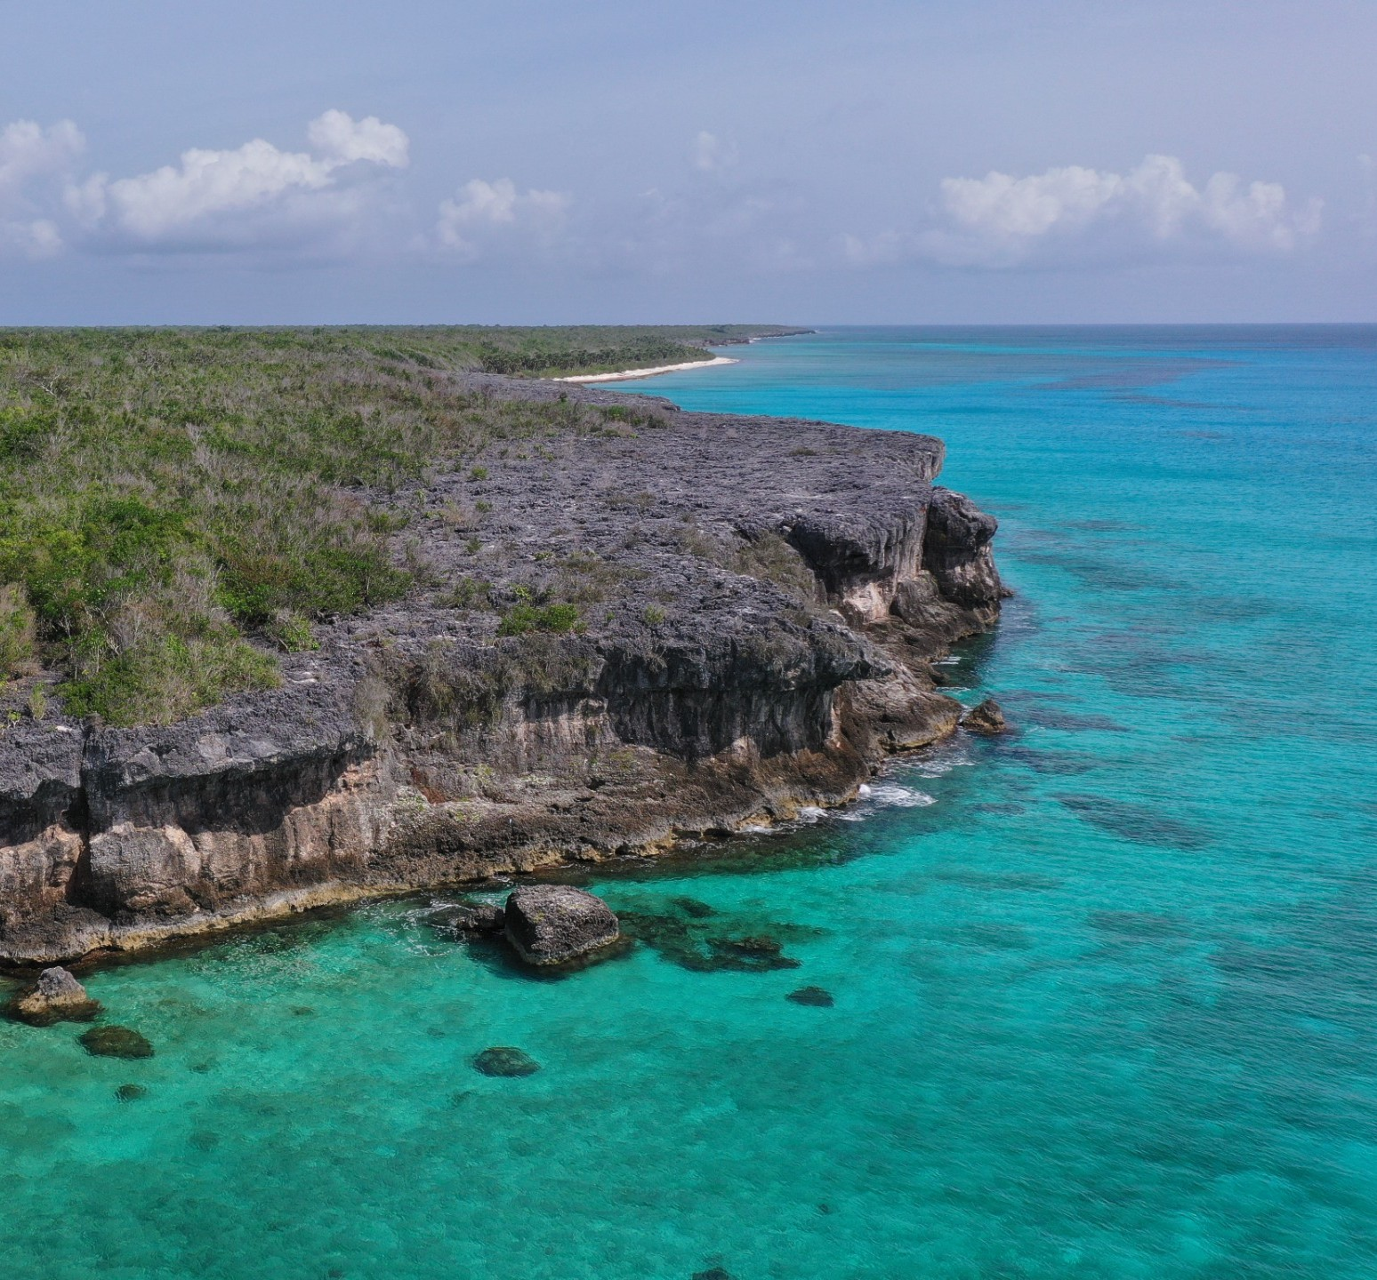
2.2. Strengthening of Pas
OBJECTIVES
Improve PAs management and regional collaboration.
Build capacity among governments and NGOs to enhance MPA effectiveness.
Promote awareness and strategies for sustainable PA financing.
Highlight the role of PAs in conserving key natural resources for sustainable development.

Slide 11


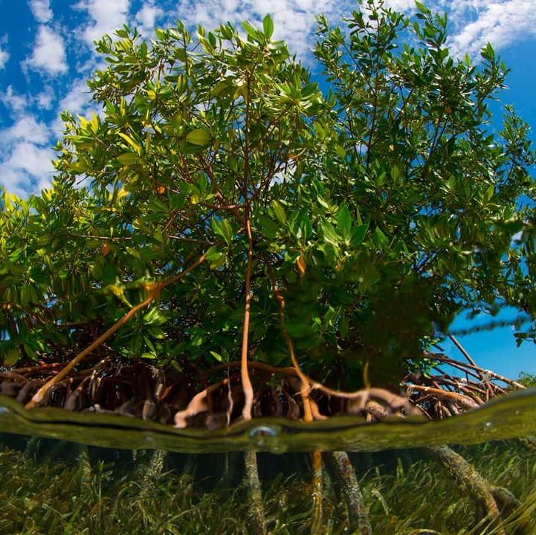
2.2. Strengthening of PAs
KEY ACTIVITIES- PROJECTS
ACP MEAs III (2023–2025)
PCA with SPAW-RAC to establish a regional network of SPAW-listed PAs.
Capacity building through national/regional workshops and the 14th CaMPAM ToT (Barbados, 2024).
Regional collaboration with regional MPA networks and initiatives.
Engaged in key forums: GCFI76/77, IMPAC5, CBD COP16, UNOC3.
CaMPAM Small Grant Programme Supported MPA-related actions in Cuba, Honduras, Belize, Jamaica, and others.

Slide 12





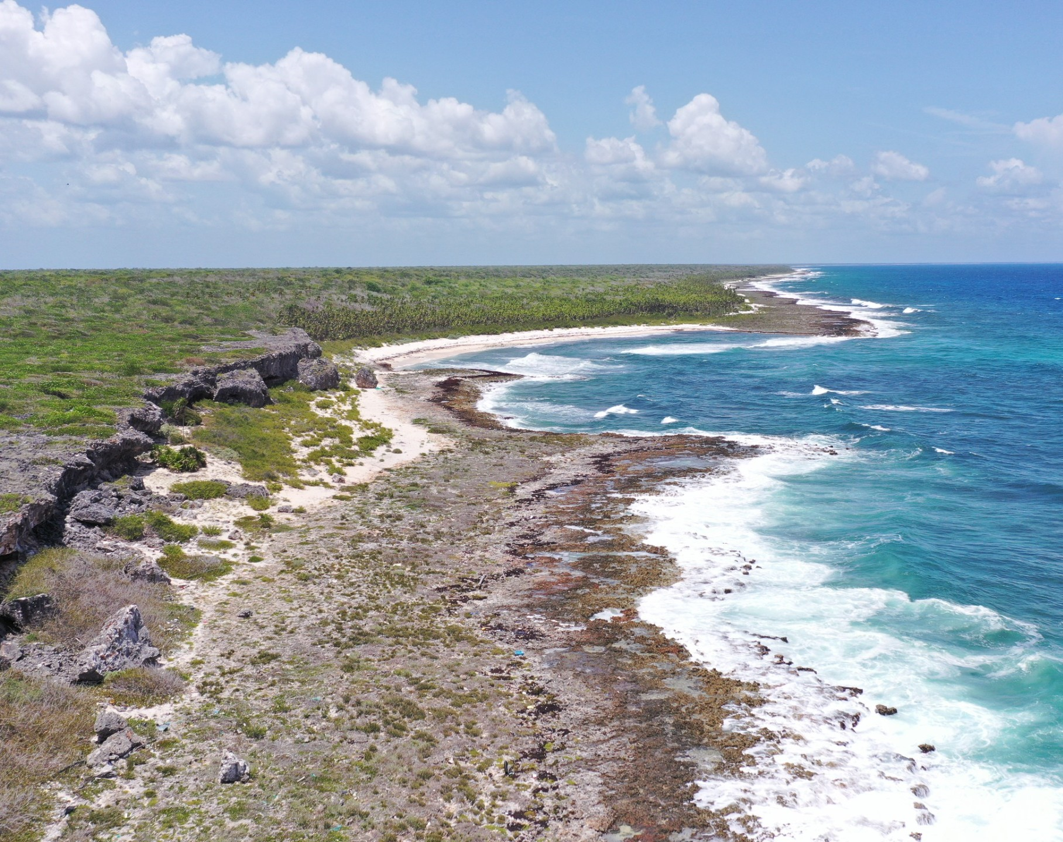
2.2. Strengthening of PAs
KEY ACTIVITIES- PROJECTS
Gulf of Mexico LME Project (2023–2025)
UN2UN agreement signed with UNOPS
Focus on:
  Strengthening MPA networks.
  Standardizing coral reef monitoring protocols.
  Enhancing oceanographic and biological monitoring.
  Assessing reef vulnerability and resilience.
Cuba formally invited and now participating as observer.
Small-scale funding agreements initiated with CONABIO, Kalanbio (Mexico), and SPAW-RAC.

Slide 13


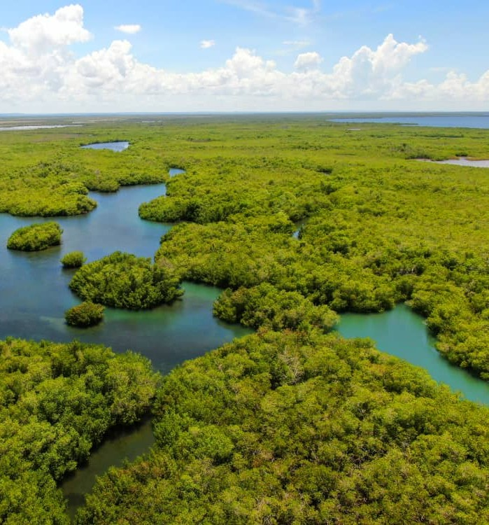
2.2. Strengthening of PAs
KEY ACTIVITIES- PROJECTS
PROCARIBE+ Project (2025–2027)
UN2UN agreement signed with UNOPS
Focus on:
  Creating new MPAs and strengthening one in Colombia.
  Establishing fishery reserves as OECMs and supporting an existing MPA in the Dominican Republic.
  Advancing the CaMPAM ToT programme on MPA Management:
    Follow-up activities from the 14th ToT edition.
    Implementation of the 15th ToT edition.
Partnership agreements underway with:
  INVEMAR (Colombia)
  Ministry of Environment and Natural Resources (Dominican Republic)
  Reef Check Dominican Republic
New partners in the process of being identified in Colombia

Slide 14
2.2. Strengthening of Pas
EXPENDITURE
Activity | 2023 Budgeted |  |  | 2024 (2025) Budgeted |  |  | Total
 | CTF | Other Contributions | Total cost | CTF | Other Contributions | Total Cost
Develop an operational network of SPAW MPAs¹ | 0.00 | 32,650.00 | 32,650.00 | 0.00 | 39,706.00 | 39,706.00 | 72,356.00
Establish SPAW MPAs Networking Group (including collaboration with other Caribbean MPA Networks)¹ | 0.00 | 40,073.00 | 40,073.00 | 0.00 | 91,052.00 | 91,052.00 | 131,125.00
Support MPA Management Effectiveness¹ | 0.00 | 89,132.00 | 89,132.00 | 0.00 | 122,269.00 | 122,269.00 | 211,401.00
Technical support to Governments to establish new MPAs¹ | 0.00 | 47,620.00 | 47,620.00 | 0.00 | 86,332.00 | 86,332.00 | 133,952.00
Capacity building for Government officials and MPA Managers (including the CaMPAM ToT 14th Edition)¹ | 0.00 | 96,300.00 | 96,300.00 | 0.00 | 129,165.00 | 129,165.00 | 225,465.00
Support to the functioning of the PA Working Group² | 0.00 | 0.00 | 0.00 | 0.00 | 2,000.00 | 2,000.00 | 2,000.00
Strengthen cooperation through improved MPA networks, standardized monitoring, and shared climate resilience strategies³ | 0.00 | 0.00 | 0.00 | 0.00 | 55,000.00 | 55,000.00 | 55,000.00
TOTAL (USD) | 0.00 | 305,775.00 | 305,775.00 | 0.00 | 525,524.00 | 525,524.00 | 831,299.00
1) Includes funds from the project Strengthening Environmental Governance and Supporting Multilateral Environmental Agreements In the Africa, Caribbean and the Pacific regions (ACP MEAs III)
2) Includes funds from bilateral contributions by the Governments of France and the Kingdom of the Netherlands
3) Includes funds from the GoM LME project

Slide 15
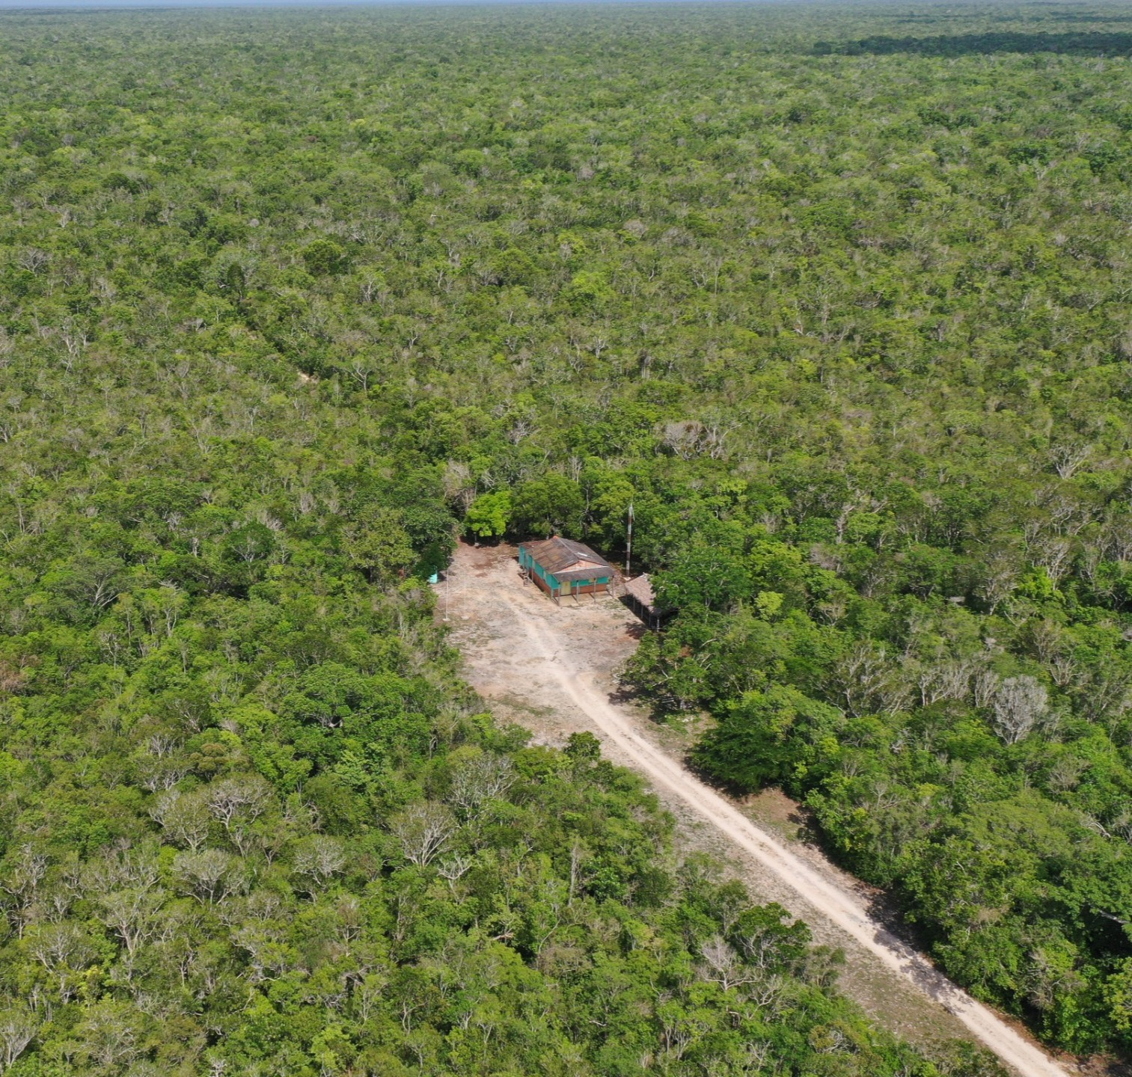
2.3. Guidelines for PaS and Species
OBJECTIVES
Support implementation of SPAW guidelines for establishing, managing, and listing PAs.
Encourage national planning for PAs, including legislation and reporting tools where relevant.
Promote species conservation through the development and application of SPAW management guidelines.

Slide 16
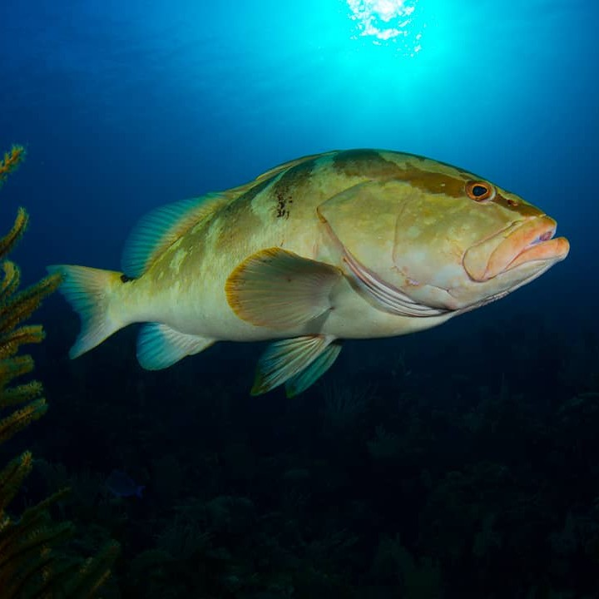
2.3. Guidelines for PaS and Species
KEY ACTIVITIES
The PAs WG, simplified the listing procedure and evaluation guidelines for SPAW PAs.
The Exemptions WG, reviewed national exemption reports and issued recommendations for STAC11.
The Species WG developed recommendations to enhance species management, including joint efforts with the PAs WG to support the conservation of the Nassau grouper.
Updated nomination for Parke Marino Aruba submitted in 2025 with the required additional documentation to be included in the SPAW PAs list.

Slide 17
2.3. Guidelines for PaS and Species
EXPENDITURE
Activity | 2023 Budgeted |  |  | 2024 (2025) Budgeted |  |  | Total
 | CTF | Other Contributions | Total cost | CTF | Other Contributions | Total Cost
Assessment to the functioning of the working groups¹ | 0.00 | 0.00 | 0.00 | 0.00 | 26,312.50 | 26,312.50 | 26,312.50
Support to the functioning of the Exemptions working groups¹ | 0.00 | 0.00 | 0.00 | 0.00 | 1,000.00 | 1,000.00 | 1,000.00
Listening session on Exemptions/Compliance¹ | 0.00 | 0.00 | 0.00 | 0.00 | 727.00 | 727.00 | 727.00
Update of the Guidelines for the establishment and functioning of the RACs and RANs¹ | 0.00 | 0.00 | 0.00 | 0.00 | 7,500.00 | 7,500.00 | 7,500.00
TOTAL (USD) | 0.00 | 0.00 | 0.00 | 0.00 | 35,539.50 | 35,539.50 | 35,539.50
1) Includes funds from bilateral contributions by the Governments of France and the Kingdom of the Netherlands

Slide 18
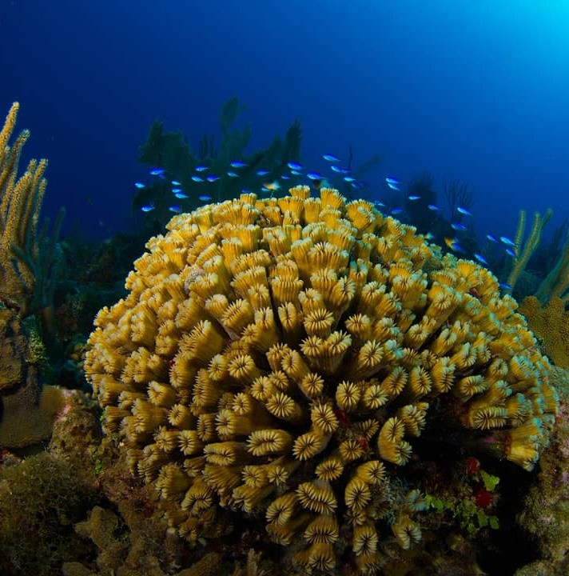
2.4. conservation of Species
OBJECTIVES
Raise regional awareness and action for the protection of threatened, endangered, and migratory species.
Implement key actions from existing species recovery and management plans.
Support the development of management plans for priority and economically important species.
Address Invasive Alien Species (IAS) threats to SPAW-listed species and coastal/marine ecosystems.

Slide 19
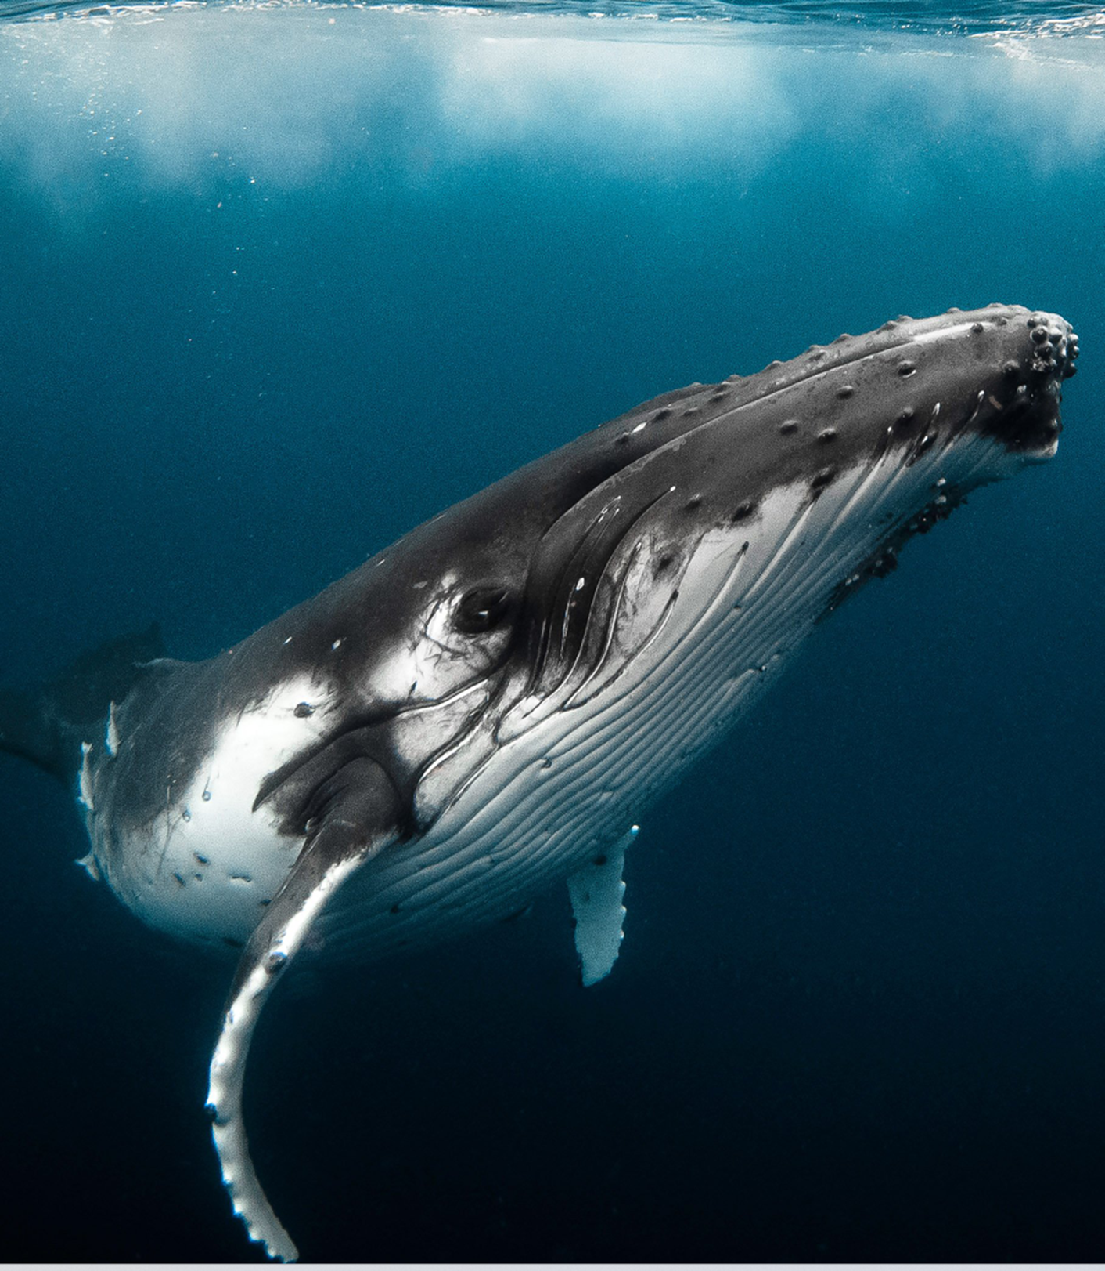
2.4. conservation of Species
KEY ACTIVITIES- MEGAFAUNA
Marine mammal monitoring and awareness strengthened through the CARI’MAM network.
Guidelines review finalized for the establishment of a Marine Mammal Regional Activity Network
Letter of Intent signed with the IWC and the IAC.
Finalization of the CAMAC Phase I and launch of the CAMAC Phase II
Advanced efforts to formalize WIDECAST as a Regional Activity Network.

Slide 20
2.4. conservation of Species
EXPENDITURE
Activity | 2023 Budgeted |  |  | 2024 (2025) Budgeted |  |  | Total
 | CTF | Other Contributions | Total cost | CTF | Other Contributions | Total Cost
Support to the functioning of the Species Working Group1 | 0.00 | 0.00 | 0.00 | 0.00 | 2,000.00 | 2,000.00 | 2,000.00
Revision of the legal and governance structure for a new Marine Mammals RAN1 | 0.00 | 0.00 | 0.00 | 0.00 | 5,000.00 | 5,000.00 | 5,000.00
Support to collaboration with other MEAs (CITES, CBD, CMS)1 | 0.00 | 0.00 | 0.00 | 0.00 | 12,500.00 | 12,500.00 | 12,500.00
TOTAL (USD) | 0.00 | 0.00 | 0.00 | 0.00 | 19,500.00 | 19,500.00 | 19,500.00
1) Includes funds from bilateral contributions by the Governments of France and the Kingdom of the Netherlands

Slide 21

2.5. Conservation and Sustainable Use of Ecosystems
OBJECTIVES
Support sustainable management of marine and coastal ecosystems through nature-based solutions.
Raise awareness and mobilize action for the conservation and restoration of key ecosystems.
Communicate the ecological and socio-economic value and threats facing coral reefs and related habitats.

Slide 22
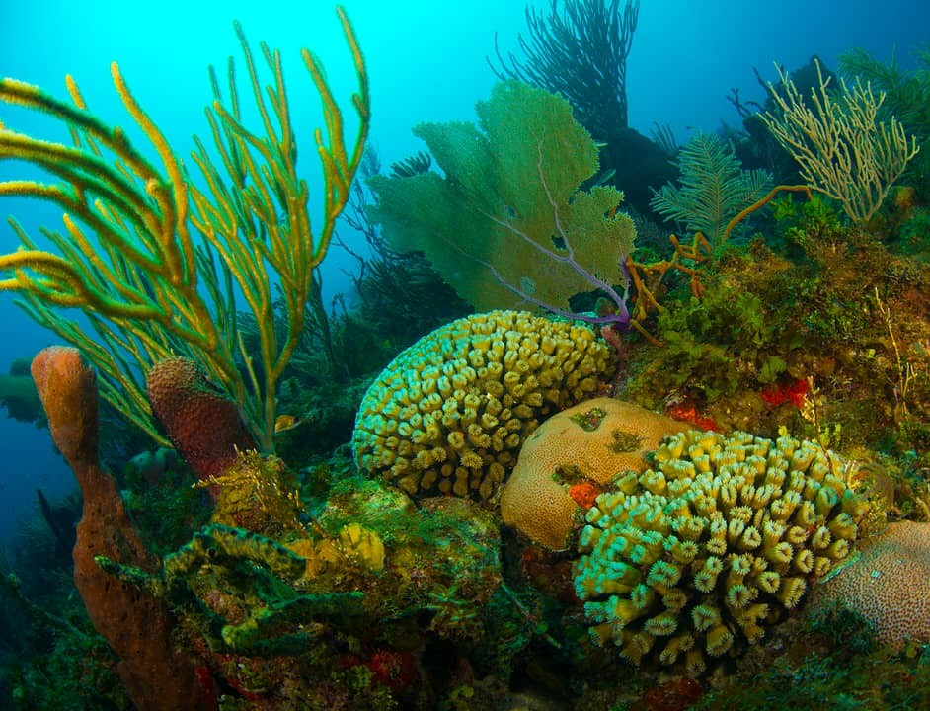
2.5. Conservation and Sustainable Use of Ecosystems
KEY ACTIVIVITIES-GCRMN CARIBBEAN
Coordination of the GCRMN Caribbean node, including regional coral reef data collection and development of the Caribbean Coral Reef Status Report.
The Secretariat and SPAW-RAC participated in ICRI and GCRMN global meetings, contributing regional data for the 2025 Global Status Report and engaging in review processes.

Slide 23
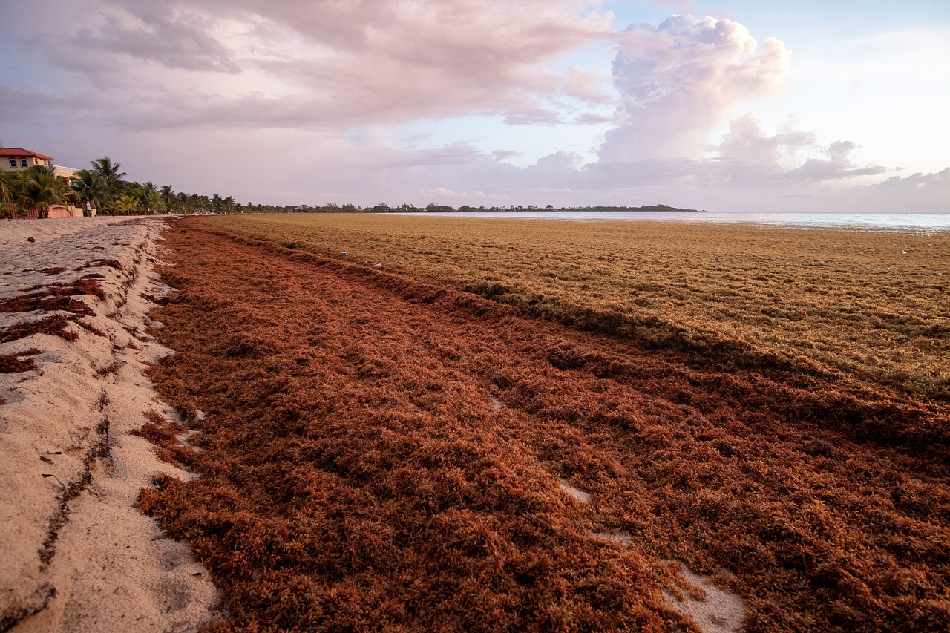
2.5. Conservation and Sustainable Use of Ecosystems
KEY ACTIVITIES - SARGASSUM
The SPAW Sargassum Working Group expanded to include all Cartagena Convention Parties and LBS experts.
A regional survey assessed how sargassum inundations affect national obligations under the Cartagena Convention, informing the updated WG Regional Sargassum Action Plan.
A joint meeting with the AMEP Subprogramme in T&T (March 2025) aligned priorities.
Coordinating and catalytic role in promoting a more integrated and effective Sargassum management approach

Slide 24
2.5. Conservation and Sustainable Use of Ecosystems
EXPENDITURE
Activity | 2023 Budgeted |  |  | 2024 (2025) Budgeted |  |  | Total
 | CTF | Other Contributions | Total cost | CTF | Other Contributions | Total Cost
Support to the Sargassum WG (including the Joint meeting of the SPAW Sargassum WG and the LBS OEWG)¹ | 0.00 | 0.00 | 0.00 | 0.00 | 37,800.00 | 37,800.00 | 37,800.00
Participation in regional Sargassum fora¹ | 0.00 | 0.00 | 0.00 | 0.00 | 20,000.00 | 20,000.00 | 20,000.00
Support for the development of the Caribbean Coral Reef Status Report^{2,3} | 0.00 | 0.00 | 0.00 | 0.00 | 66,800.00 | 66,800.00 | 66,800.00
TOTAL (USD) | 0.00 | 0.00 | 0.00 | 0.00 | 124,600.00 | 124,600.00 | 124,600.00
1) Includes funds from bilateral contributions by the Governments of France and the Kingdom of the Netherlands
2) Includes funds from the GFCR
3) Includes funds from the GoM LME project

Slide 25
General EXPENDITURE
Activity | 2023 Budgeted |  |  | 2024 (2025) Budgeted |  |  | Total
 | CTF | Other Contributions | Total cost | CTF | Other Contributions | Total Cost
Programme Coordination | 240,800.00 | 0.00 | 240,800.00 | 383,400.00 | 0.00 | 383,400.00 | 624,200.00
Strengthening of PAs | 0.00 | 305,775.00 | 305,775.00 | 0.00 | 525,524.00 | 525,524.00 | 831,299.00
Guidelines for PAs and Species Management | 0.00 | 0.00 | 0.00 | 0.00 | 35,539.50 | 35,539.50 | 35,539.50
Conservation of Threatened and Endangered Species | 0.00 | 0.00 | 0.00 | 0.00 | 19,500.00 | 19,500.00 | 19,500.00
Conservation and Sustainable Use of Coastal and Marine Ecosystems using the EBM approach | 0.00 | 0.00 | 0.00 | 0.00 | 124,600.00 | 124,600.00 | 124,600.00
TOTAL (USD) | 240,800.00 | 305,775.00 | 546,575.00 | 383,400.00 | 705,163.50 | 1,088,563.50 | 1,635,138.50

Slide 26
SPAW COP12 Decisions
28 Completed (100%), 0 Ongoing (0%), 0 Not initiated (0%)
Decision SPAW COP12 |  | Status | Summary of Implementation
I | Workplan and Budget | Completed | Fully adopted and implemented with priority activities and strengthened synergies across regional partners.
II | Protected Areas and Species | Completed | New protected areas and species listings approved; species-specific recommendations advanced; cooperation among working groups fostered.
III | Adoption of Documents | Completed | Strategic Plan 2023-2028 and Marine Mammal Action Plan adopted.
IV | Ratification | Completed | Targeted outreach led to increased engagement and the ratification of SPAW and LBS by St. Kitts and Nevis.
V | Working Groups | Completed | Participation encouraged; assessment conducted; inter-subprogramme integration improved (with LBS-OEWG).
VI | Coordination and Management | Completed | SPAW Consortium operational with regular meetings and inputs to Workplan.
VII | Governance | Completed | Expanded Bureau created; improved outreach to all Contracting Parties.
VIII | Sargassum | Completed | Regional collaboration enhanced, including joint WG meetings and updated Action Plan; SPAW side event held at SIDS4.

Slide 27
SPAW STAC10 RECOMMENDATIONS
47 Completed (96%), 1 Ongoing (2%), 1 Not initiated (2%)
Recommendation SPAW STAC 10 |  | Status | Summary of Implementation
I | Review of Documents | Completed | All key documents revised and adopted following Party inputs.
II | Programme Coordination | Completed | SPAW Consortium acknowledged and supported; Blue Corridors concept noted.
III | Work and Budget | Ongoing | SPAW-RAC engagement in CAMAC recognized; further participation encouraged.
IV | Protected Areas | Completed | Progress made in developing SPAW-listed MPA network; new listings added; database updated.
V | Exemptions | Completed | Capacity building initiated; webinar held on compliance mechanisms.
VI | Sargassum | Completed | Engagement in regional fora; needs survey completed; Action Plan updated.
VII | Working Groups | Completed | Parties invited to designate experts; integration across WGs promoted.
VIII | Emerging Issues | Completed | SPAW involved in ocean acidification and deep-seabed mining discussions.
IX | Species | Completed / Not Initiated | All listing proposals adopted and species-specific recommendations finalized except for parrotfish conservation, which was not initiated due to lack of response.

Slide 28
Main Challenges Identified
Delays or non-payment to the Caribbean Trust Fund impact the Secretariat’s ability to operate and deliver the Workplan.
Lack of compliance with the provisions of the SPAW Protocol and regular reporting by some countries.
Low expert participation in Working Groups hinders technical progress and consensus building.
Insufficient participation and communication from some focal points hinder effective coordination.
Limited technical capacity and resources make it difficult to apply SPAW guidelines or nominate new sites and species.
Need for better alignment with other agendas, avoiding gaps and duplication with national policies and agreements.
Communication and visibility challenges require improving awareness of SPAW’s benefits and opportunities.

Slide 29
SUGGESTED TOPICS FOR DELIBERATION
POSSIBLE RECOMMENDATIONS
Endorsement of the RAC/RAN Guidelines
Endorsement of Working Group Governance Arrangements
Mandates or expanded mandates related to BBNJ and GBF Targets
Compliance and Reporting Mechanisms
Sargassum: regional coordination and WG Action Plan
Endorsement of recommendations from the various Working Groups

Slide 30
SPECIALLY PROTECTED AREAS AND WILDLIFE (SPAW) PROTOCOL
11th meeting of the Scientific and Technical Advisory Committee (STAC)
THANK YOU
FOR YOUR ATTENTION

