Slide 1

Revision of the 2008 Guidelines for the Establishment and Operation of Regional Activity Centers (RACs) and Regional Activity Networks (RANs) of the Cartagena Convention
Juliana Chaves Chaparro - Consultant
Environmental and Social scientist
President of Mixtura ambiental

Slide 2
1. Justification & Method
Desk research
Interviews to RACs, RANs and other models-Barcelona Convention, Ocean governance mechanism, etc.
Coordination meetings with CCS
First draft document
Validation workshop- 29.01.2025
Feedback from all stakeholders
Second draft document- STAC
30.06.2025
Paris agreement and Agenda 2030
BBNJ Treaty, SIDS Action Plan, etc
UNEP partnership policies, Cartagena Convention
UN Decade of Ocean Science for SD 2021-2030
Enhance the marine governance, weak in the WCR (McConney et al. 2016)
Low intrarregional scientific cooperation (UNESC0, 2021) 0,09% GERD (0,66% LAC- 1,79%global) 2% copublications ( 40% US):
Increased complex and interdisciplinary challenges-need for inter disciplinarity, inter-protocol and more societal focus work
What roles/ operations for RACs and RANS as instrumental to the Cartagena Convention and protocols implementation in these complexity of WCR ocean challenges and governance?

Slide 3
General considerations on Roles of RACs and RANs
RACs and RANs need differentiated structures-guidelines
RACs are implementing arms for the CCS : policy oriented (HCA):, technical –research based, insitutional capacity and knowledge exchange, Science-policy interface
RANS more diverse, flexible (MoU), based on Project, community resilience , public awareness, funding mobilisation: Policy-society interface
RACs reflecting diversity of the Caribbean region , so very diverse in terms of: background ( research vs management); regional scope ( national institutions vs regional centers for the Protocols); legal and institutional framework ( HCA, staff hiring, etc); language and cultural mindset (F,S, E); Operations ( experience, reporting to CCS, Fund mobilisation, etc)
NEED to reflect coherence and new requirements of RACs/RANs in the guidelines revision as well as transparent & clear process for their establishment and operations in a coordinated manner

Slide 4
2. Need to harmonise and enhance synergies RACs and RANs: evolving system and neds
STAC LBS; STAC SPAW
Working groups
Marine Mammals RAN
REMARCO, IAEA, Gulf and Caribbean Fisheries Institute, CRFM, Ocean Foundation, Sargassum Commission, etc
Ocean Governance Coordination Mechanism
Notes:
RACs and RANs need differentiated structures-guidelines
RACs are implementing arms for the CCS : policy oriented (HCA):, technical –research based, insitutional capacity and knowledge exchange, Science-policy interface
RANS more diverse, flexible, based on Project, community resilience , public awareness, funding mobilisation: Policy-society interface
RACs reflecting diversity of the Caribbean region , so very diverse in terms of: background ( research vs management); regional scope ( national institutions vs regional centers for the Protocols); legal and institutional framework ( HCA, staff hiring, etc); language and cultural mindset (F,S, E); Operations ( experience, reporting to CCS, Fund mobilisation, etc)
NEED to reflect coherence and new requirements of RACs/RANs in the guidelines revision as well as transparent & clear process for their establishment and operations in a coordinated manner

Slide 5
Guidelines index proposal
i. INTRODUCTION
II. GENERAL CONSIDERATIONS
III. DEFINITIONS: REGIONAL ACTIVITY CENTRES (RACs) AND REGIONAL ACTIVITY NETWORK (RANs)
FIRST PART- RACs GUIDELINES
IV. OBJECTIVES AND FUNCTIONS OF THE RACs
V. ESTABLISHMENT OF THE RACs
    V.i. NECCESITY
    V.ii CRITERIA FOR THE SELECTION
    V.iii. PROCEDURE TO ESTABLISH A RAC
  VI. RACS OPERATIONS:
    VI.i ADMINISTRATIVE
    VI.ii.OPERATIONAL
    IV. Iii. FINANCE
SECOND PART- RACs GUIDELINES
VII. OBJECTIVES AND FUNCTIONS OF THE RANs
VIII. ESTABLISHMENT OF THE RANs
  VIII.i. NECCESITY
  VIII.ii CRITERIA FOR THE SELECTION
  VIII.iii. PROCEDURE TO ESTABLISH A RAN
IX. RANs OPERATIONS
  IX.i ADMINISTRATIVE
  IX. ii OPERATIONAL
  IX.iii. FINANCE
ACRONYMX
REFERENCES
ANNEX 1:
Common provisions for RACs Agreement
ANNEX 2:
CHECK LIST FOR NEW RANs

Slide 6
III. DEFINITIONS: REGIONAL ACTIVITY CENTRES (RACs) AND REGIONAL ACTIVITY NETWORKS (RANs)
11. A Regional Activity Centre (RAC) is a financially autonomous, international or regional organization, or regional or national institution with regional focus, which has been designated by the Contracting Parties to the Cartagena Convention to coordinate or carry out specific technical functions and activities in support of the Convention and its Protocols or any future protocols. The primary objective of the RAC is to strengthen the delivery of activities in support of the Convention and its Protocols and the science-policy interface through decentralizing the work, building regional institutional capacity and addition of human and financial resources from a member country, another UN or international organization, non governmental organization or other donors.

Slide 7
12. A Regional Activity Network (RAN) is a network of technical institutions or individuals(including inter alias, governmental, intergovernmental, international, non-governmental, scientific or academic institutions) that provides input, peer review, technical expertise or other supporting services ( i.e. communication, networking, capacity building or awareness raising), in one or more scientific or technical areas covered under the Cartagena Convention and its Protocols through its coordinating mechanism as designated by the Decision of Parties. The primary objective of the RANs is to enhance the science-policy-society interface and the level and depth of cooperation and sharing of expertise in the WCR related to the implementation of the Cartagena Convention and its Protocols.

Slide 8
FIRST PART: GUIDELINES ON THE ESTABLISHMENT AND OPERATIONS OF THE RACs IV. OBJECTIVES RACS Art 13.
To maintain regular contact with the Secretariat and other RACs and RANs for coordinating holistic, integrated and synergetic action
To foster and catalyze regional knowledge production and exchange among i.a., RANs, international, national and regional agencies, and research institutions related to the relevant scientific and technical aspects of the Convention and its Protocols;
To compile, update and disseminate data, reports and provide technical advice in an appropriate form to the governments of the region, in particular in response to the COP Decisions and in coordination with RACs, RANs and the Scientific and Technical Advisory Committees (STAC) and working groups of the Convention and/or its Protocols,
To facilitate the provision of technical and scientific assistance (expertise, consultancies) and capacity building activities to Contracting Parties, other governments and organisations as appropriate;
To provide technical support and participate in outreach activities to increase the ratification of the Cartagena Convention and its protocols in the Wider Caribbean Region
To advise on the establishment of new RACs and RANs, and support their effective integration and complementarity of actions;
To assist the CCS with the implementation of activities and projects and the mobilization of funding to ensure the achievement of Convention/Protocol objectives;

Slide 9
Objectives 2
To collect information on state-of-the-art technology and support its transfer and adoption to Parties as required for the implementation of the Biennial Work Plans and Decisions of Contracting Parties
To ensure effective and targeted communication to the public and decision makers and support awareness on the Cartagena Convention and its protocols and activities
To enable an open access to the related Cartagena Convention information available to governments of the region, as well as relevant partner organizations, institutions and members of the RANs, among others;
To foster scientific and technical cooperation and synergies with regional and global initiatives and partners e.g. UN specialized agencies, intergovernmental, governmental and non-governmental organizations;
To promote and undertake joint implementation of specific activities individually or jointly in cooperation with e.g. other RACs, RANs, UN specialized agencies, intergovernmental, governmental and non-governmental organizations as appropriate and in coordination with the CCS;
To promote accessibility to data sources for regional environmental monitoring and transdisciplinary cooperation on complex and holistic regional challenges as the impact of climate change
To support foresight action and provide evidence to inform national and regional responses to emerging issues and challenges and new policy frameworks- in particular for most vulnerable groups and Small Island and Developing States (SIDS)

Slide 10
V. ESTABLISHMENT OF RACS
V.i) Necessity of RACs (15-19)
New RACs are to be established or the scope of existing RACs redefined in order to fill in gaps in terms of technical and scientific support to the Contracting Parties, enhance the technical capacity of UNEP-CAR/RCU, assist in mobilizing additional financial resources or promote activities to implement the Cartagena Convention and its Protocols, and support the Caribbean Environment Programme (CEP) in general.
A RAC, as a technical institution, should have the capacity to implement projects using its own staff and facilities/services as defined in their Host Country and/or Framework Agreements as applicable and agreed with the Convention Secretariat
RAC´s should be hosted by institutions with demonstrated competency, technical capacity and regional focus on one or more areas of the Cartagena Convention and its protocols or offering cross cutting services inter alias ( i.a.): Communication and awareness, capacity building and training, community engagement, fund mobilization, increased capacity to addresss new and emerging challenges, or any other activities aiming at supporting the implementation capacity of other RACs, the Secretariat or the COP .
The hosting institutions or government can be a) UN regional or International organizations; b) Regional institutions (existing or newly created to host the RAC) or c) National institutions ( existing or created to serve purpose).

Slide 11
PART TWO: GUIDELINES FOR THE REGIONAL ACTIVITY NETWORKS (RANs)
VII. OBJECTIVES AND FUNCTIONS OF THE RANs
Assist with the provision of scientific data and information and advice in support of the Convention and its Protocols when required
(p) Provide support as appropriate for the implementation of approved biennial work plans of the Secretariat and responding to COP Decisions;
(q) Promote coordination and cooperation with other institutions and individuals, in particular other RACs and RANs;
(r) Assist in the mobilization of relevant expertise and resources to support programme and project implementation or capacity building actions when required by the parties or the Secretariat
(s) Provide periodic reports to the CCS and related RACs on their activities and participate, as appropriate in any related meetings called by them;
(t) Assist with fundraising for activities, to fulfil the goals or emerging needs of the Convention and/or its Protocols, with special focus on Community based projects, SIDS and vulnerable groups including women and youth;
 | Enhance the science-policy-society interface by enhancing stakeholder engagement and interdisciplinary cooperation and exchange within the WCR

Slide 12
CRITERION for nomination or redefining roles
Some general criterion will be assessed for consideration of the necessity to establish a new RAN or re-defining existing ones competencies that shall be properly justify in the official candidature to the CC Secretariat and Contracting Parties:
a) support the achievement of the objectives of the Cartagena Convention and its Protocols;
b) disseminate information relating to the Convention and its Protocols in the region and/or their respective countries and/or at the international level
c) contribute, through a specific project or programme, to the implementation of the biennial work plan of the Cartagena Convention and its Protocols and/or in responding to COP Decisions;
d) contribute to data generation, awareness-raising and dissemination of information;
e) provide advice relating to the work of the CCS, RACs or other RANs;
f) share, as appropriate resources, publications, documents, information and/or opinions at the request of the CCS, RACs or RANs relating to their own field(s) of competence.
They can also provide support to the CCS and the RACs, on cross cutting issues

Slide 14
VIII.iii) PROCEDURE FOR ESTABLISHMENT OF A RAN
67. The establishment of a new RAN aims at enhancing the advancement of the CC in the region and should be guided by the following:
a) The nomination of a new RAN can be initiated and/or endorsed by a contracting partner, a RAC or the RAN itself, through a formal request to the CCS.
b) The nomination request should justify how the proposed RAN meets the criteria outlined in these Guidelines and should include detailed information on its ) operational procedures- including the RAN legal structure and governance financial management and budget, reporting mechanisms, and other oversight provisionswhich should be consistent with those found in this Guidelines Paper and the CCS legal requirements and United Nations System rules and code of ethics.
c) The RAN nomination proposal will be revised by the the CSS in coordination with the relevant RAC or RACs as to ensure that it is completed and once reviewed submitted to the Contracting Parties for its consideration and approval.
d) This proposal should clearly indicate the scope of the RANs in terms of i.a. topics, geographical coverage, proposed activities and complementarity with other RACs and RANs, facilities, personnel andbudget timeline and/or any other provisions or mandates that the CCS or the Contracting Parties wish to establish.
e) CCS will negotiate the appropriate agreement with the proposed RAN organisation that is consistent with the approved TOR and any other provisions or mandates that Contracting Parties had established in its approval, and the ones in this Guidelines.

Slide 15
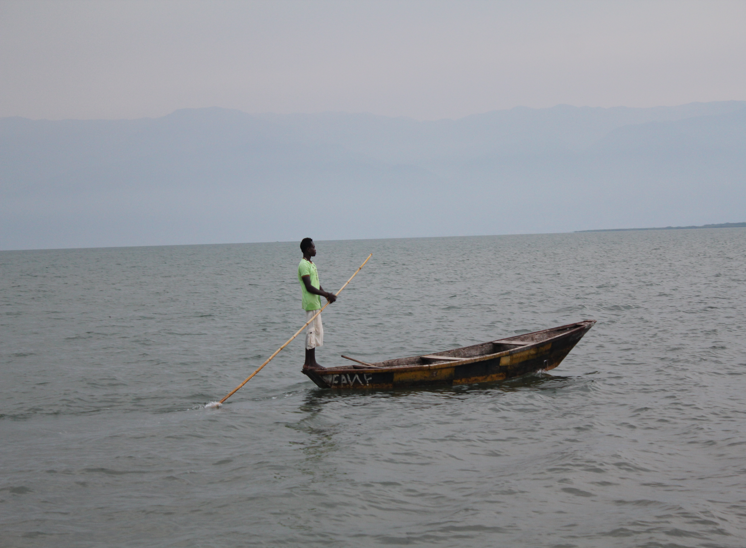
“Caminante no hay camino, se hace camino al andar
….Caminante no hay camino, sino estelas en la mar”
Antonio Machado, Cantares 1912

