Slide 1



Agenda Item 4: Status of Activities of the SPAW Sub-Programme for 2023-2025
Update on the SPAW Consortium’s Contributions to the SPAW Sub-Programme
Susan Millward, Animal Welfare Institute and Founding Member of the SPAW Consortium

Slide 2
Brief History
  The SPAW Consortium was officially launched on October 4, 2023, during the 6th LBS CoP in Aruba
  Decision VI of the 12th SPAW CoP in Aruba, recognized:
      “the contribution of NGOs to the implementation of the Cartagena Convention, in
      particular to the SPAW Protocol and welcomed the establishment of the SPAW Consortium”

Slide 3
  Purpose
  The SPAW Consortium is an independent alliance, promoting, enhancing and supporting implementation of the SPAW Protocol as a coordinated regional platform to encourage best practices, share lessons learned, enhance synergies, and recruit participation from civil society and elsewhere to support the implementation of the SPAW Programme
  Seeks to strengthen the role of NGOs and civil society in the implementation of the SPAW Protocol by advocating for and optimizing NGO participation and engagement to strengthen the effective implementation of the SPAW Programme by countries at national and regional levels

Slide 4
Functionality
  Composed of institutional members of major groups and stakeholders [per UNEP defn] and individuals with expertise, experience, and interest in advancing the objectives of the SPAW Programme
  Aims to build partnerships in support of the SPAW Protocol and Programme through:
    Up-scaling best practices; sharing share lessons learned; enhancing synergies among members;
    By recruiting commitments from civil society and supporting capacity building
  Own governance structure, with a Steering Committee and an Assembly of Members
  Does not duplicate work or compete with the roles or mandates of UNEP entities including RACS, RANs
  Consortium membership does not imply membership in an ‘’organisation’’ nor observer accreditation status but a commitment to the objectives and work of the Consortium.

Slide 5
Activities in the Biennium
  10 members from 7 countries and territories; continues to grow
  Developed and adopted the SPAW Consortium Workplan 2024-2025, with 5 main strategic pillars and 6 objectives and expected outcomes
  Press Release (October 2023); Article in the SPAW-RAC Newsletter (in English, French and Spanish); Consortium piece for campaign celebrating 25 years of the coming into force of the SPAW Protocol
  Regular meetings with the Secretariat and SPAW-RAC
  Contributed to the Secretariat and SPAW-RAC with the definition and parameters for members of the Working Groups under SPAW

Slide 6
  Activities in the Biennium (cont’d)
  Provided inputs to the:
    Revision of the RAC/RAN Guidelines and of the functioning of the working groups
    Development of a marine mammal RAN
    Development of indicators for assessment of the impact of the SPAW Protocol
    Listening session on Implementation and Compliance Issues within the SPAW Protocol
  Elaboration of a briefing paper on Expanding Civil Society Participation in the Caribbean Environment Programme by Founding Member Foundation for Development Planning, Inc. presented to the present STAC meeting as Information Document UNEP(DEPI)/CAR WG.45/INF.17

Slide 7
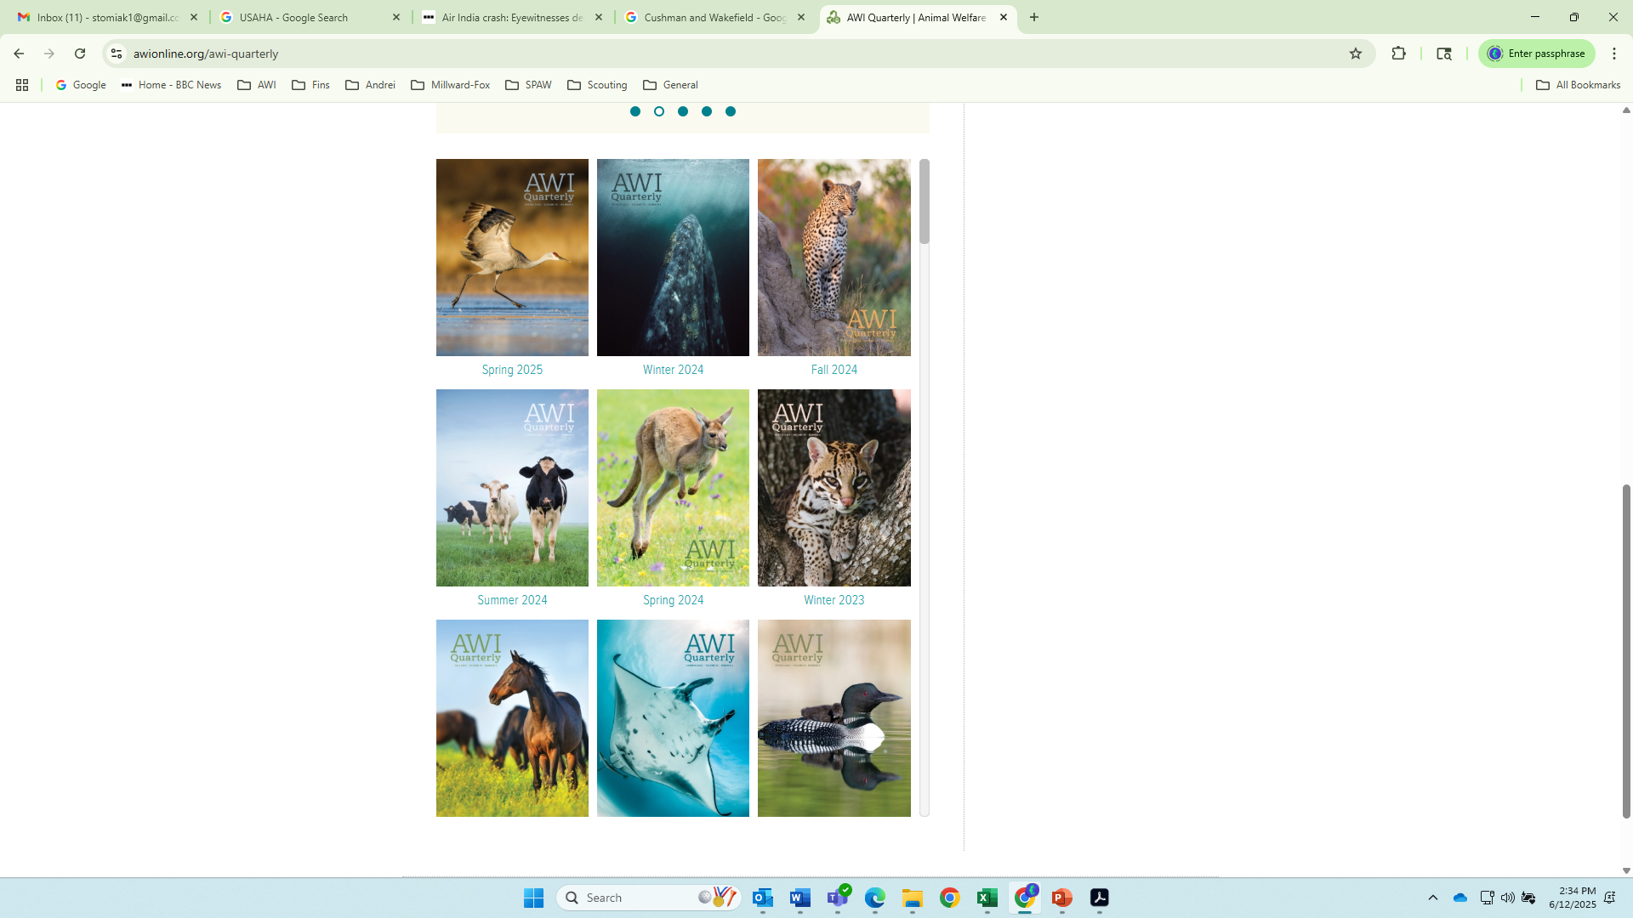
  Activities in the Biennium (cont’d)
  Hosted a virtual FORUM in April 2025:
    32 participants from 13 countries and territories
    Recruited interest from regional & national NGOs, academia, governments, private sector
    Covered the SPAW fundamentals, role of civil society in advancing the Protocol, and contemporary issues facing SPAW.
    Participation of the Secretariat and SPAW-RAC was most welcomed
  The SPAW Consortium extends its appreciation to the Secretariat for the spirit of collaboration and openness allowing progress in civil society contributions to the work of the Cartagena Convention

Slide 8
Merci! Thankyou! Gracias!
Questions ???

