Slide 1
Current and future projects for the next biennal
Lucile ROSSIN – SPAW-RAC director

Slide 2
Agenda
CAMAC 2
SARG’COOP2
CARIPAP

Slide 3



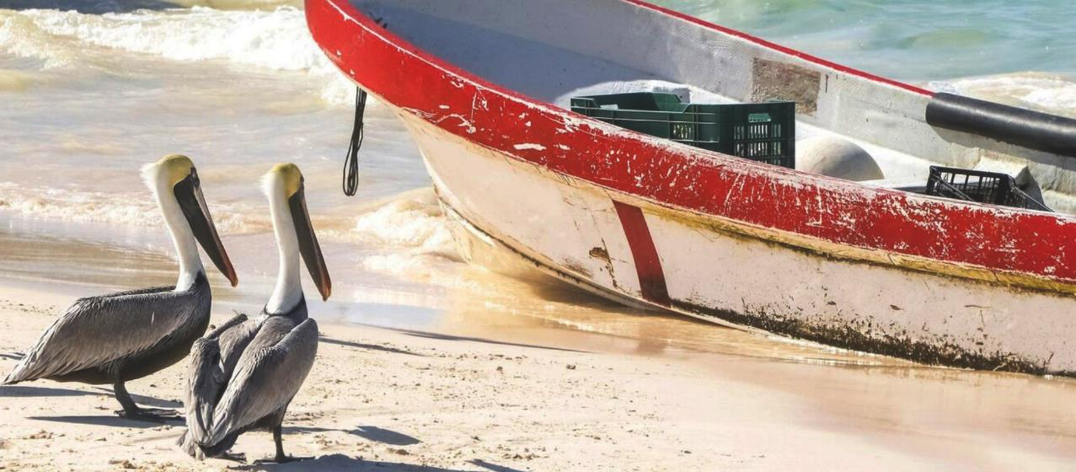
CAMAC
CARIBBEAN MARINE MEGAFAUNA AND ANTHROPOGENIC ACTIVITES
SPAW RAC

Slide 4

OBJECTIVE
General objective
A response to a priority issue identified in recommendation documents (Conference of Parties for the Cartagena Convention (COPs) - SPAW COP12):
Strengthen knowledge and regional collaboration on the interactions between human activities and marine megafauna
to provide the governing bodies of the Caribbean and environmental stakeholders with recommendations and tools to efficiently mitigate the negative impacts
Species we focused on : marine mammals, sea turtles, seabirds, sharks and rays
1
Enhance knowledge on the Caribbean marine megafauna
2
Assess the environmental and socio-economic issues related to interactions between human activities and marine megafauna
3
Strengthen regional cooperation and stakeholders’ capacities
4
Strengthen the ownership of young Caribbean people to the issues of conservation of megafauna and marine heritage in general
5
Make recommendations to governing bodies

Slide 5
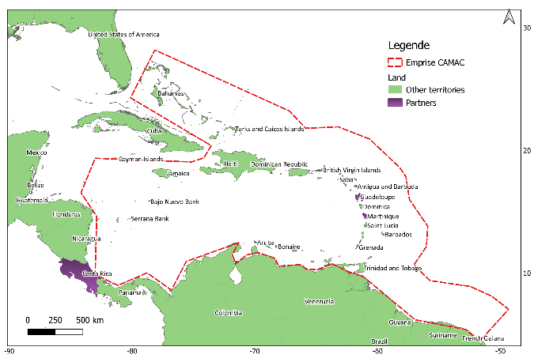

SCOPE
Regional cooperation is essential and key to successfully carrying out these objectives.
The Wider Caribbean Region and the focus area of the CAMAC project - - - - - - -
Effective range has been defined by the partnerships developed during phase 1 and completed during phase 2 set up.

Slide 6
PROGRAMMING
6 thematic work packages
1
Work package 1: Interaction with fisheries
2
Work package 2: Stranding network strengthening - Turtles
3
Work package 3: Awareness raising – School twinning
4
Work package 4: Knowledge enhancement – MMammals & Sea birds
5
Work package 5: Knowledge enhancement - Elasmobranch
6
Work package 6: Communication and recommendation

Slide 7
Work package 1 : Interaction with fisheries
review available data on species distribution and fisheries and map interactions (IWC ByRA tool)
build partnership with Caribbean fisheries organizations
define protocols and priority areas for knowledge enhancement (phase 2)
enhance knowledge in priority areas with interview surveys and embarkments
Enhance map interactions by statistic models
make recommendations for bycatch mitigation
PHASE 1
PHASE 2
28
Fisheries experts
21
Caribbean territories
Summary maps
Species/
fisheries interactions
1
Survey protocol deployed on
4
Caribbean territories at least
Maps of interactions and risk area
Expected outputs
Maps of interactions between megafauna and fisheries
Locate hotspots of interactions
Specific and operational recommendations for mitigation
An enhanced interest for the topic in the region
An enhanced capacity for bycatch monitoring

Slide 8
Work package 2 : Stranding networks
PHASE 1
PHASE 2
Development of a standardized protocol and a training kit for marine mammals
Capacity building, supply of equipment
Identify data/sample analyses to be conducted during phase 2
Conduct the analyses of data/sample collected by stranding networks identified during phase 1
Training and capacity building for sea turtle stranding networks
142
People trained
8
regions
Training kit
En, Es, Fr
Strengthened stranding network
1 database
1
Turtle stranding protocol
1
beach-accessible training materials
Expected outputs
Caribbean stranding networks are strengthened
Data and samples are collected during most of the stranding events
Knowledge on human impacts is enhanced
Knowledge on MM populations is enhanced

Slide 9
Work package 4/5 : knowledge enhancement
PHASE 1
PHASE 2
build technical partnership with scientific organizations of the Caribbean
define scientific protocols
get official commitment of territories
implement the regional survey(s) with partners and protocols identified during phase 1
implement analyses of the distribution of species based on existing datasets (sightings, telemetry tracking)
3
Thematic groups of experts
2
Scientific monitoring protocols
1
Elasmo
branch action plan
2
Data collection protocols
For 2
Groups of species
Stanard protocol for elasmo
branch
Expected outputs
Maps of distribution of megafauna at regional and local scales
Abundance of megafauna main taxonomic groups
Maps of overlap between megafauna and human activities

Slide 10
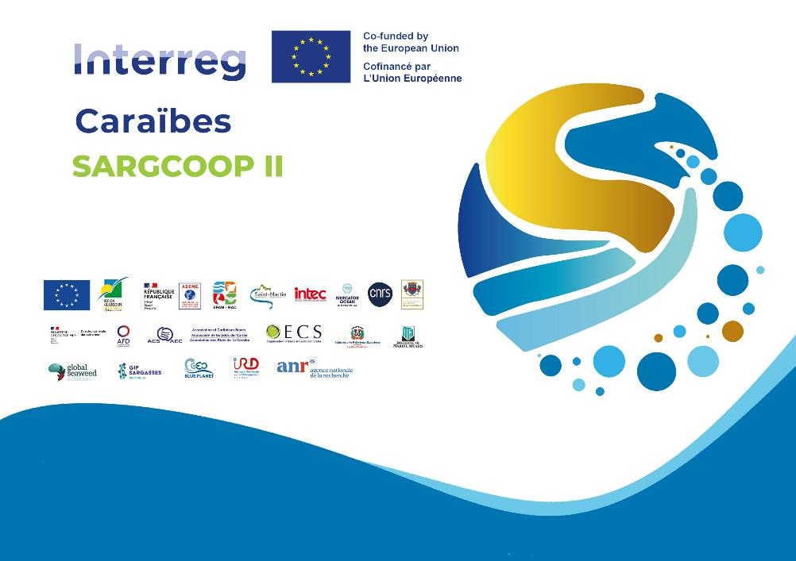
Project SARGCOOP II

Slide 11

program’s intervention logic
Project SARGCOOP II
3 years project 2025 – 2028 lead by the Regional Council of Guadeloupe
Our vision: by 2030, the management of marine, coastal and terrestrial protected areas in the Greater Caribbean Region is significantly strengthened, through a coordinated and inclusive regional approach
  operationalization of the objectives of the SPAW regional network of protected area managers
  contribution to the implementation of the Regional Protected Areas Strategy 2021-2030, particularly in Pillars 3 (Governance and Partnership) and 4 (Systems and Capacities)
Budget: The overall budget for this European union funded Interreg project is 5.766 million euros over 3 years. The SPAW-RAC budget within this project is 947 000 euros over 3 years.
Main partner: Regional Council of Guadeloupe, OECO, GEO Blue Planet, AEC, IMA, Mercator Ocean, CNRS, ACS, Saint-Martin, Dominican Republic

Slide 12




















Partner’s
Notes:
Vous pouvez voir l’ensemble des partenaires associés au projet.

Slide 13

6 Work Package
WP1 - Steering and coordination: Ensure overall project coordination
WP3 – Collection, storage and valorization: Improve techniques for the collection, storage, and valorization of sargassum
WP4 – Observation and forecasting: Strengthen observation and forecasting capacity
WP5 – Effects and impacts: Evaluate environmental, economic, and health impacts
WP2 – Cluster: : Structure a regional
cluster on sargassum
WP6 – Internalization: Promote the sargassum issue internationally

Slide 14
Our missions
Project SARGCOOP II
Project objectives
Strengthen regional governance on the influx of Sargassum in the Caribbean.
Activities
The operational objectives of SPAW-RAC in SargCoop II are:
To develop or complete the biodiversity component of a regional biodiversity action plan to improve sargassum management practices in the Caribbean and the cooperation of efforts (WP6 Internationalization)
Improve knowledge of the effects and impacts of Sargassum influxes on the coastal and marine environment and associated biodiversity (WP5 Effect & Impact)
Conduct a needs and feasibility study for a biodiversity layer on a tool for monitoring Sargassum influxes on sensitive marine environments (WP2 Cluster)
Strengthen communication and awareness of the ecological value of sargassum and good management practices. (WP1 Project coordination and management).

Slide 15
CONCLUSION
✅ More effective and locally adapted solutions
🌍 SARGCOOP II embodies agile and
inclusive regional cooperation
🤝 Pooling of actions
🤝 Better social acceptability of decisions
👥 Each work package is co-led by
multiple actors
📚 Capitalization and dissemination of best practices
📤 Sharing of expertise, distributed governance
🌐Creation of communities of practice
around regional practices
📅 Concrete deliverables expected as early as
2025
➡️ Multi-level governance serving the territories

Slide 16

CARICAP
Proposal for a regional support program for protected area in the Greater Caribbean Region
5 years project 2026 – 2030
Our vision: by 2030, the management of marine, coastal and terrestrial protected areas in the Greater Caribbean Region is significantly strengthened, through a coordinated and inclusive regional approach
  operationalization of the objectives of the SPAW regional network of protected area managers
  contribution to the implementation of the Regional Protected Areas Strategy 2021-2030, particularly in Pillars 3 (Governance and Partnership) and 4 (Systems and Capacities)
Budget: 3.95 millions euros over 5 year:
  50 % funded by FFEM
  25 % funded by other grants
  25% to be funded
Main partner: NatureXpairs, the French Hub for Protected areas & people
Notes:
CARICAP est un projet d’une durée de 5 ans, qui se déroulera de 2026 à 2030. L'objectif du projet est que, d'ici 2030, la gestion des aires protégées marines, côtières et terrestres dans la Granderégion des Caraïbes soit considérablement renforcée grâce à une approche régionale coordonnée et inclusive.
Le programme soutiendra l'opérationnalisation du réseau de gestionnaires d'aires protégées SPAW et contribuera à la mise en œuvre de la stratégie régionale 2021-2030 pour les aires protégées, en mettant l'accent sur le pilier 3, Gouvernance et Partenariat, et le pilier 4, Systèmes et Capacités.
Le budget total est de 3,95 millions d'euros sur cinq ans. Cinquante pour cent devraient être financés par le FFEM, vingt-cinq pour cent par d'autres subventions et partenaires, et les vingt-cinq pour cent restants restent à sécuriser. Le principal partenaire de cette initiative est NatureXpairs, une initiative française hébergée par les réserves naturelles de France qui a porté un projet similaire, le projet Varuna, dans l’océan indien.

Slide 17
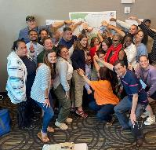
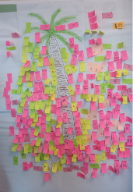
CARICAP
Proposal for a regional support program for protected area in the Greater Caribbean Region
Objective: contribute to the preservation of biodiversity in the Wider Caribbean Region
  1. Sharing and strengthening the capacities of managers through peer-to-peer exchanges, for more effective and sustainable management of protected areas in the WCR;
  2.Meet current and future challenges by enabling PA to better adapt to global climate change
  3. Ensuring the proper integration of civil society in the protection of biodiversity in the Wider Caribbean region
  4. Bringing the issues and the voice of marine and coastal protected areas beyond the Caribbean region
  5.Ensuring the sustainability of the network and its actions for the post-2030 period
Calendar:
  2024: project validated by SPAW protected area managers
  2025: securing fundings & first call for peer-to-peer exchange
  2026: preliminary studies and installation of project governance bodies
  End 2026: launch of the project
Notes:
L’objectif du programme est de contribuer à la préservation de la biodiversité dans la grande région Caraïbe, en renforçant les capacités des gestionnaires d’aires protégées grâce à des échanges entre pairs, en soutenant l’adaptation des sites aux effets du changement climatique, et en assurant une meilleure intégration de la société civile. Le programme vise aussi à donner une voix plus forte aux aires protégées caribéennes sur la scène internationale et à assurer la pérennité du réseau après 2030.
L’objectif 1, sur le renforcement des capacités, a été co-construit avec les gestionnaires du réseau SPAW lors d’une réunion en présentiel à Homestead, en novembre 2024, au cours de laquelle une feuille de route pour le renforcement des capacités d’ici 2030 a été élaborée.
Les résultats attendus de ce projet CARICAP incluent un réseau SPAW renforcé, actif et reconnu à l’échelle régionale et mondiale, une montée en compétence des gestionnaires, entre 5 et 10 sites ayant intégré des mesures d’adaptation climatique, la création de aires marines ou terrestres éducatives, une meilleure gestion de l’impact du Sargasse, et l’expérimentation de modèles de gouvernance plus inclusifs.

