Slide 1

SPAW PROTOCOL
COMPLIANCE

Slide 2
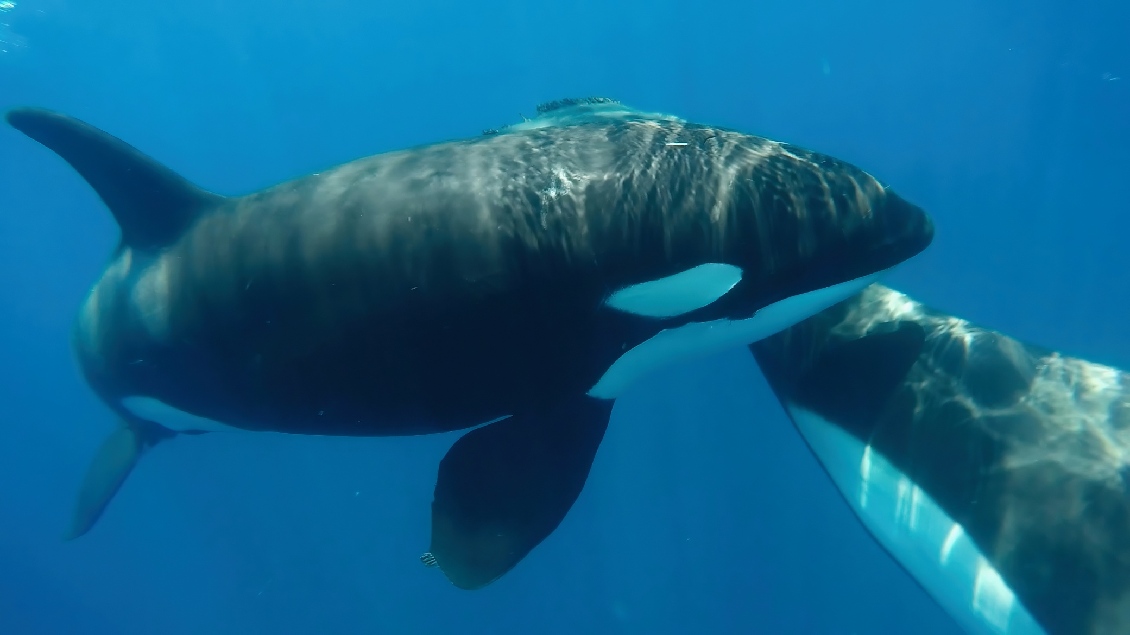
Implementation of MEAs depends on Parties’ compliance with their provisions.
Many countries face challenges meeting obligations under multiple agreements.
Monitoring, reporting, and enforcement are key tools to support compliance.
The challenge of
Compliance in MEAS

Slide 3
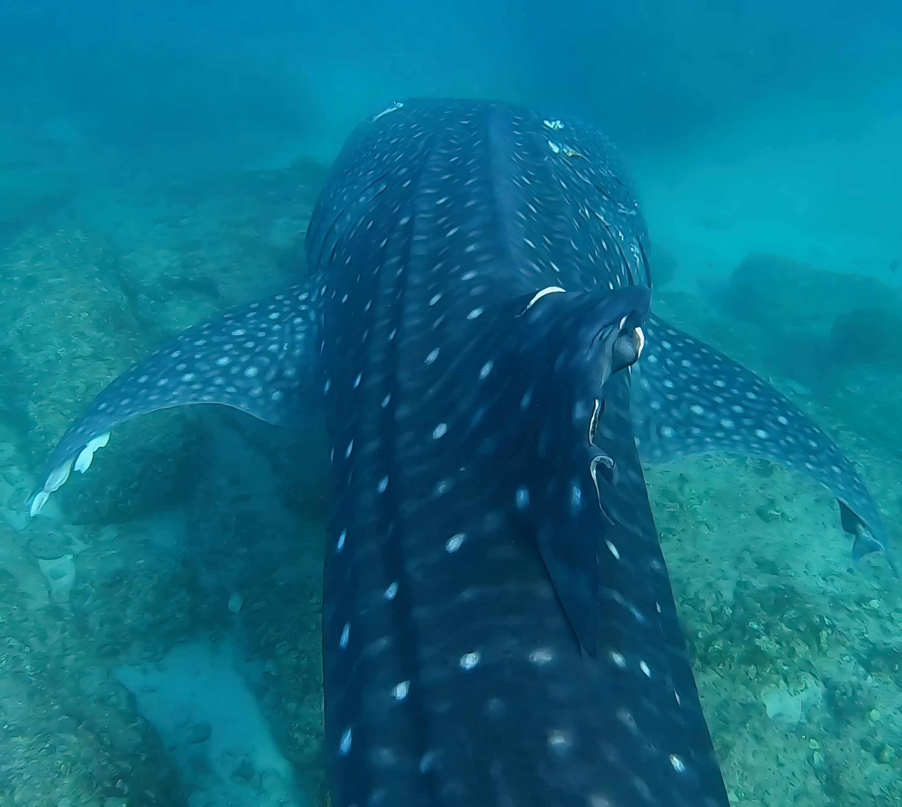
Compliance and
The SPAW Protocol
No formal compliance or enforcement mechanism.
The Protocol includes reporting requirements to support data exchange and assess implementation.
Contracting Party reporting has been limited or inconsistent.
Barriers include limited capacity, poor coordination, lack of continuity, and unclear obligations.
Some Parties may hesitate to report due to perceived reputational risks.
Addressing these issues through national consultations could help improve compliance and effectiveness.

Slide 4


Contracting Party Responsibilities
Under SPAW
Art. 11(2): Requires reporting exemptions to species protections (e.g., for science or management); reviewed by STAC using a standard format adopted at COP8.
Art. 14: Allows exemptions for traditional subsistence and cultural needs; must be reported but not reviewed by STAC. Terms remain undefined.
Art. 19: Calls for periodic reports on the status of protected areas and species, including threats and management plans. No set timeline.
Art. 22 (Cartagena Conv.): Biennial national reports required across all Protocols. Includes SPAW-related data, but reporting rates remain low.

Slide 5

Other Contracting Party Obligations under the
SPAW Protocol
Article / Obligation | Type | Summary of Obligation / Implementation
Article 10 – National Measures | Legal / National | Parties must identify and protect threatened species through national legislation that prohibits destruction or disturbance.
Article 13 – Environmental Impact Assessment | Assessment | Encourages Parties to assess impacts of activities on protected areas/species; STAC may assist with evaluation.
Article 16 – Awareness and Engagement | Outreach | Requires Parties to publicize protected areas/species, raise public awareness, and promote understanding of their value.
Articles 17 & 18 – Research and Monitoring | Capacity / Science | Parties must develop training, education, and monitoring programs, coordinating efforts with the Secretariat and others.
Caribbean Trust Fund (CTF) | Financial | Parties are expected to make annual voluntary contributions to the CTF to support Convention and Protocol implementation.

Slide 6
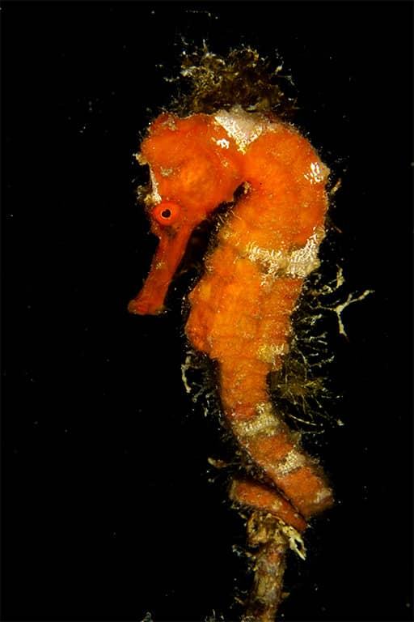
Decisions of the Contracting Parties
Requiring Action
Species Protection:
COP10 Decision 9 urges Parties to ban cetacean hunting via national legislation, report any takes, and strengthen collaboration on marine mammal data.
STAC6 Recommendation VI calls on Parties to stop sea turtle harvesting unless properly exempted under Article 11(2).
STAC10 Recommendation IX.12 requests the Secretariat and SPAW-RAC to support Contracting Parties in implementing the MMAP and Recommendation IX.13 to report to STAC11 on their activities in support of the Action Plan.
Exemptions (Art. 11(2)):
COP9–COP12 decisions emphasize the importance of reporting exemptions for listed species using the approved format.
Repeated calls were made for Parties to report any takes not prohibited by law to the STAC for assessment.
Voluntary Contributions:
COP11 Decision II and COP16 Cartagena call on Parties to increase financial contributions to the Caribbean Trust Fund (CTF) to support SPAW implementation.
Protocol Implementation:
COP12 Decision IV encourages more countries to ratify the SPAW Protocol and fulfill their obligations.

Slide 7






Key Challenges to
SPAW Protocol Compliance
LOW REPORTING RATES
WEAK LEGAL FRAMEWORKS
PROTECTION MEASURES NOT APPLIED
< 25% of SPAW Parties submitted biennial reports in the last cycle.
National laws often lack enforcement or do not fully protect SPAW-listed species and areas.
Ongoing harmful activities (e.g., hunting of cetaceans, destruction of coral) undermine Article 11 obligations.
FEW EXEMPTIONS REPORTED (ART. 11(2))
MINIMAL REPORTING UNDER ARTICLE 14
INSUFFICIENT FINANCIAL CONTRIBUTIONS
Only 3 Parties have submitted formal exemption reports as required.
Only 1 Party has reported to the Secretariat of traditional subsistence and cultural uses.
Chronic underfunding of the Caribbean Trust Fund (CTF) threatens Secretariat operations.

Slide 8


Existing Mechanisms to Encourage
SPAW Implementation
Diplomatic bilateral outreach with Parties to address non-compliance
Decisions of the Parties that reflect collective commitments but are not binding or enforceable.
Biennial reporting required under the Cartagena Convention, though compliance remains very low.
Monitoring Committee (Not Operational), proposed at IGM19, but no consensus to establish it.
Extended Bureau
STAC Working Groups

Slide 9

Recommendations to Strengthen
SPAW Compliance and Reporting
Conduct Listening Sessions (LS on Compliance in Feb 2025 in collaboration with the Barcelona Convention and OSPAR)
Establish a Compliance mechanism
Expand the Exemptions Working Group’s Mandate
Organize Capacity-Building Workshops
Enhance Outreach and Bilateral Dialogue
Conduct a National Capacities Survey
Implement Exemptions WG Recommendations
Ecosystems are essential to life on Earth. Every part, from the tiniest insect to the tallest tree, has a role in keeping nature balanced. By protecting ecosystems, we’re also protecting our future. Even small actions can help make a big difference.

Slide 10

Possible Recommendations for
STAC consideration
Recommendation Option 1
The Secretariat, acknowledging the current challenges facing the SPAW Protocol regarding implementation, reporting and compliance, will, in consultation with contracting parties and Observers, work intersessionally to develop a proposed compliance mechanism for presentation to STAC12. This proposal will include the structure, operation, and administration of such a compliance mechanism.
Recommendation Option 2
The STAC extends the mandate of the Exemptions Working Group to further analyze and advance those recommendations to enhance reporting of exemptions recommended by STAC10 and adopted at COP12.
Recommendation Option 3
The STAC recommends the creation of a compliance committee to advance implementation of the Protocol. To create the compliance committee, the STAC recommends approval of an Ad Hoc working group led by the RAC and comprised of Parties and Observers to propose rules of procedure, define Committee objectives, and identify steps necessary to establish and convene a compliance committee for the SPAW Protocol. The working group will review the Barcelona Convention’s compliance mechanisms to identify implementation challenges and successes for such a committee; consider the procedural roadmap exemplified by the Barcelona Convention’s Compliance Committee; and define the committee’s mandate under SPAW.

Slide 11

THANK YOU

