Slide 1
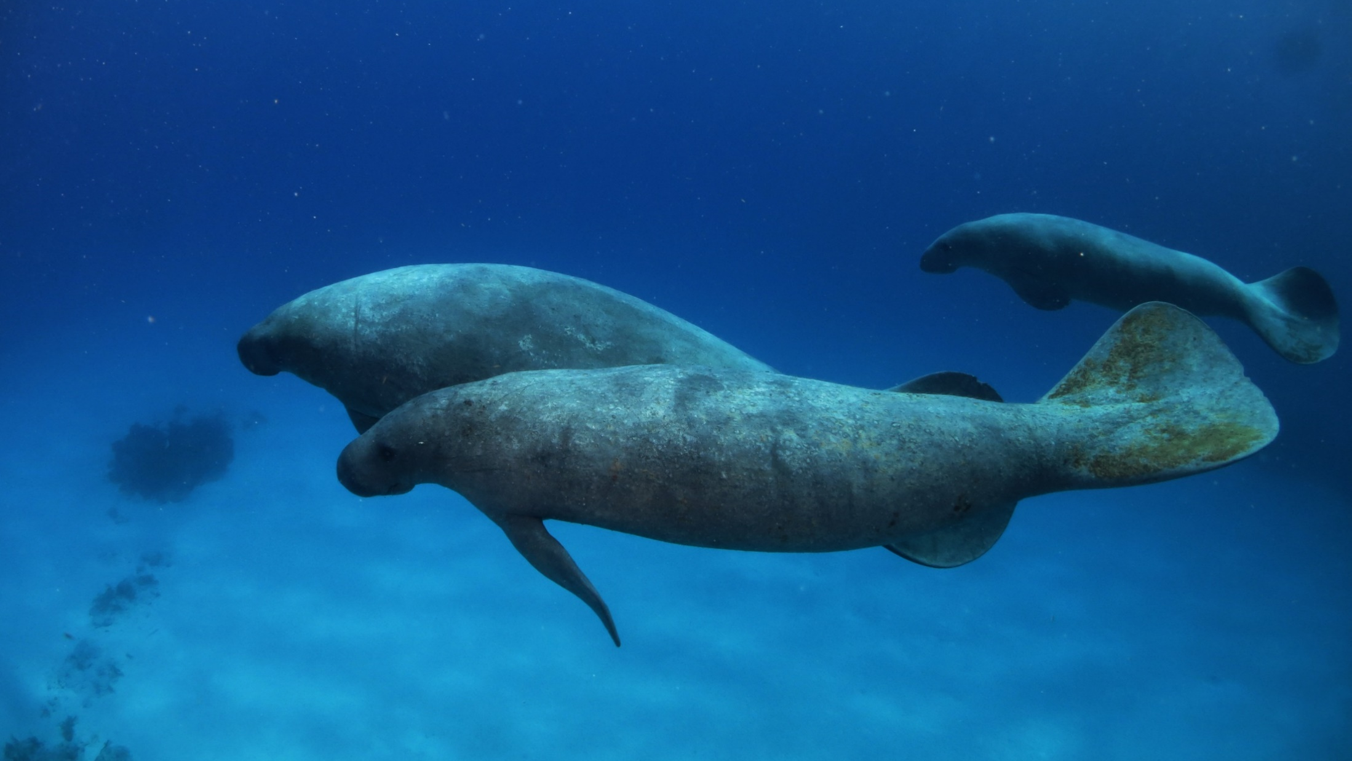
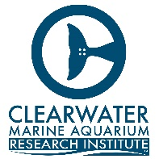


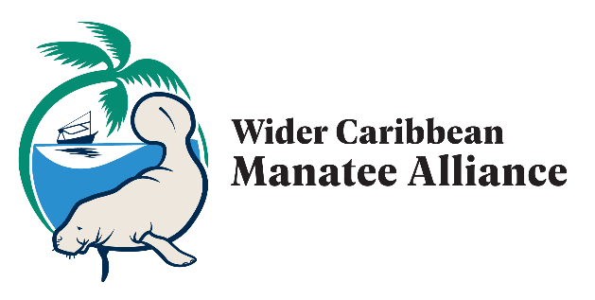
Eleventh Meeting of the Scientific and Technical Advisory Committee (STAC) of the Protocol Concerning Specially Protected Areas and Wildlife (SPAW) in the Wider Caribbean Region
"Manatees of the Wider Caribbean: Building a Regional Alliance for Conservation"
Anmari Alvarez-Aleman
Caribbean Research Director, Clearwater Marine Aquarium
Co-Chair Sirenia Specialist Group, SSC/IUCN

Slide 2

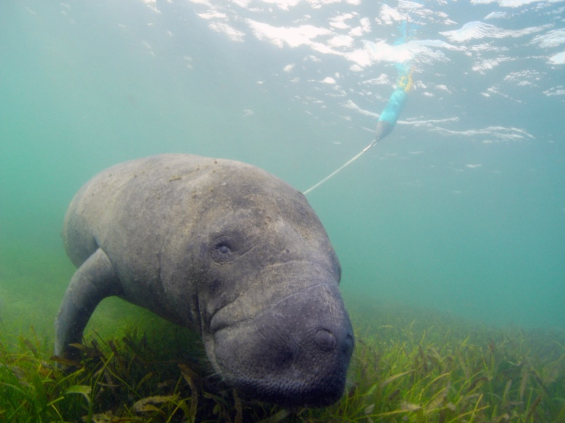
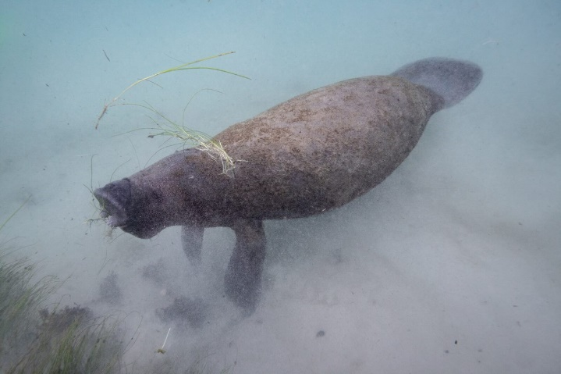
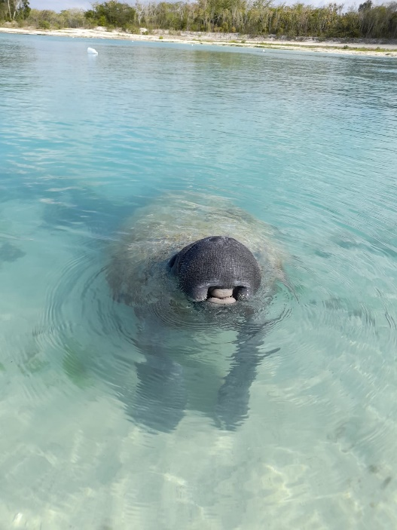
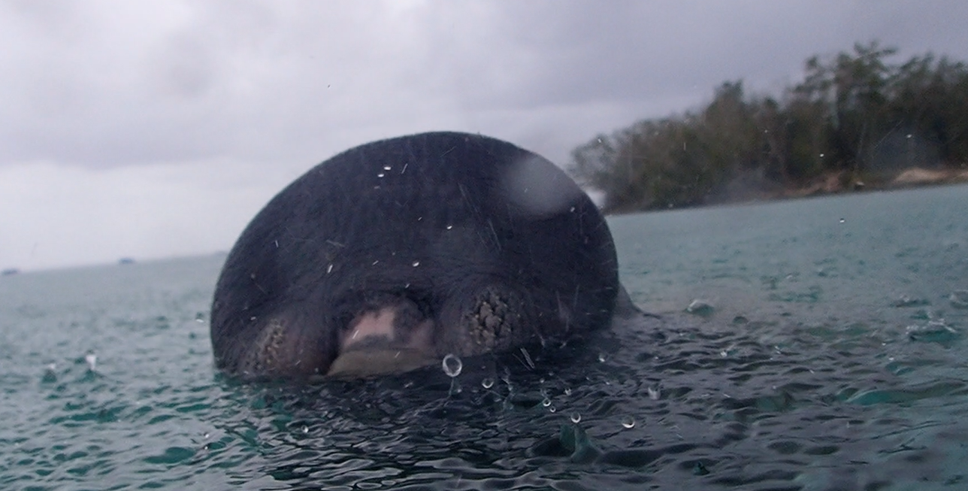
Manatees: the treasure of the Wider Caribbean
A Flagship species and Symbol of Coastal Ecosystem Health
The only aquatic mammal with a herbivorous diet
Has a limited physiological capacity for thermoregulation and the apparent need for drinking freshwater
Complex population dynamics and connectivity patterns
Photos by: Rachel Plekaniec, Marvin del Cid, Antonio Mignucci

Slide 3
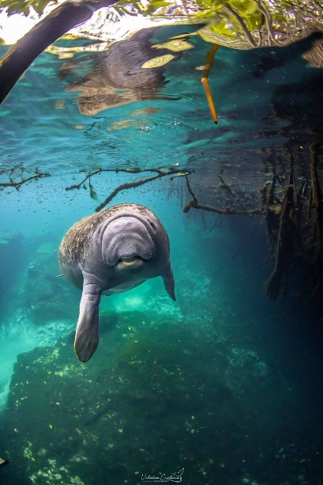
Manatees: the treasure of the Wider Caribbean
-The Wider Caribbean encompasses a rich diversity of manatee habitats. Estuaries, rivers, shallow coastal, springs, seagrass beds
-Two subspecies described
Based on morphology, geographic distribution, and behavior, and two genetic lineages
Mignucci-Giannoni et al. 2024
Photos by: Valentina Cucchiara, Leonardo Espinosa, PNCZ

Slide 4
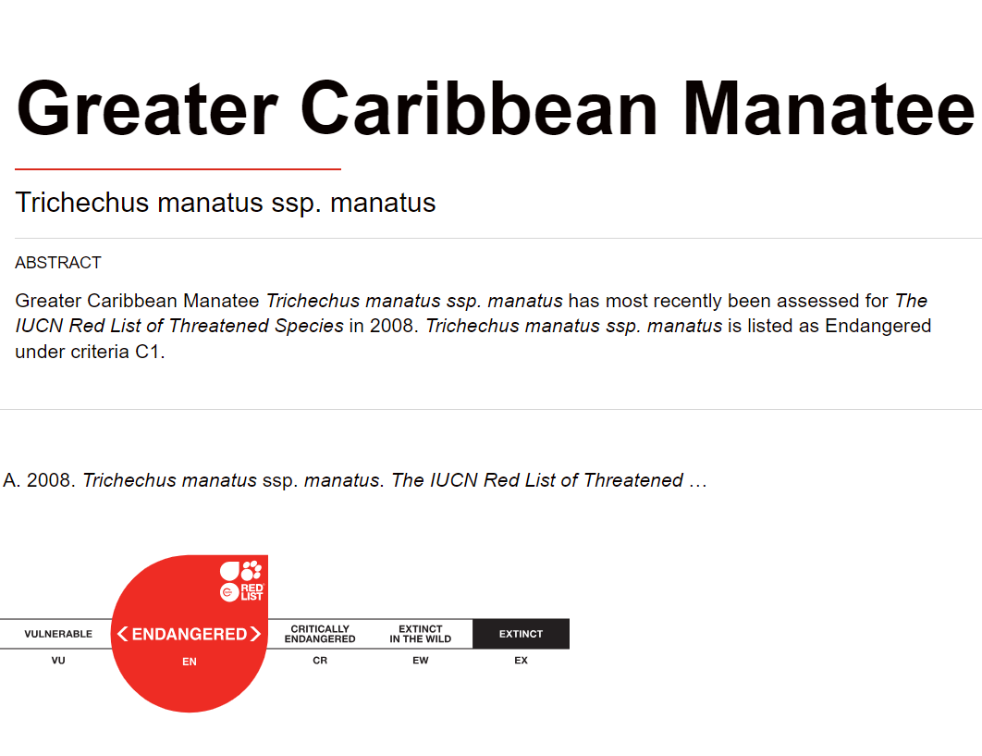
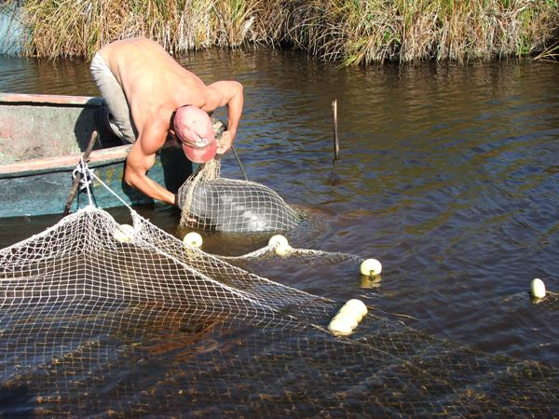
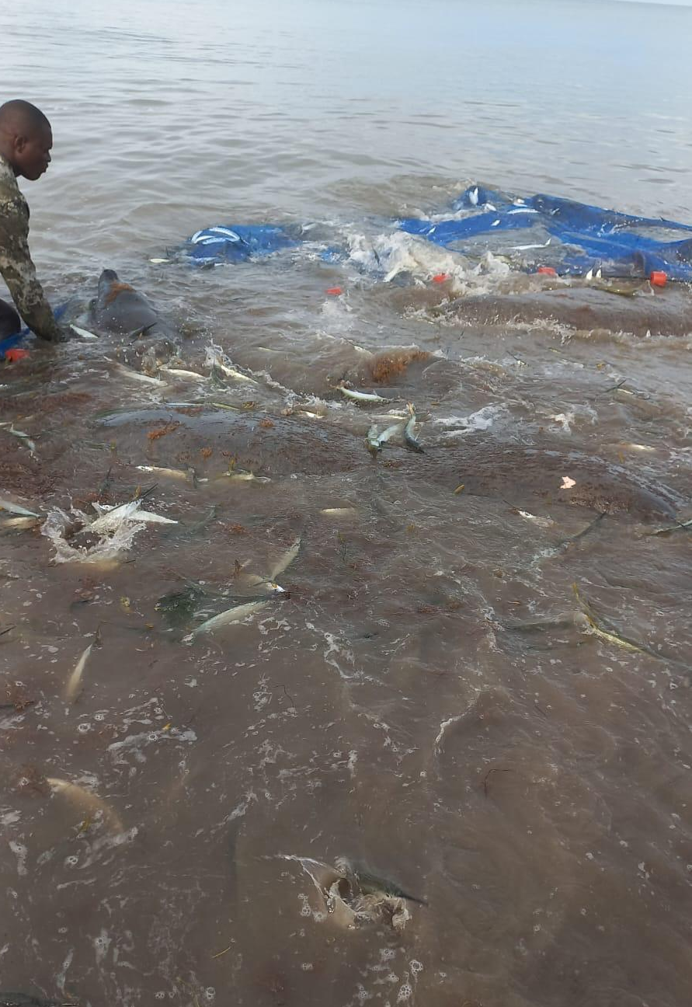
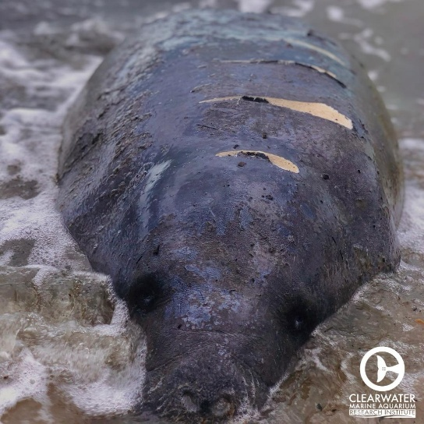
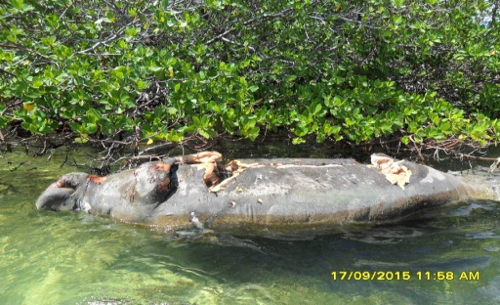
Regional Conservation Urgency
Cuba
-Low population sizes (Estimated 2,091 mature individuals)
-High frequency of undetermined cause of death in countries databases (20-50%)
-Populations classified as Endangered or Critically endangered.
Jamaica
Belize
Threats for the species
Interaction with fisheries
Poaching
Watercraft collisions (on the rise)
Habitat loss and habitat fragmentation
Climate change
Cold Stress/red tide
Five manatees in a trawl net
Cuba

Slide 5
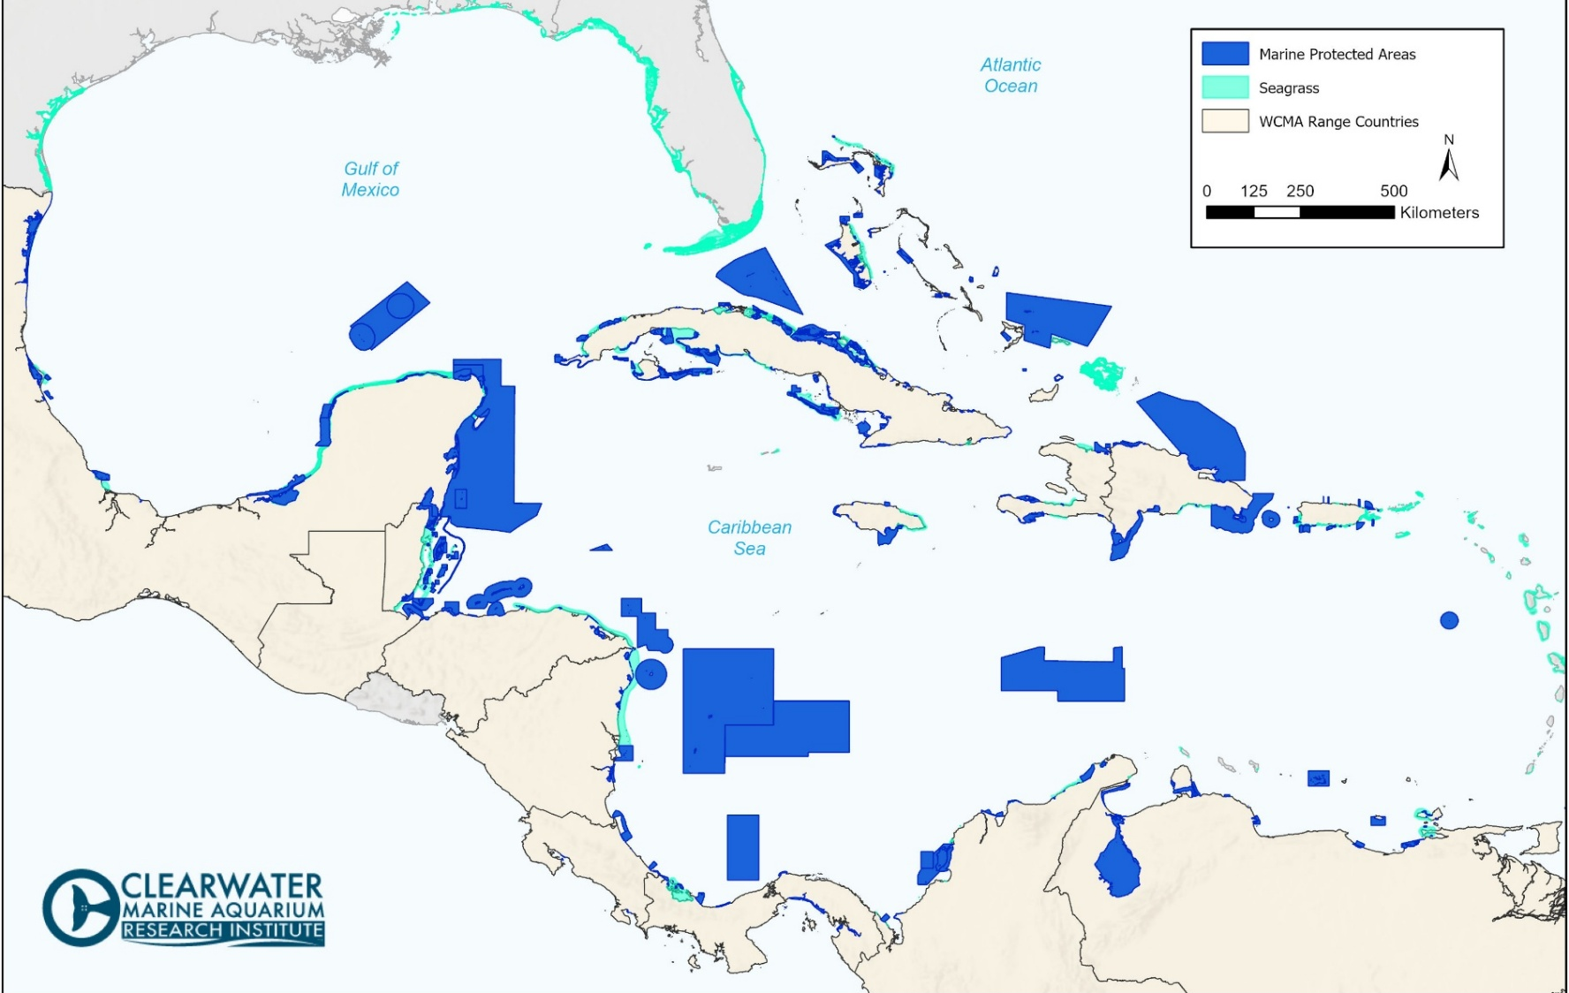
Regional Conservation Urgency
-Seagrass availability is already scarce and projected to decline significantly
-Estuarine and riparian habitats are also in decline
-Island nations in the region are particularly vulnerable to climate change impacts.
-On average, only 5% of marine areas are under protection per country in the Wider Caribbean.
-Critical habitats for manatees are often left outside of existing protection measures.
-The effectiveness of existing Marine Protected Areas (MPAs) remains poorly evaluated or unassessed.
https://habitats.oceanplus.org/, Explore the World's Protected Areas

Slide 6
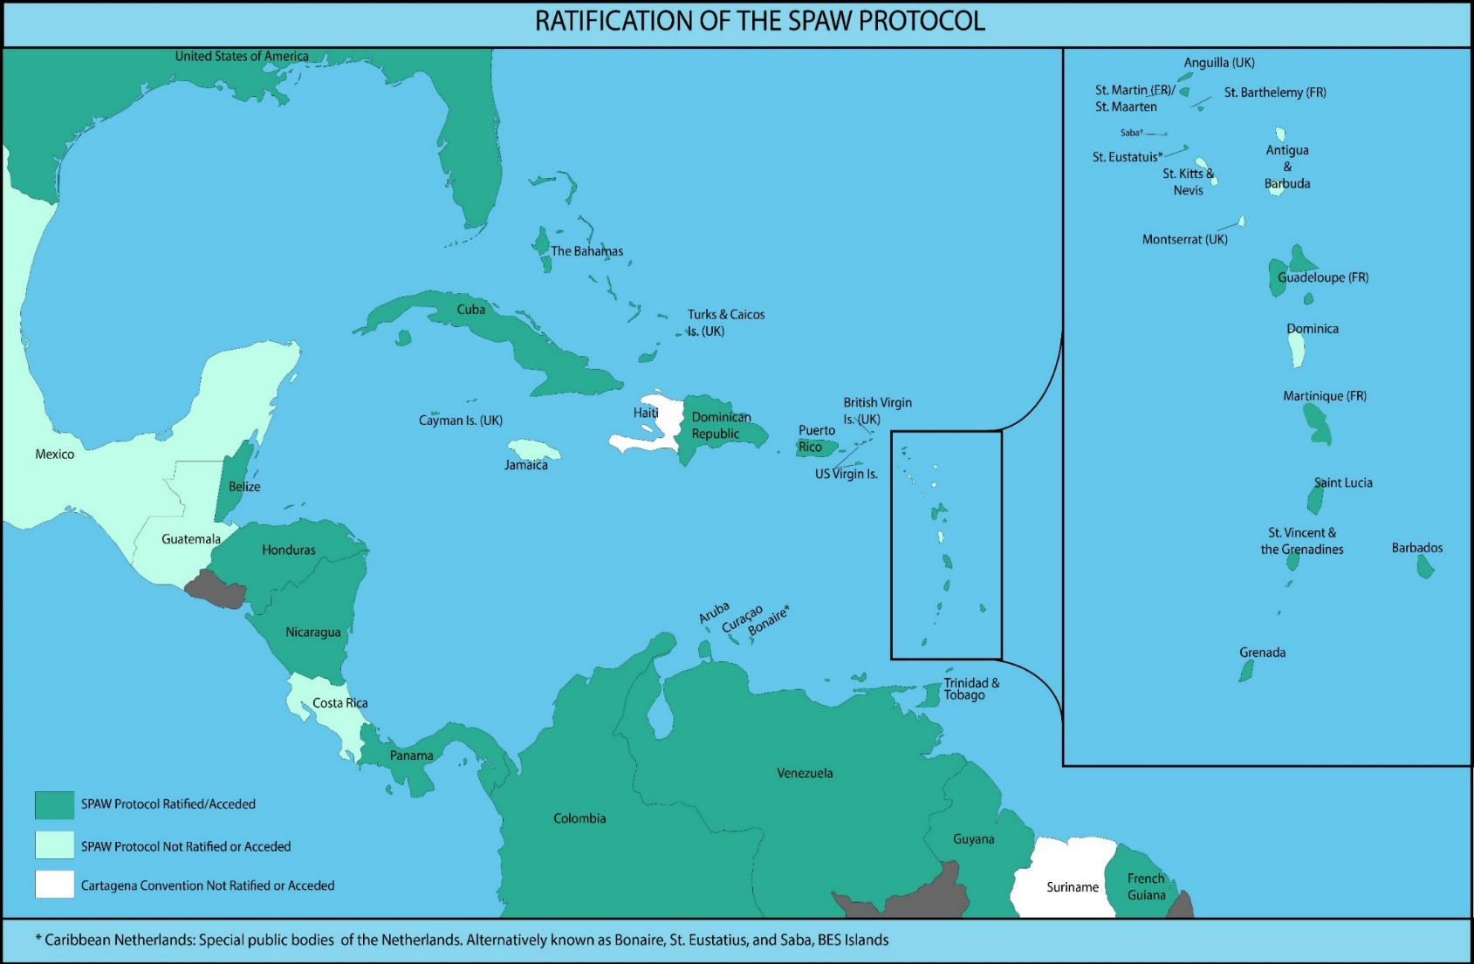
Regional Conservation Urgency
-20 countries with populations
-13 countries are signatories of the SPAW Protocol International Conservation Instrument
-6 countries with Species Conservation Plans
-IUCN Sirenia Species Members in 5 countries
-Gap in the species regional knowledge and conservation strategies

Slide 7
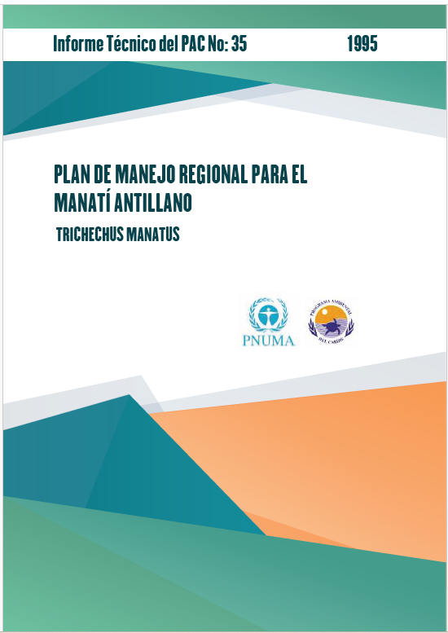
Regional Conservation Strategies
Priorities in 1995:
Improve (AWARENESS) about the manatee among the people of the Wider Caribbean
Creation of protected areas and enforcement of relevant laws (PROTECTION)
Reduction of human-caused mortality
Develop national recovery plans and organize national recovery teams (MANAGEMENT PLANS)
Establish an information and cooperation network among countries in the Wider Caribbean Region that share manatee populations (COLLABORATION NETWORK)

Slide 8
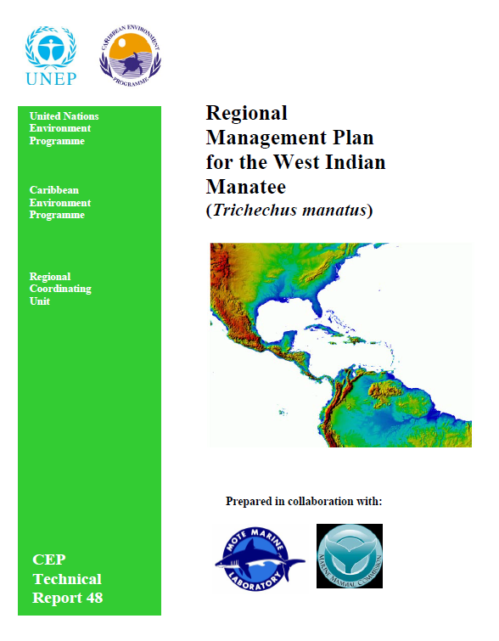
Regional Conservation Strategies
Priorities in 2010:
Assess manatee current status and distribution (RESEARCH AND MONITORING)
Define guidelines for data collection/censusing (GUIDELINES AND PROTOCOLS)
Improve manatee awareness (AWARENESS)
Protected areas (PROTECTION)
Enforcement laws (PROTECTION)
Reduce human-related mortality
Promote cooperation and exchange of information on manatee conservation (national and regional) Prepare/update national recovery plans. and organize recovery teams. Establish an information and cooperation network (NETWORK)

Slide 9
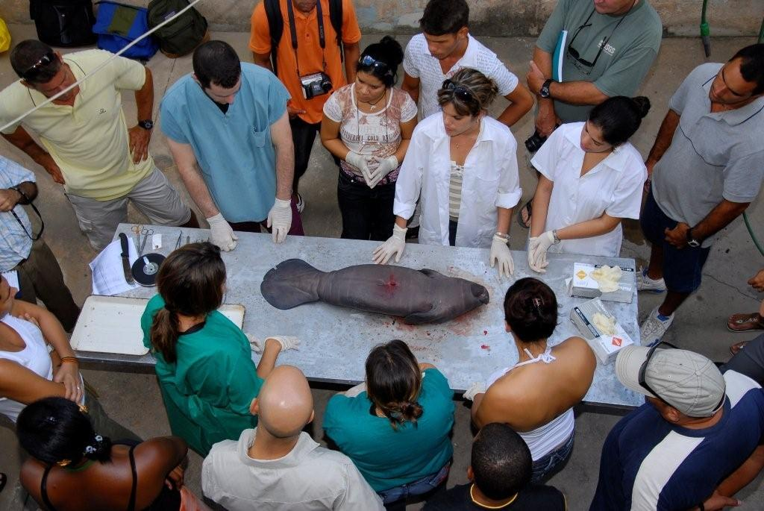
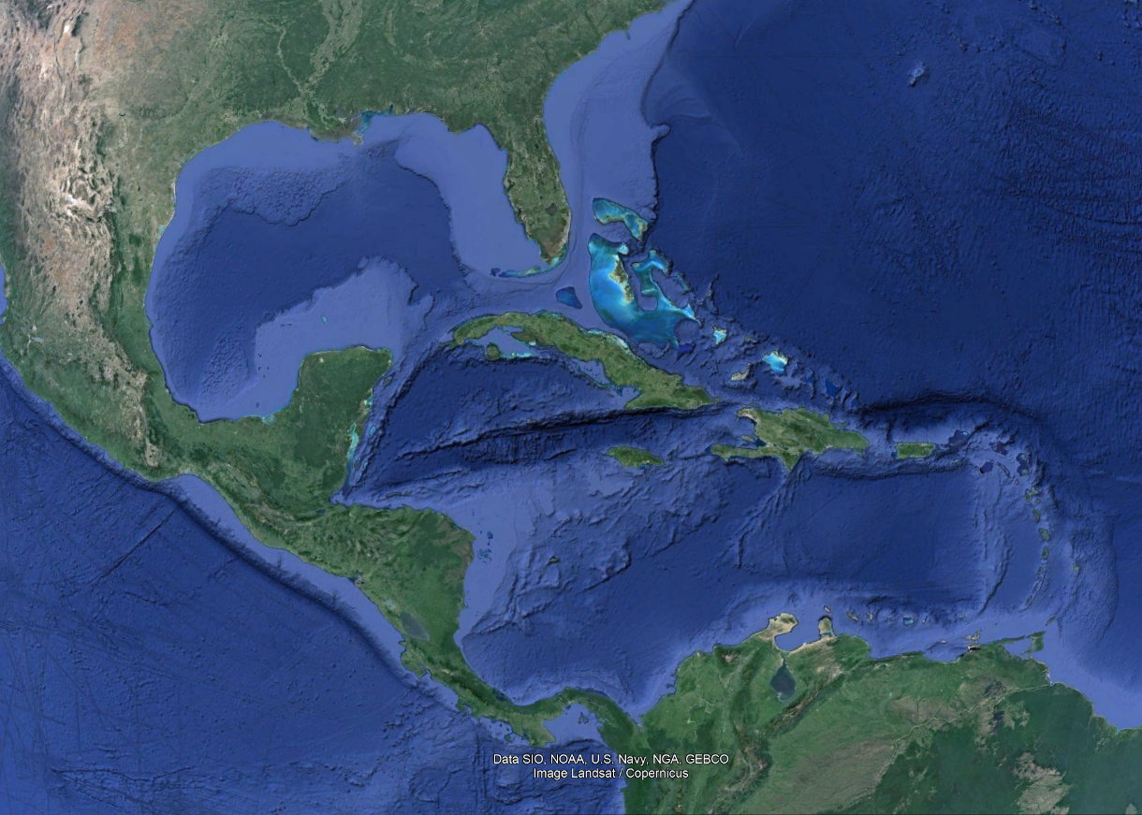
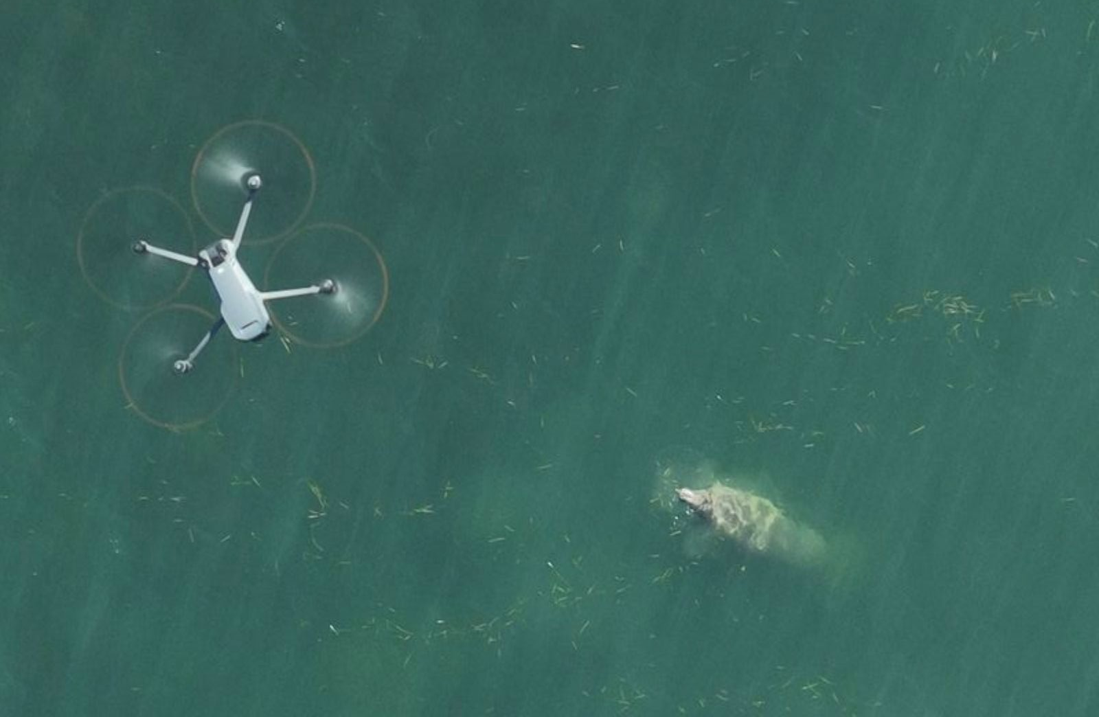
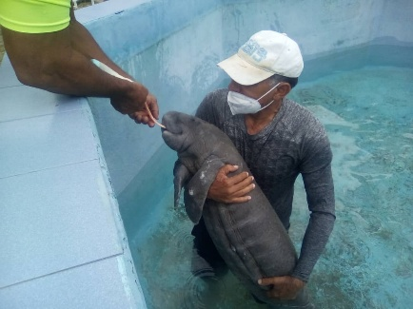
Wider Caribbean Manatee Alliance
A strategic alliance can leverage each other's strengths to achieve mutual benefits.
Goal 2. Enhance manatee conservation capacity in the Caribbean through various strategies, which will ultimately strengthen the capacity of countries and stakeholders to effectively conserve manatees
  Goal 1. Establish and maintain a robust network of manatee experts and stakeholders
Goal 3. Expand scientific research focused on the Greater Caribbean manatee, aiming to bridge existing knowledge gaps.
Goal 4. Strengthen the rescue, rehabilitation, and release capabilities for the Greater Caribbean

Slide 10


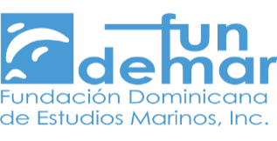


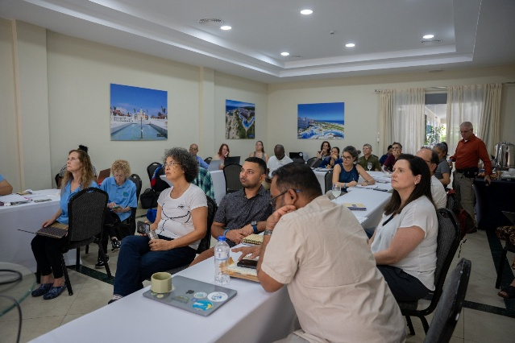
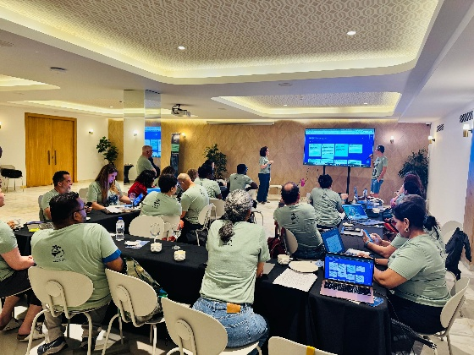
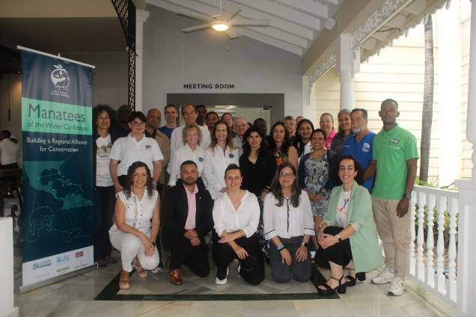
Wider Caribbean Manatee Alliance
February 2025-
Regional workshop: "Manatees of the Wider Caribbean: Building a Regional Alliance for Conservation“
Workshops Participants
32 regional participants, 27 institutions, and 17 Caribbean countries in the Dominican Republic

Slide 11
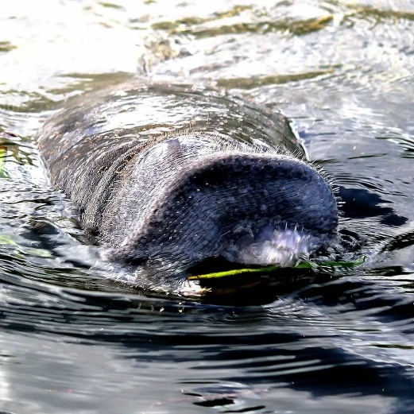
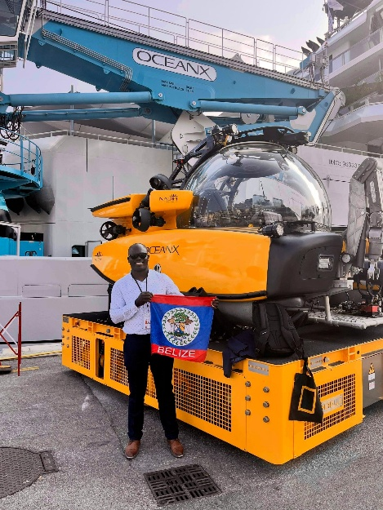
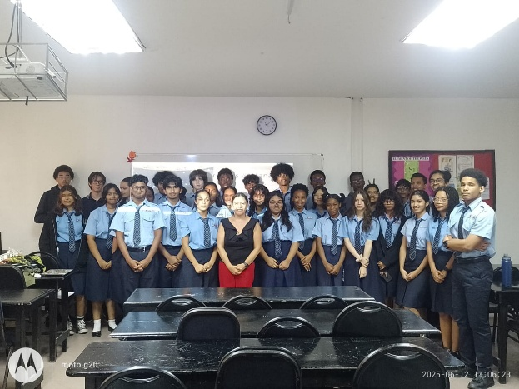
Wider Caribbean Manatee Alliance
February 2025-
Regional workshop: "Manatees of the Wider Caribbean: Building a Regional Alliance for Conservation“
Strategies
-Increase Governance, Planning and Institutional Capacity in the Caribbean Region
-Promote Regional Collaboration
-Increase habitat protection
-Reduce Human Related Mortality
-Expand Research and Monitoring.
-Increase Education and Awareness
-Institutionalize the regional network
Vision
A thriving and interconnected manatee population across the Wider Caribbean, sustained by effective conservation, regional collaboration, and community engagement. By 2040, manatees will coexist harmoniously with local communities, their key habitats will be protected, and their ecological, cultural, and economic significance will be recognized and valued across the region.
Mission
"To coordinate regional efforts for the conservation and recovery of the Greater Caribbean manatee by supporting research, monitoring, information sharing, education, and sustainable management of key habitats, while building national and regional capacities to ensure effective action across the Wider Caribbean."

Slide 12
Wider Caribbean Manatee Alliance Call to Action
"The WCMA provides a timely and unified regional platform to safeguard endangered manatees and their habitats, strengthening the implementation of national environmental commitments, advancing the objectives of the SPAW Protocol, and supporting the IUCN-SSC Sirenia Group—positioning the Wider Caribbean as a leader in collaborative conservation under international biodiversity frameworks."
Given the urgency of reversing the decline of this iconic species, we call on all government representatives and observers to join and support this critical regional effort."
HOW?
Endorse and help implement the WCMA regional strategy
Identify national stakeholders to connect with the Alliance
Facilitate in-country research and monitoring of manatee populations and habitats
Help shape education and awareness campaigns tailored to each country
Promote interagency coordination and regional collaboration
Explore and protect critical habitats (e.g., seagrass beds, estuaries)

Slide 13
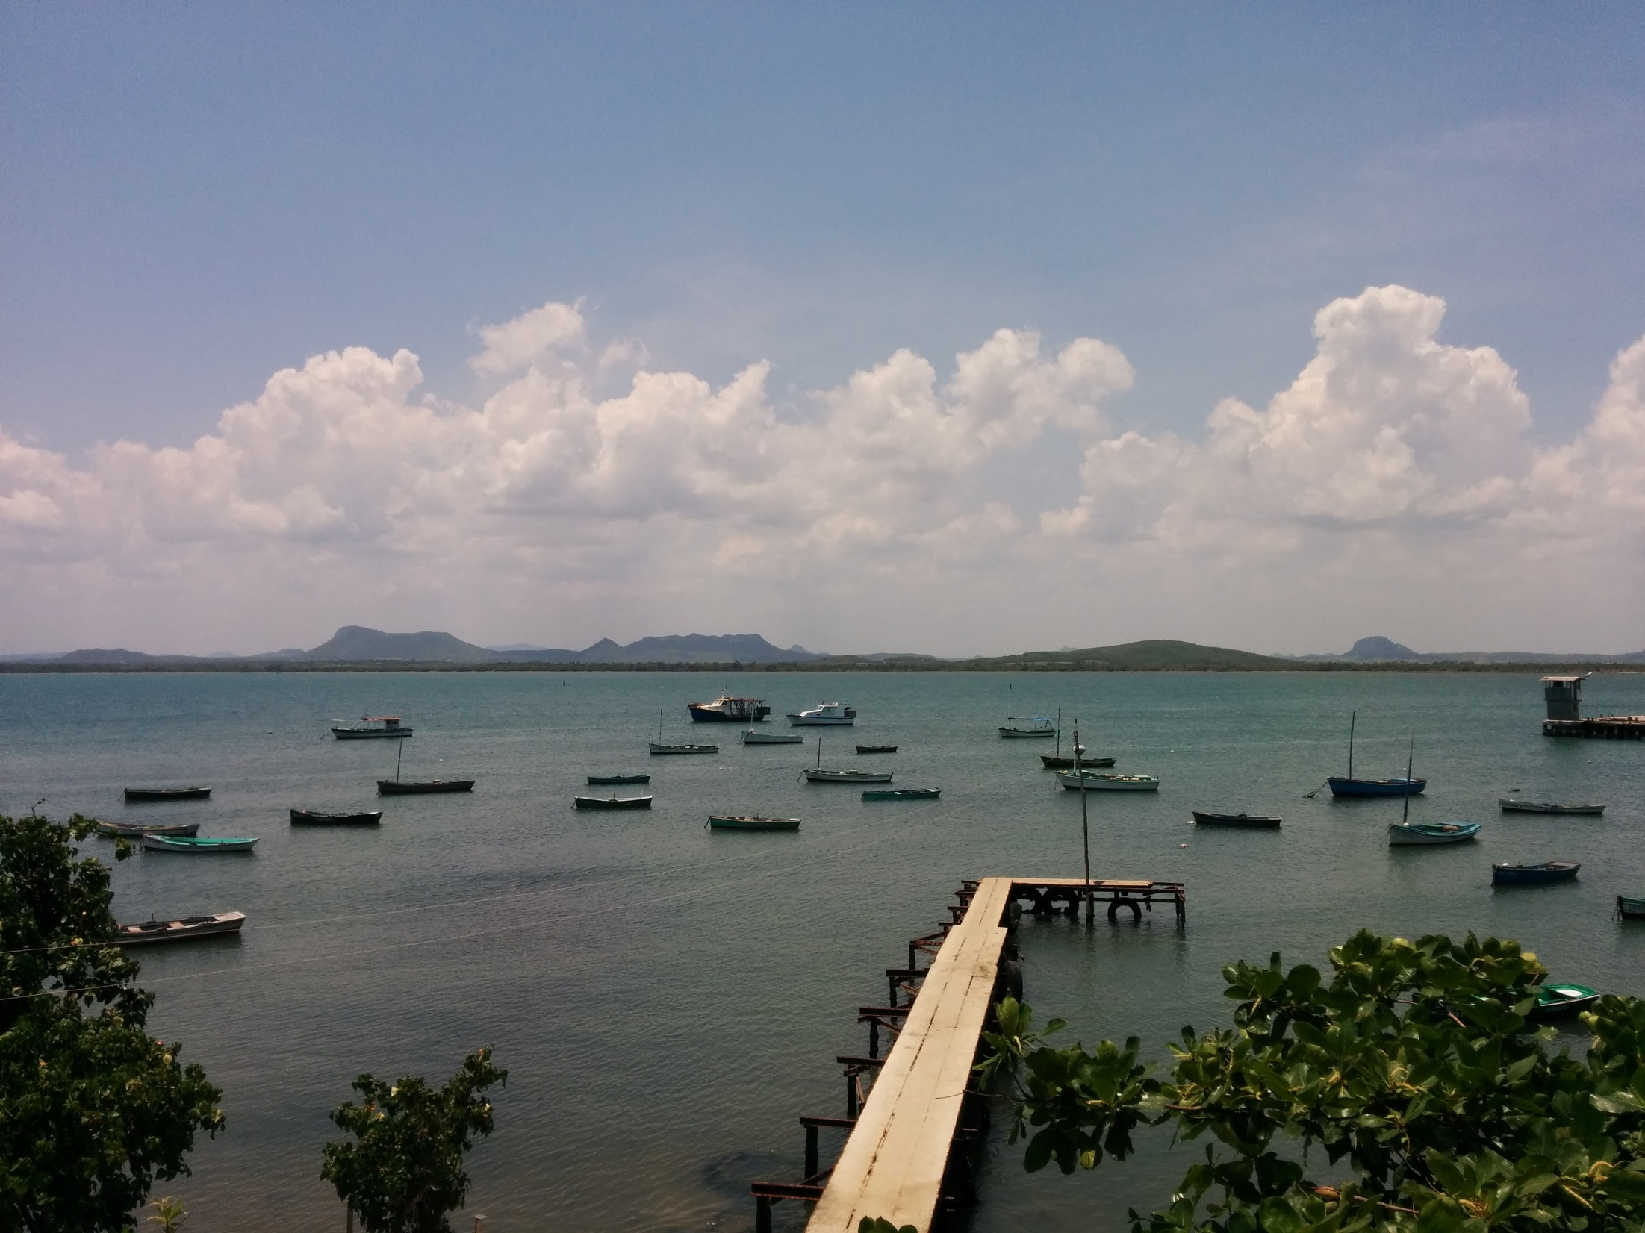
MUCHAS GRACIAS
MERCI BEAUCOUP
THANK YOU SO MUCH

