Slide 1
SPAW and the International Whaling Commission:
A Strategic Partnership for Marine Mammal Conservation

Slide 2
IWC Background
The International Whaling Commission (IWC) is the primary international body responsible for the management of whaling and conservation and stewardship of cetaceans
IWC is an inter-governmental organisation with a current membership of 88 governments
The mandate has not changed but many new conservation concerns exist and the IWC work programme has expanded to address these

Slide 3
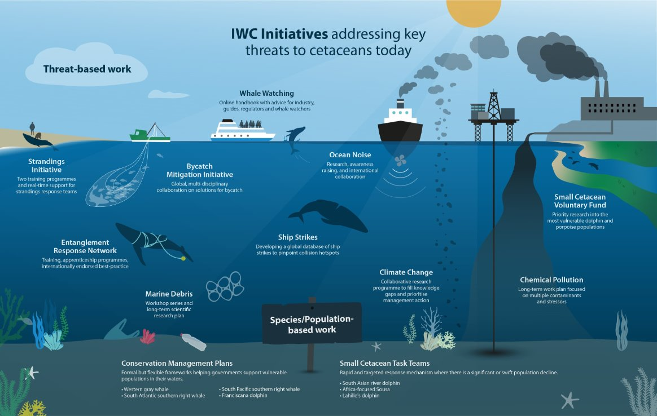
Notes:
This infographic shows the range of threat based work that the IWC currently works on with regards to cetaceans. Some of these have already been made available to SPAW members (press key to highlight) particularly ship strikes, and entanglement response and whale watching and more recently strandings response via CAMAc 1 program.
In addition to these we work on bycatch, ocean noise, pollution and debris, and sustainable whale watching.

Slide 4
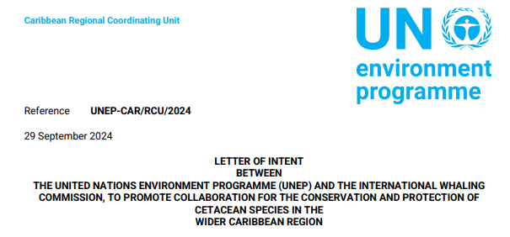
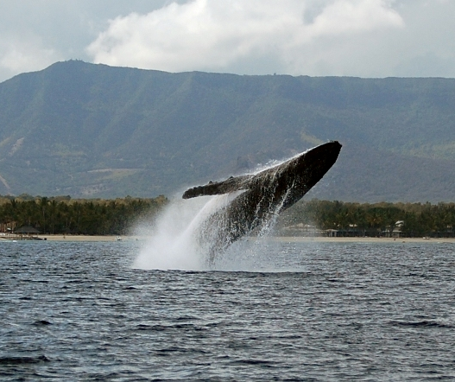
SPAW and the International Whaling Commission:
A Strategic Partnership for Marine Mammal Conservation
Capacity building
Reciprocal Observers
2024 Letter of Intent agreed
  Knowledge exchange
  Regional collaboration
  Joint initiatives
Notes:
So IWC is very happy to now have a Letter of Intent between UNEP and SPAW agreed last year, in order to continue to work towards greater conservation actions for cetaceans. As mentioned we have previously worked together on capacity building and been observers at our respective meetings.
The Letter of Intent will build on this existing cooperation and be guided by the workplan developed between the two organizations in order to
1. Identify and develop synergies and ensure effective cooperation in pursuit of common goals and objectives within each Parties respective mandates and governing rules and regulations.
2. Improve information and data sharing on the status and abundance of cetacean species.
3. Promote and encourage the conservation and management of key cetacean species and population.
4. Enhance collaboration on research, prevention of, and response to anthropogenic threats

Slide 5
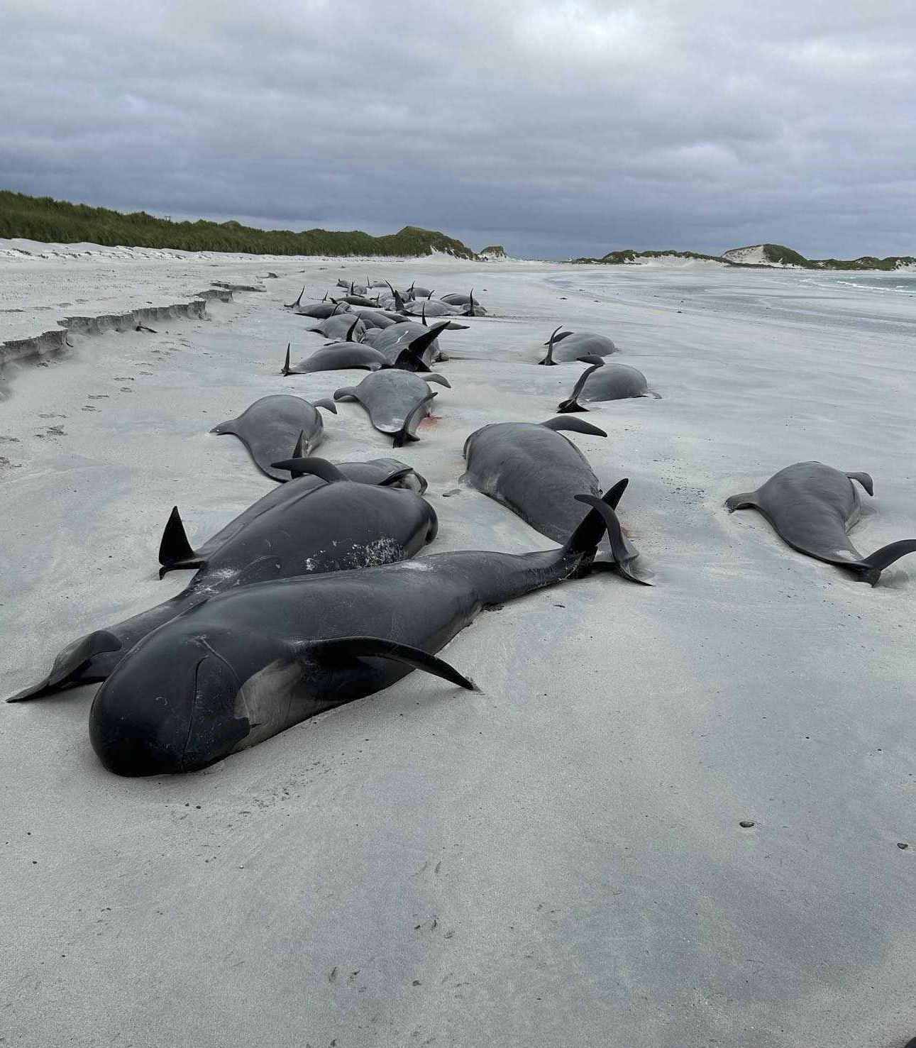
Strandings Initiative Our Mission
Emergency Response: Provide real-time support and advice for live strandings and investigations
  In-person or remote expert assistance
  Necropsy guidance and laboratory support
  Connect teams with specialists worldwide
Capacity Building: Develop skills and knowledge across the global community
  Training in marine mammal physiology and live strandings response
  Necropsy techniques and specialist disease investigations
  Best practice guidelines and protocols
Global Coordination: Foster international collaboration and knowledge sharing
  Connect 35 multi-disciplinary experts from around the world
  Link stranding networks, research facilities, and laboratories
  Maintain databases and facilitate sample/data sharing
Led by expert panel of veterinarians, pathologists, marine biologists, and educators
Notes:
I just wanted briefly to cover two of our Initiatives which are currently the most relevant given the conclusion of CAMAC 1 and the recent approval and start of CAMAC2.
In CAMAC 1 the Strandings Initiative provided training in the region and is continuing to support with the provision of equipment and advice. This slide ives you an outline of the areas covered by the Initiative.

Slide 6
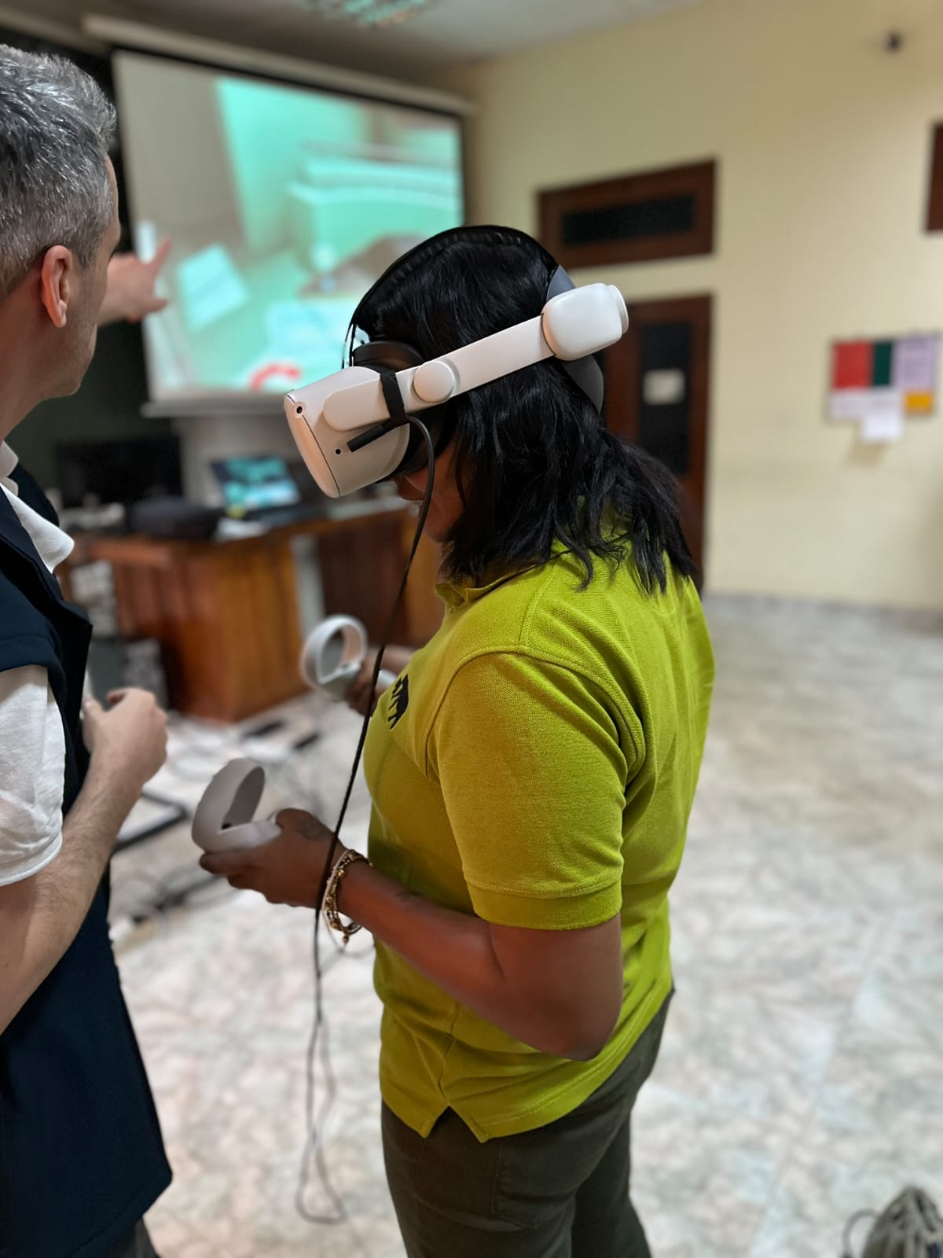
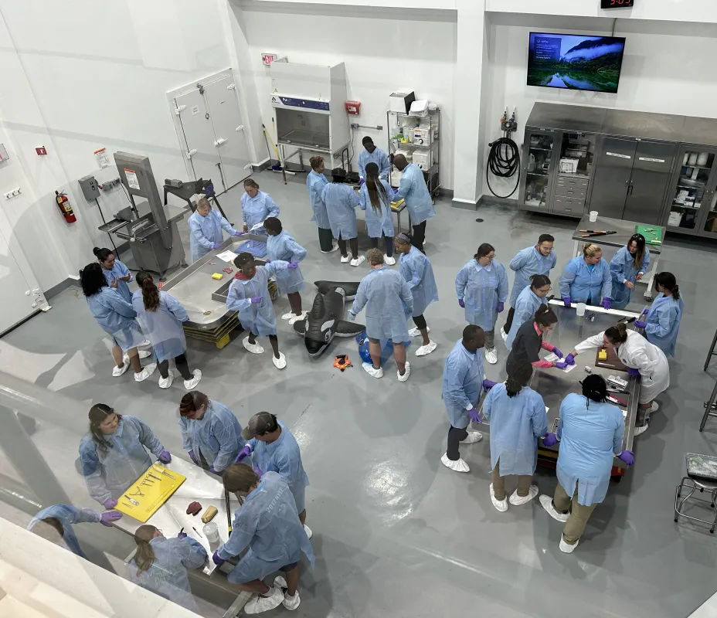
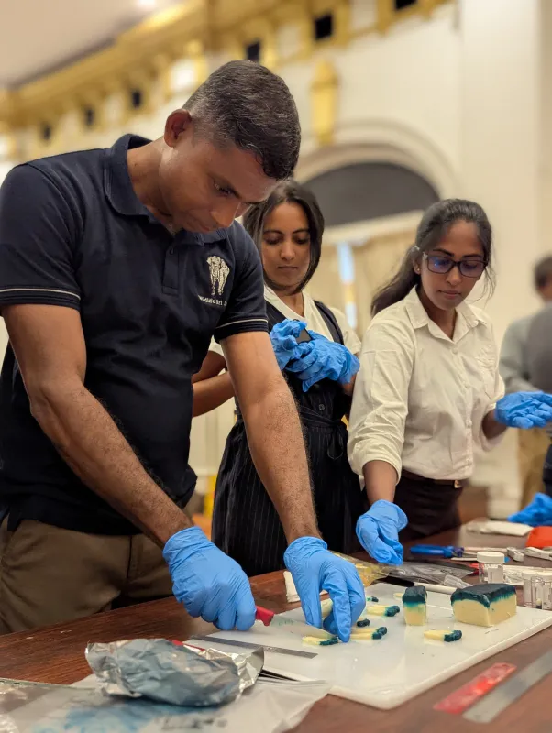
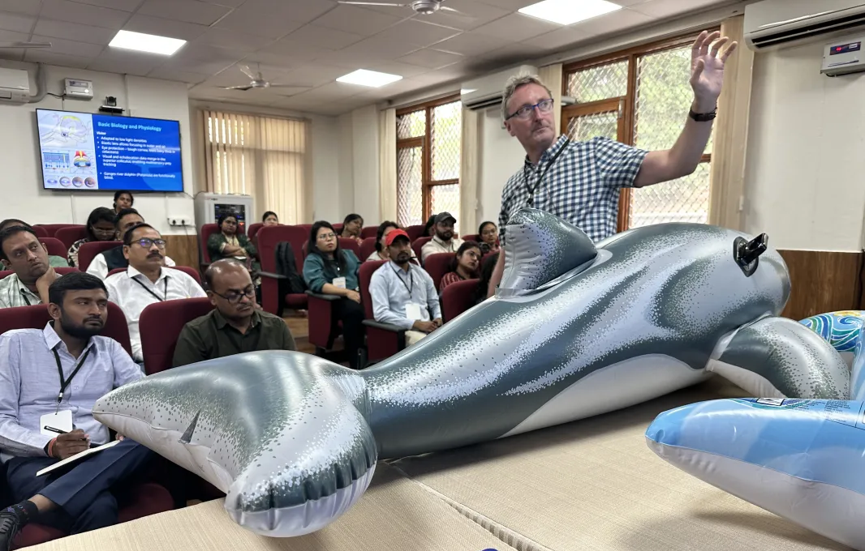
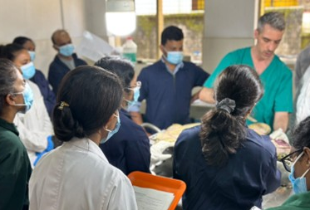
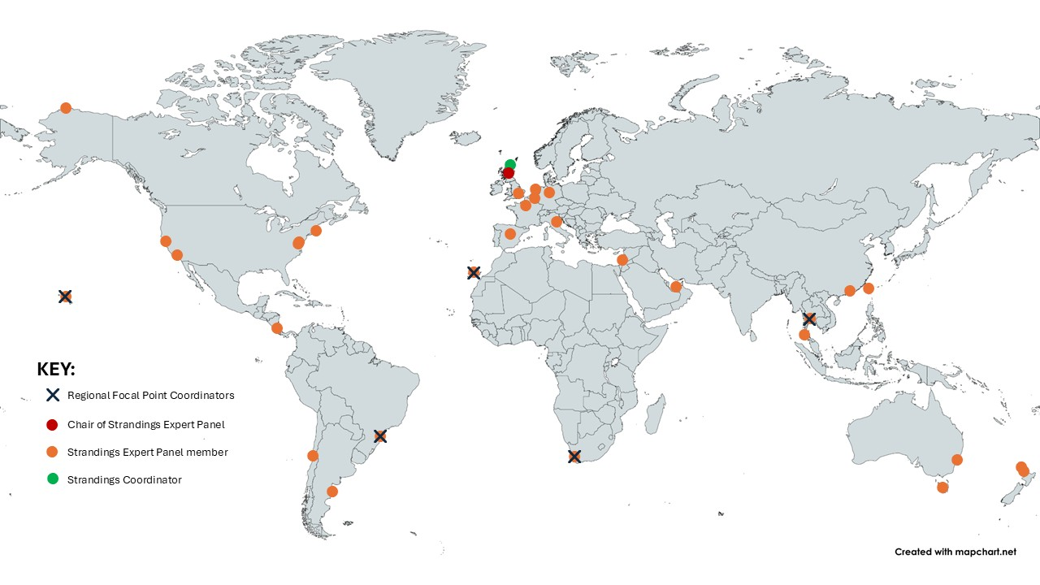
Support Available Through the Expert Panel
Immediate Assistance
  24/7 expert consultation for emergency strandings
  Virtual or in-person response support
  Guidance on live stranding response, necropsy procedures and sample collection
Training & Development
  Customised capacity building programs (delivered in multiple languages)
  Mentoring and knowledge exchange opportunities
Resources & Networks
  Best practice guidelines and digital toolbox
  Training videos
  Connections to laboratories and research facilities worldwide
Ongoing Collaboration
  Partnership opportunities with existing stranding networks
  Technical support for establishing new response programmes
Contact: Emma Neave-Webb, Strandings Co-ordinator
emma.neavewebb@iwc.int
Notes:
Strandings Response: is also supported by a coordinator and an Expert Panel. This panel provides real-time advice and support to teams dealing with strandings around the globe. Within the Secretariat we have a dedicated Strandings Coordinator. The photographs on this slide are from recent national level trainings in India. Should inperson training not be possible we are developing ideo demonstrations that can be used and followed for training purposes.
Global Whale Entanglement Response Network: this programme began in 2011. To date the workshops have taught safe and effective entanglement response skills to over 1200 participants from more than 30 countries.
Bycatch Mitigation: since 2016, this programme is led by a coordinator and also has a multi-disciplinary Expert Panel. The BMI is working to raise awareness of the solutions available to monitor and mitigate cetacean bycatch.
Mitigation of Ship Strikes: Since 2007 the IWC has maintained a global Ship Strikes database; the information is used to identify high risk areas and populations. The Programme also has a multi-disciplinary Expert Panel working to implement mitigation measures.
Conservation Management Plans (CMPs): provide a framework for national governments and other stakeholders to work together on measures to protect vulnerable populations.

Slide 7
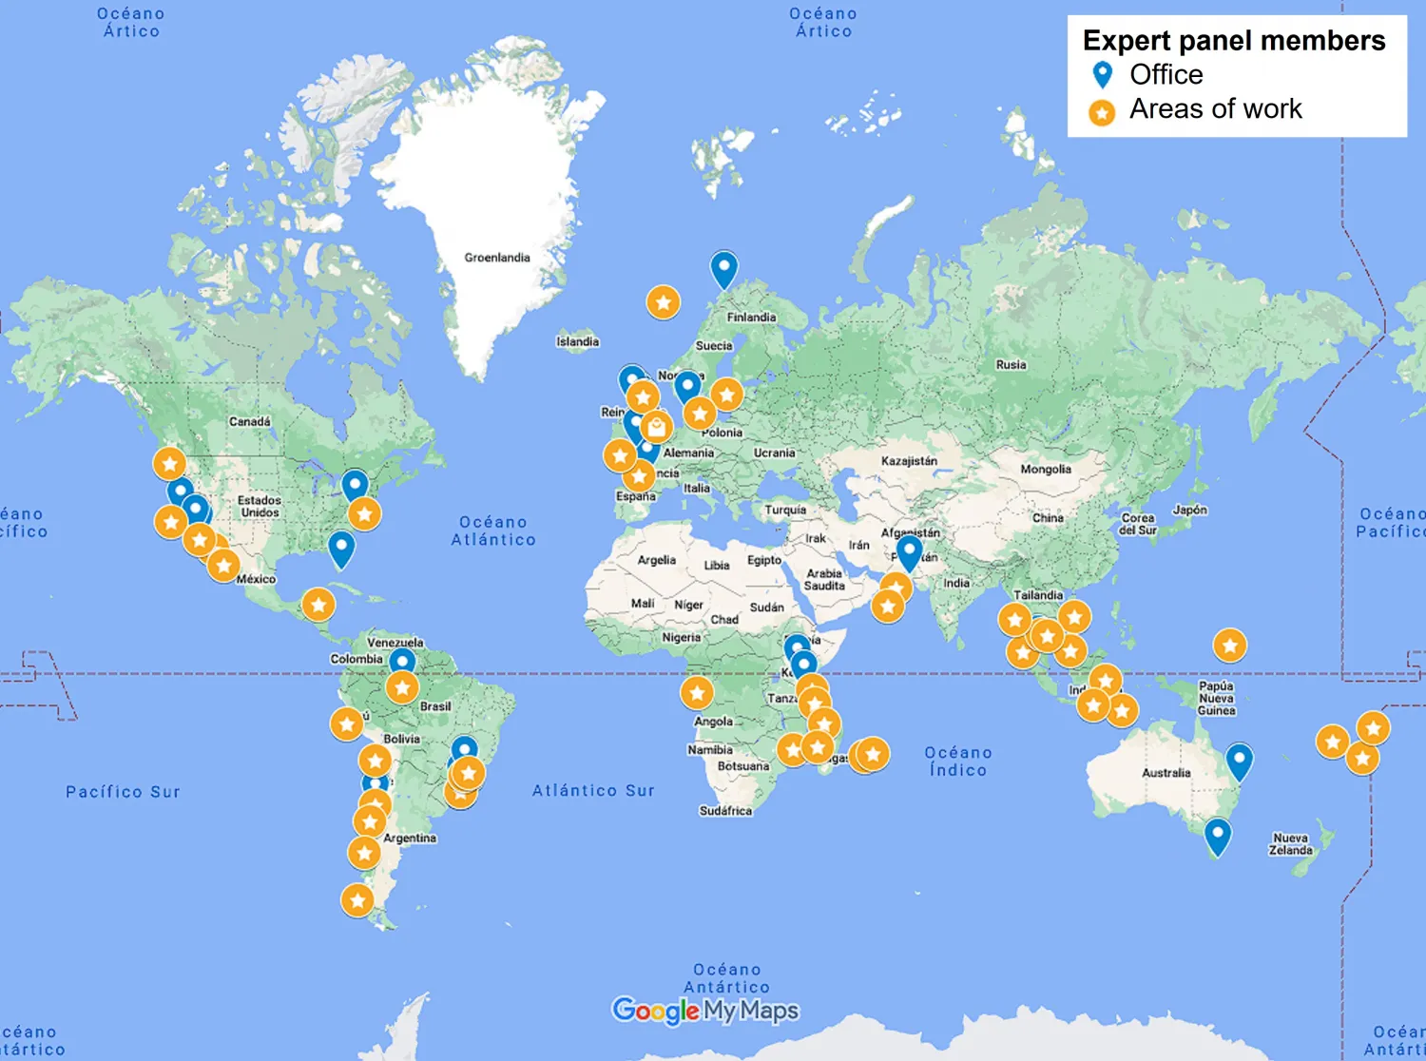
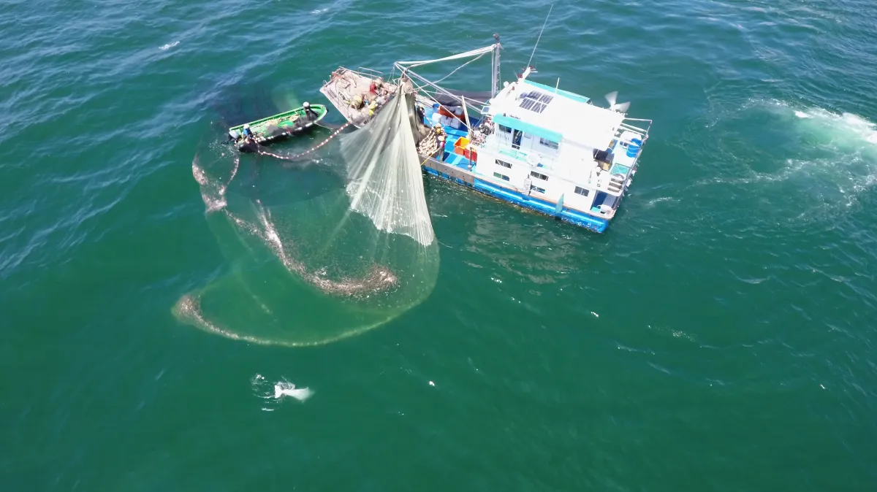
Bycatch Mitigation Initiative (BMI)
Goals: develop, assess and promote effective bycatch prevention and mitigation measures world-wide
Collaboration & coordination is essential to ensure:
  Improved bycatch assessment and mitigation
  Engagement and collaboration with fisheries managers
  Capacity building and transfer of expertise
Main thematic areas:
Data collection and risk assessments on bycatch
On the ground trials of mitigation and monitoring solutions with fishing communities
Awareness raising and capacity building at national level
Working with FAO and Regional Fisheries Management Organisations
Notes:
The second Initiative I want to highlight is the IWC Bycatch Mitigation Initiative (BMI). Bycatch in fisheries is currently the major threat for many populations of dolphins and whales. This initiative works worldwide in collaboration with other organisations (including RFMOs), national governments and fishing communities, with the aim to develop, assess and promote effective bycatch prevention and mitigation measures.
As with the Strandings Initiative the bycatch Mitigation work has an Expert Panel to draw on knowledge and expertise to advise on possible measures and means of implementation to reduce and prevent bycatch as well as practical work to assess levels of bycatch within fisheries
The workplan of the Bycatch Mitigaion Initiative includes several objectives that promote collaboration with RFMO: One is specific to Raise awareness of cetacean bycatch and available solutions within regional and international fisheries management organisations (where relevant and applicable): this includes
outreach activities on bycatch prevent entanglement of large cetaceans and provide response capability
provide expert advice on cetacean bycatch where applicable as requested,.

Slide 8
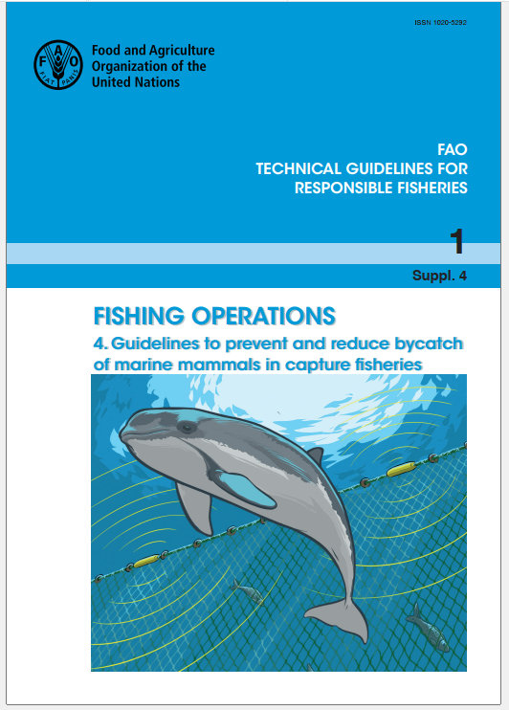
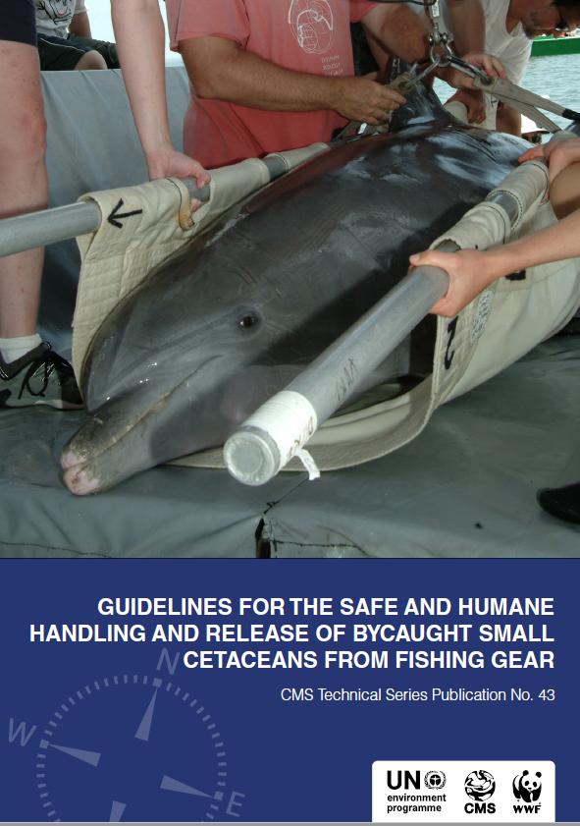
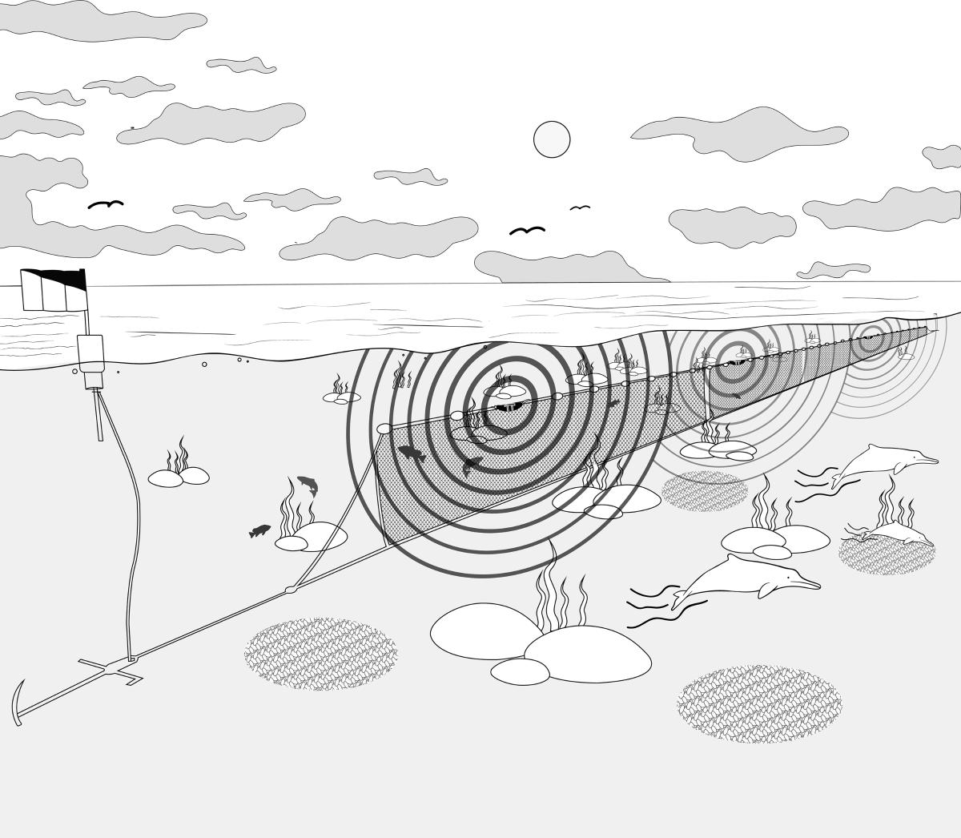
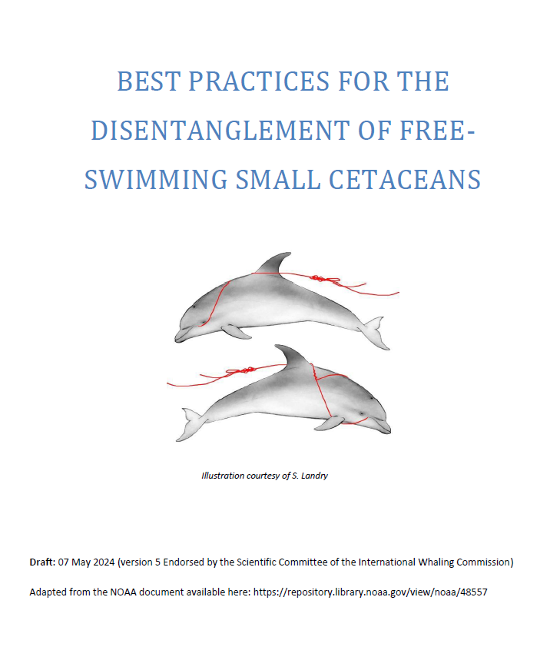
Bycatch Mitigation Initiative (BMI)
Examples of BMI Outcomes
Multipartner projects: CIBBRiNA, FAO-GEF Common Oceans Tuna, Pilot projects
Development and dissemination of guidelines:
  ‘FAO Technical Guidelines to prevent and reduce bycatch in capture fisheries’ and ‘factsheets’
  ‘Guidelines for the safe and humane handling and release of bycaught small cetaceans from fishing gear’ (Hamer & Minton, 2020)
  'Best Practices for the disentanglement of free-swimming small cetaceans'
Contact: Elizabeth Campbell, Bycatch Co-ordinator
elizabeth.campbell@iwc.int
Notes:
Besides those IWC initiatives, members of the Scientific Committee and experts from IWC, continuously collaborate with other organisations developing and disseminating guidelines to address bycatch such as the FAO ‘FAO Technical Guidelines to prevent and reduce bycatch in capture fisheries’ and associated ‘factsheets’, the ‘Guidelines for the safe and humane handling and release of bycaught small cetaceans from fishing gear’ which was produced with CMS experts, and recently the SC endorsed the 'Best Practices for the disentanglement of free-swimming small cetaceans’.
We have a dedicated Bycatch Coordintor her contact details are on the screen and we are very happy to be participating CAMAC 2 to contribute to the work programme addressing bycatch

Slide 9
Thank you
Notes:
I will end by showing the infographic again highlighting the areas where we can assist with cetacean conservation via education and awareness work, capacity building and offering advice and expertise and also an opportunity for research to be presented to the Scientific Committee. We look forward to contributing to the work of SPAW and closer collaboration. Thank you.
Global Whale Entanglement Response Network: this programme began in 2011. To date the workshops have taught safe and effective entanglement response skills to over 1200 participants from more than 30 countries.
Bycatch Mitigation: since 2016, this programme is led by a coordinator and also has a multi-disciplinary Expert Panel. The BMI is working to raise awareness of the solutions available to monitor and mitigate cetacean bycatch.
Strandings Response: is also supported by a coordinator and an Expert Panel. This panel provides real-time advice and support to teams dealing with strandings around the globe.
Mitigation of Ship Strikes: Since 2007 the IWC has maintained a global Ship Strikes database; the information is used to identify high risk areas and populations. The Programme also has a multi-disciplinary Expert Panel working to implement mitigation measures.
Conservation Management Plans (CMPs): provide a framework for national governments and other stakeholders to work together on measures to protect vulnerable populations.

